Slide 1
The Five Kingdoms
E x p l o r I n g L I v I n g T h I n g s I n w e t l a n d s

Slide 2
What are the Five Kingdoms?
The five kingdoms are groups of living things classified (sorted, grouped, organized) by scientists into a classification system.
Why organize living things into a classification system?
To learn and better understand life’s diversity
To recognize the similarities and differences between living things
To help us identify living things
All Living Things
Animalia
Plantae
Fungi
Protista
Monera

Slide 3
What is a Wetland?
An area of land that is permanently or periodically saturated with water
Has plants that are adapted to water or moist-soil conditions
The deepest a wetland can be is 2 metres (a little more than 6’5’’)
An ecosystem and habitat for many types of living things
Types of Wetlands:
Freshwater Marsh
Fen
Swamp
Bog
Shallow Open Water

Slide 4
Wetlands & the Five Kingdoms
Wetlands are home to living things from all of the kingdoms.
Today, we are going to review the five kingdoms and learn about examples of living things that are known to live in wetlands.
Living Things in Wetlands
Animalia
Plantae
Fungi
Protista
Monera
Beacon photo by Les Coe, picssr.com. Algae photo from media.framar.bg. Nodules photos by Dr. Jeremy Burgess.
American Avocet
Pitcher Plant
Swamp Beacon
Green Algae
Rhizobium leguminosarum bacteria

Slide 5
Animalia
Structure:
Multicellular
Have cells with a nucleus
Locomotion abilities (running, swimming, flying, etc.)
Feeding Mechanism:
Ingestion
Must go look for food
Wetland Examples:
American Avocet, Pond Snail, American Beaver, Boreal Chorus Frog
Frog photo by Sam Brinkler, ontarionature.org.

Slide 6
Plantae
Structure:
Multicellular
Have cells with a nucleus, cell walls and chloroplasts
Very limited locomotion abilities
Feeding Mechanism:
Photosynthesis
Can make their own food
Wetland Examples:
Black-eyed Susan, Pitcher Plant, Cattail, Duckweed
Cattail photo from sandiegozoo.org.

Slide 7
Fungi
Structure:
Multicellular
Have cells with a nucleus and cell walls
No locomotion abilities
Feeding Mechanism:
Absorption
Cannot make their own food
Wetland Examples:
Tinder Conk, Emetic russula, Swamp Beacon, Wrinkled Thimble Cap
Conk photo from medicalmushrooms.net. Russula photo from tcpermaculture.com. Beacon photo by Les Coe, picssr.com. Cap photo by Myrique Baumier, flickr.com.

Slide 8
Protista
Structure:
Single celled
Contains a nucleus; some may have cell walls and chloroplasts
Locomotion abilities
Feeding Mechanism:
Ingestion, photosynthesis or both
Finds food, makes food, or does both
Wetland Examples:
Giardia (animal-like protist), Diatoms (plant-like protist), Green Algae like Elephant Snot (plant-like protist), Paramecium (animal-like protist)
Giardia photo from cdc.gov. Diatoms photo from ucmp.berkeley.edu. Algae photo from media.framar.bg. Paramecium photo from youtube.com/watch?v=gN42ggEgO8g.

Slide 9
Monera
Structure:
Single celled
Have a cell wall, do not have a nucleus
No or highly limited locomotion abilities
Feeding Mechanism:
No visible feeding mechanism
Absorb nutrients through cell wall
Wetland Examples:
Methanogens (Archaebacteria), Eubacteria, Nitrogen-fixing nodules on leguminous-plant (Rhizobium leguminosarum bacteria)
Archaebacteria photo from biology.tutorvist.com. Petri dish photo from science.howstuffworks.com. Nodules photos by Dr. Jeremy Burgess.

Slide 10
Kingdom Chaos Bingo!
What You Need:
Bingo cards for all who are playing
Writing utensil
How to Play:
A living thing will be shown on the screen
If you have this living thing on your bingo card, write down which kingdom you think the living thing is a part of in the space provided on the card
As new living things are shown, if you have five living things in a line (across, in a row, in a column) then you have a bingo!

Slide 11
Ready?
Let’s Play!

Slide 12
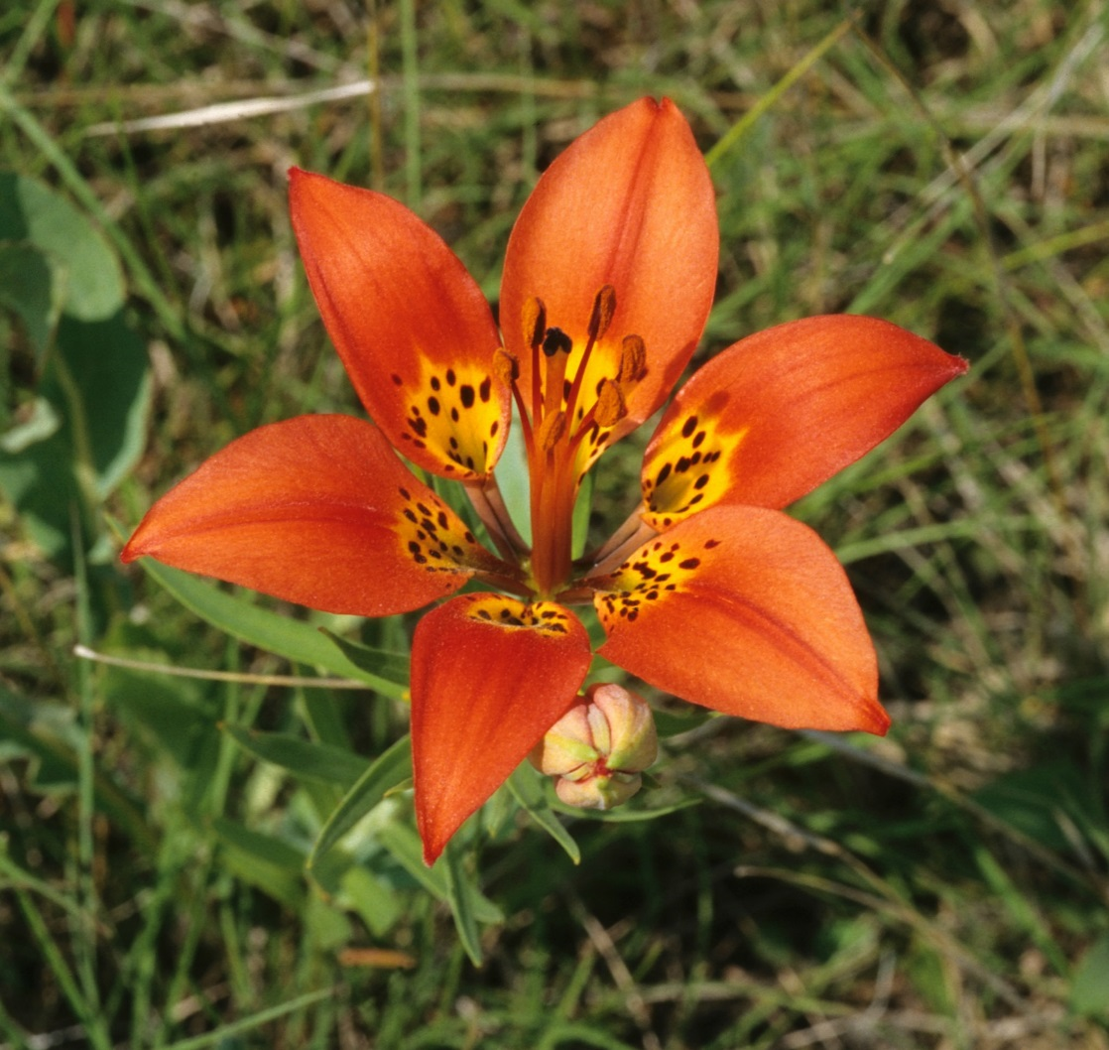
Western Red Lily
Picture from Ducks Unlimited Canada.
Notes:
Answer: Plantae

Slide 13
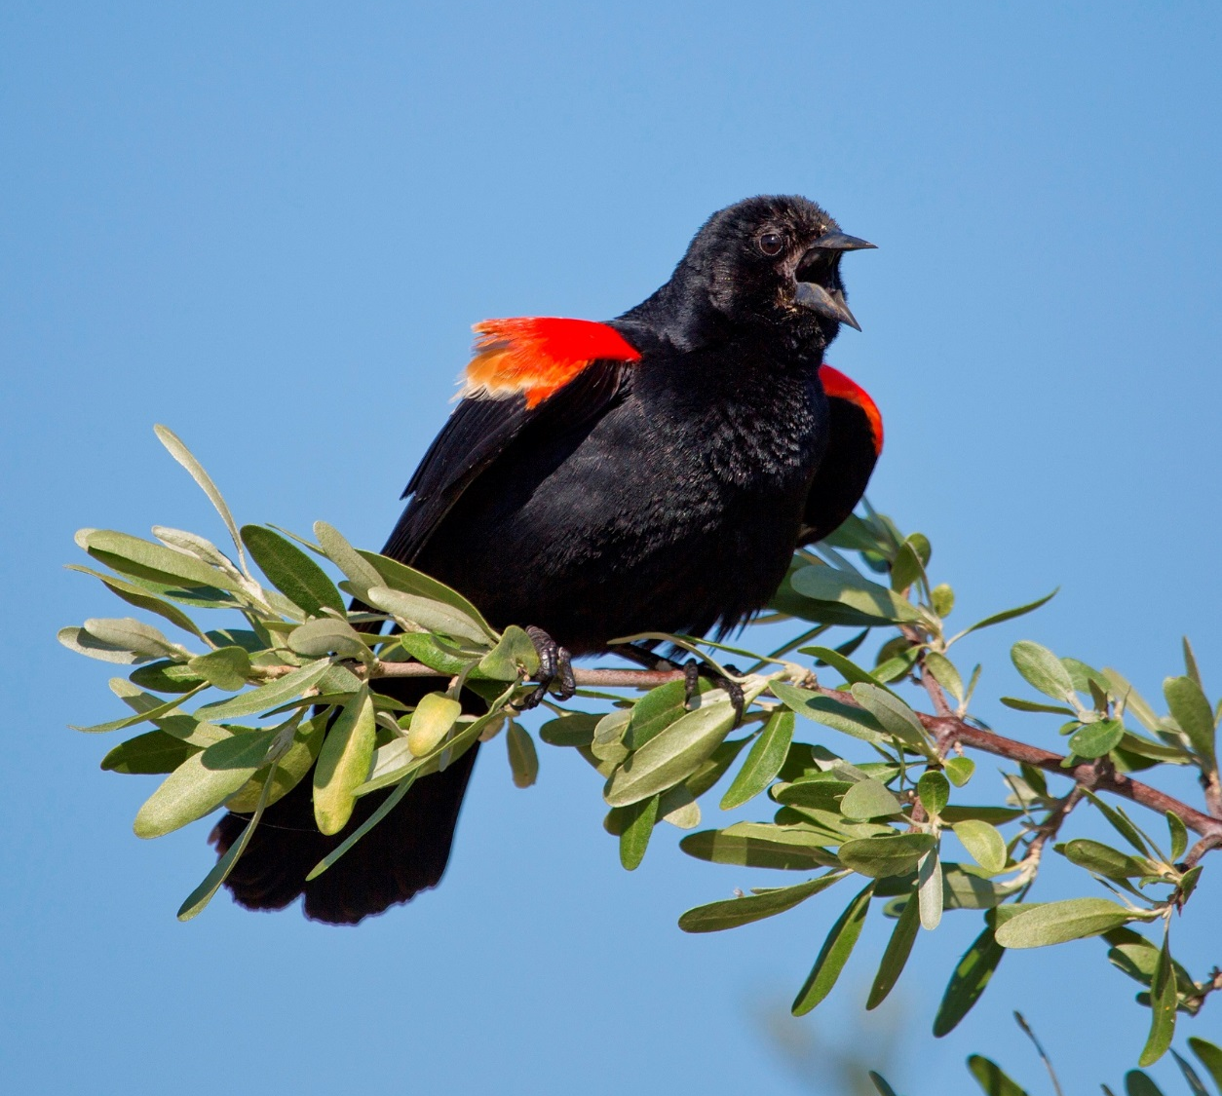
Red-winged Blackbird
Picture from Ducks Unlimited Canada.
Notes:
Answer: Animalia

Slide 14
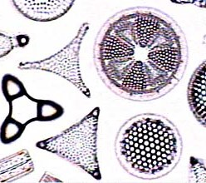
Diatoms
Picture from ucmp.berkeley.edu.
Notes:
Answer: Protista

Slide 15
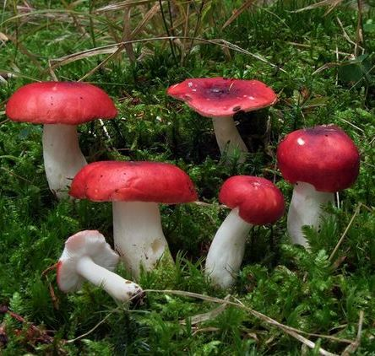
Emetic russula
Russula photo from tcpermaculture.com.
Notes:
Answer: Fungi

Slide 16
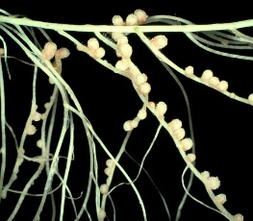
Rhizobium leguminosarum bacteria
Picture by Dr. Jeremy Burgess.
Notes:
Answer: Monera

Slide 17
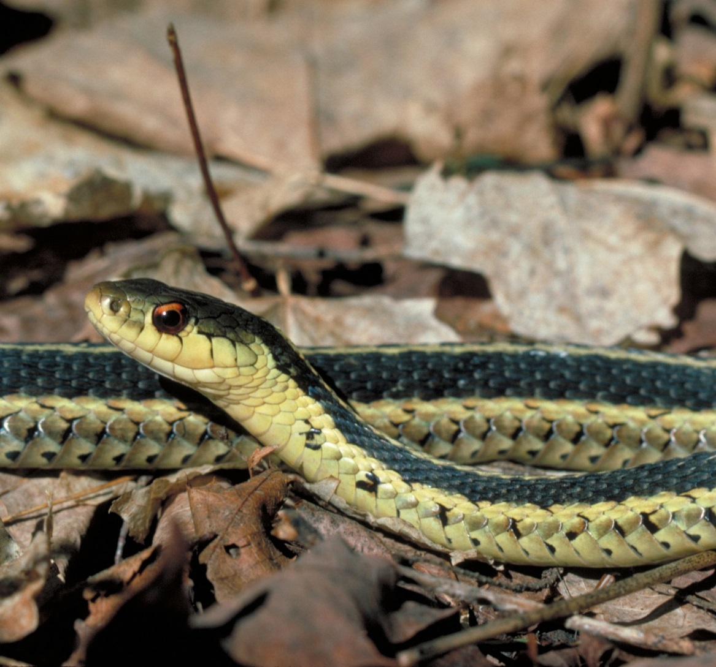
Western Garter Snake
Picture from Ducks Unlimited Canada.
Notes:
Answer: Animalia

Slide 18
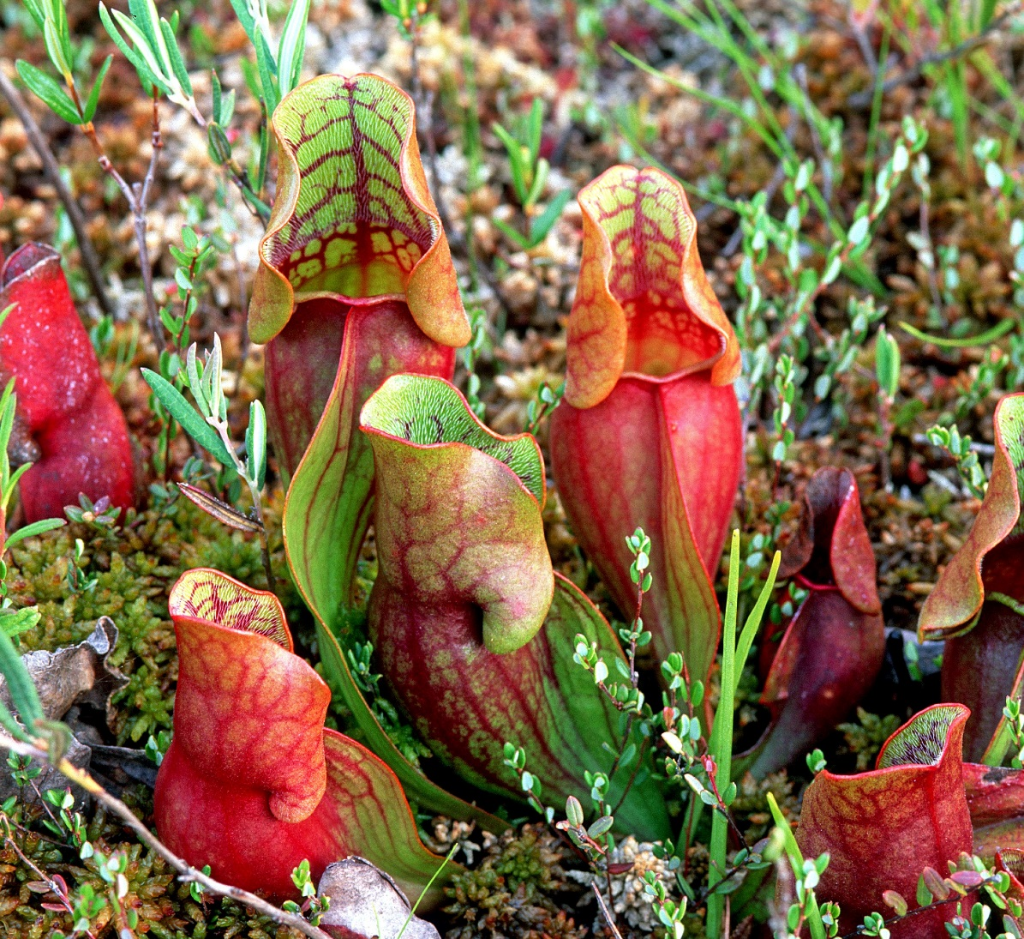
Pitcher Plant
Picture from Ducks Unlimited Canada.
Notes:
Answer: Plantae

Slide 19
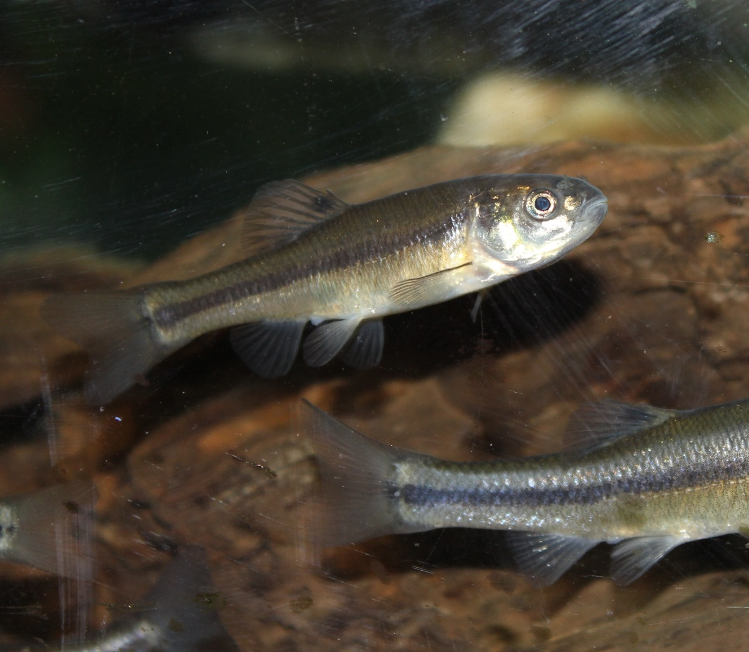
Fathead Minnow
Picture from Oak Hammock Marsh Interpretive Centre.
Notes:
Answer: Animalia

Slide 20
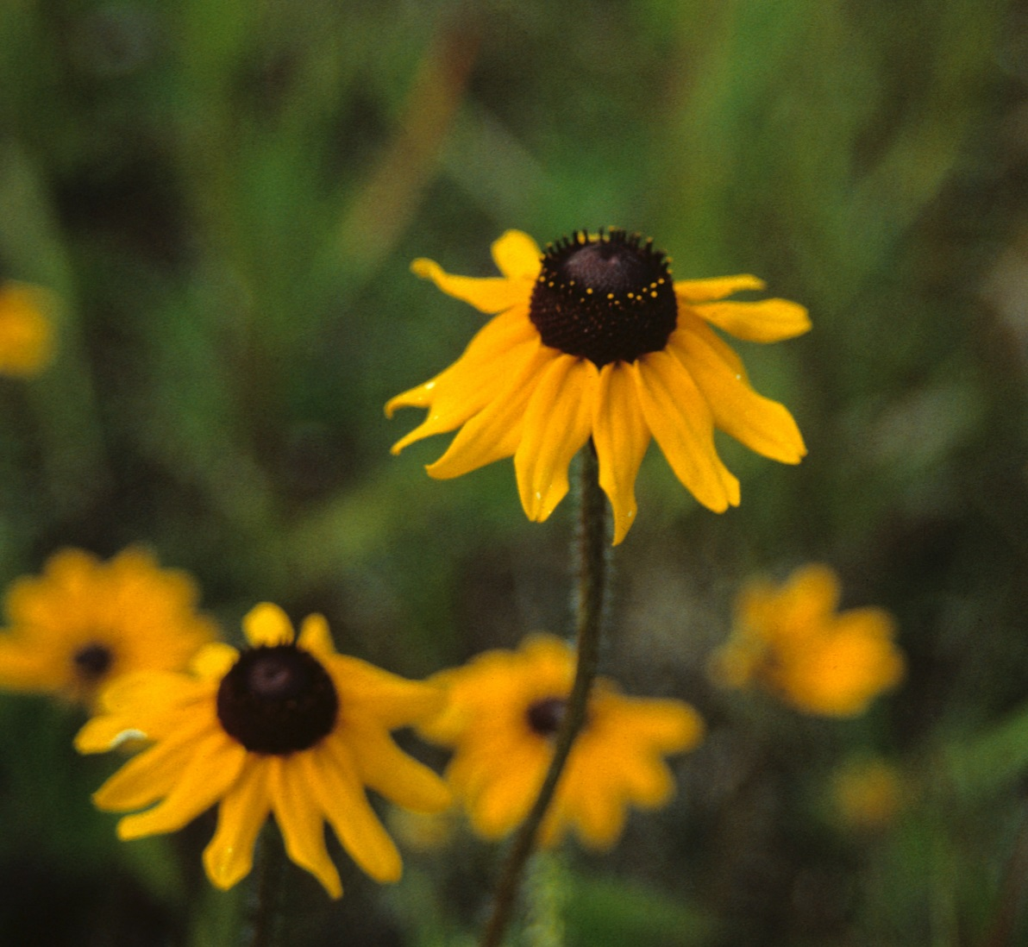
Black-eyed Susan
Picture from Ducks Unlimited Canada.
Notes:
Answer: Plantae

Slide 21
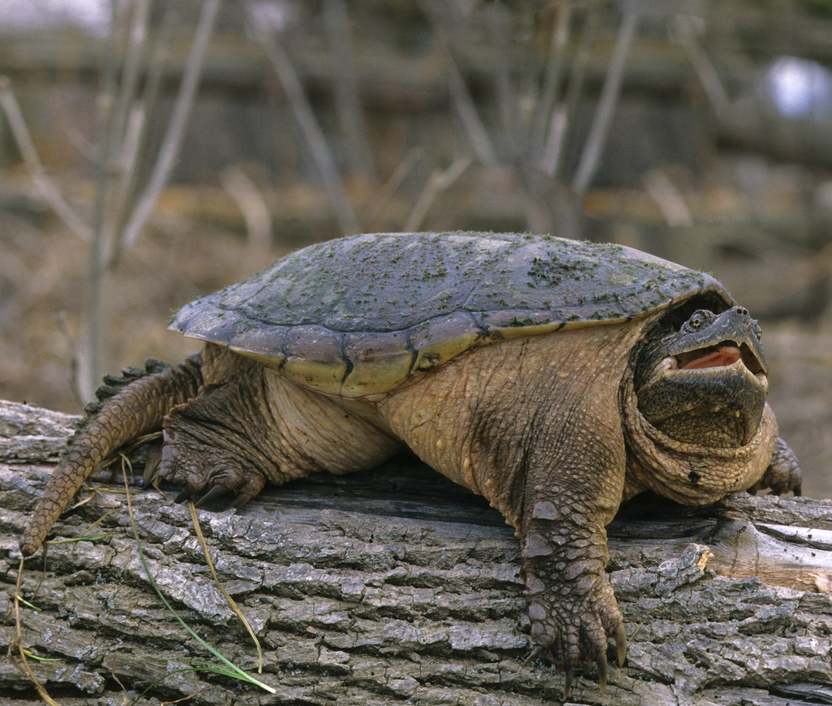
Snapping Turtle
Picture from Ducks Unlimited Canada.
Notes:
Answer: Animalia

Slide 22
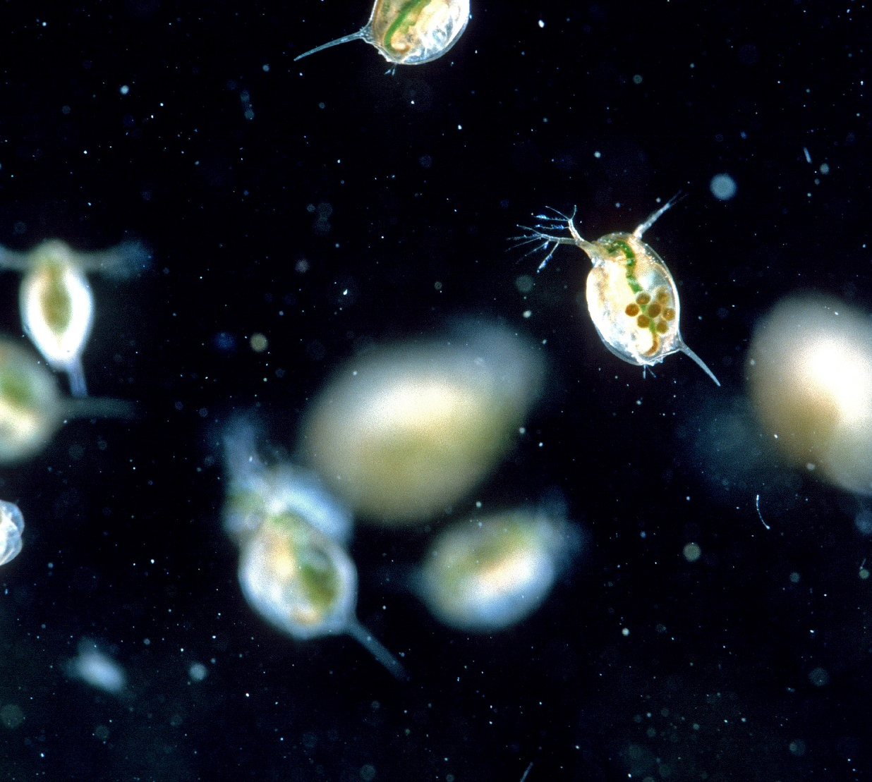
Water Fleas
Picture from Ducks Unlimited Canada.
Notes:
Answer: Animalia

Slide 23
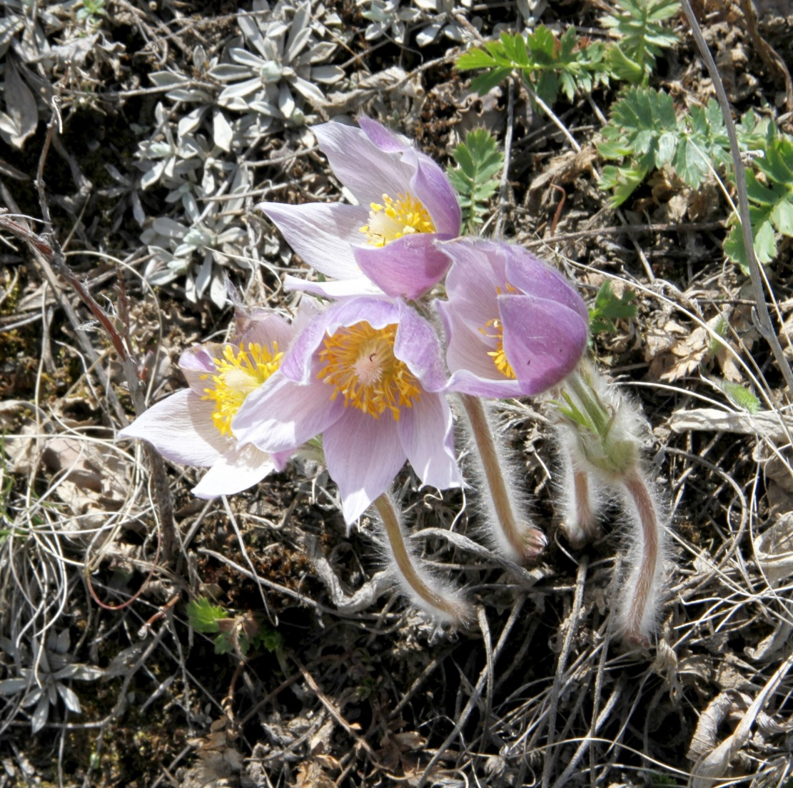
Prairie Crocus
Picture from Ducks Unlimited Canada.
Notes:
Answer: Animalia

Slide 24
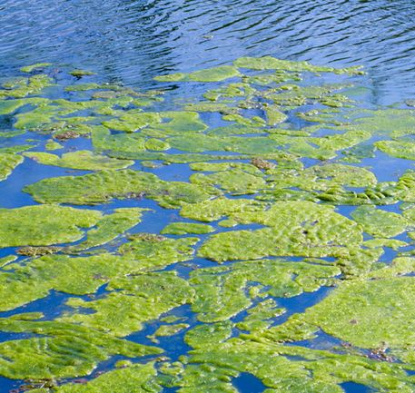
Blue-green Algae
Picture from thesudburystar.com
Notes:
Answer: Protista

Slide 25
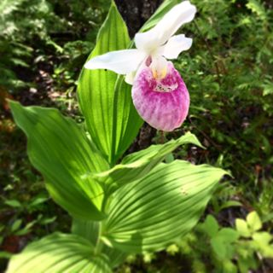
Showy Lady Slipper
Picture by Barbara Bucheli..
Notes:
Answer: Plantae

Slide 26
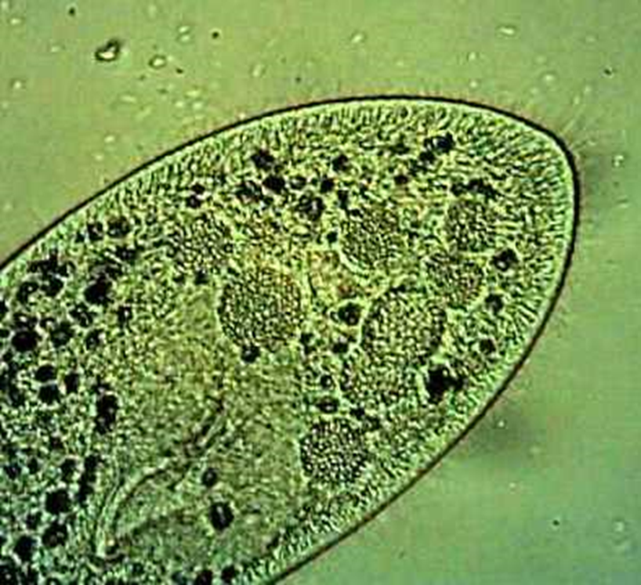
Paramecium cilia - Protozoa
Picture from youtube.com/channelUCC6In9V611vfs_yNC4SjRgQ.
Notes:
Answer: Protista

Slide 27
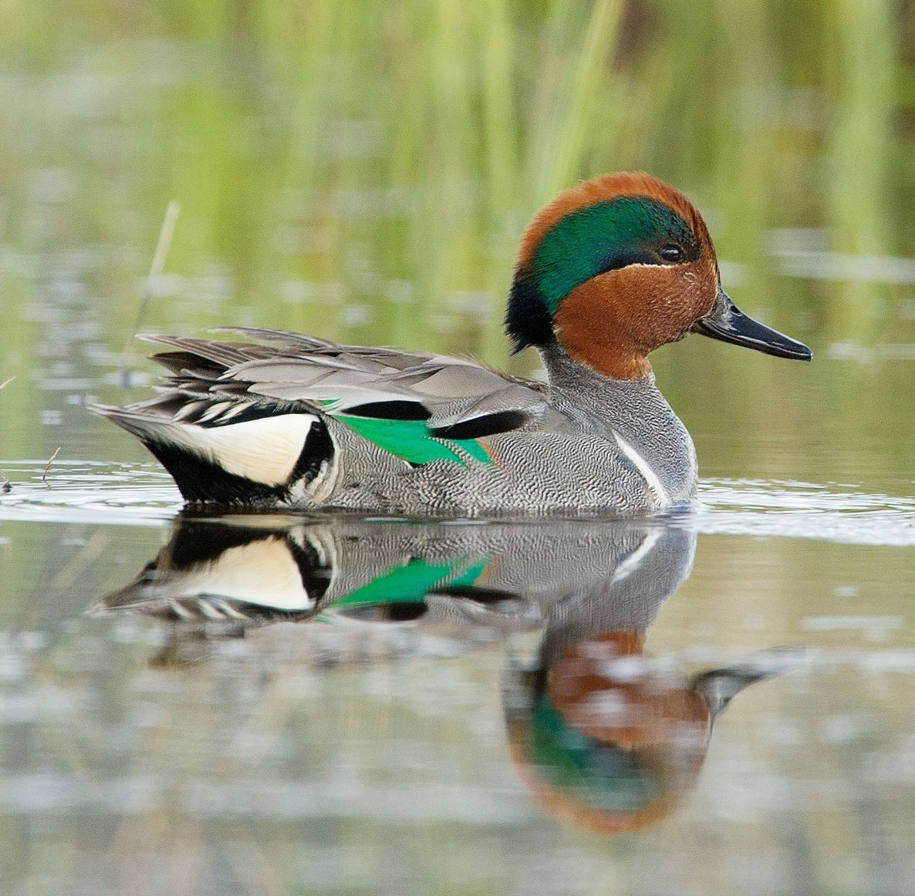
Green-winged Teal
Picture from Ducks Unlimited Canada.
Notes:
Answer: Animalia

Slide 28
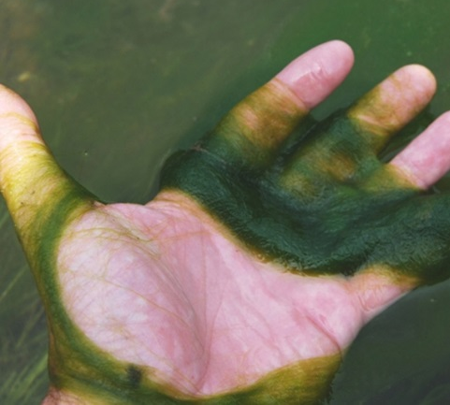
Elephant Snot Algae
Picture from potomacriverkeepernetwork.org.
Notes:
Answer: Protista

Slide 29
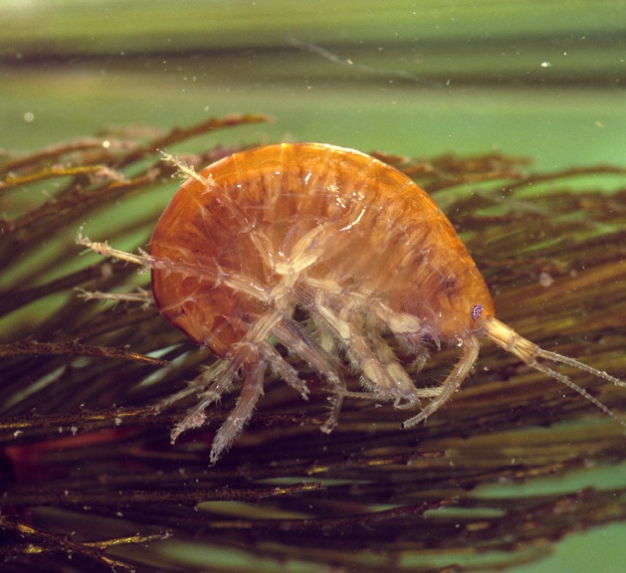
Freshwater Shrimp
Picture from Ducks Unlimited Canada.
Notes:
Answer: Animalia

Slide 30
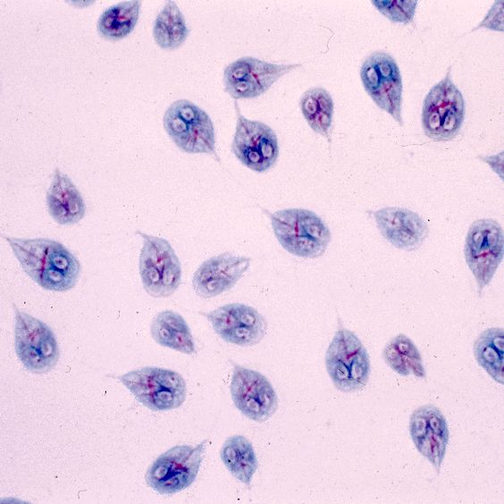
Giardias - Protozoa
Picture from www.cdc.gov.
Notes:
Answer: Protista

Slide 31
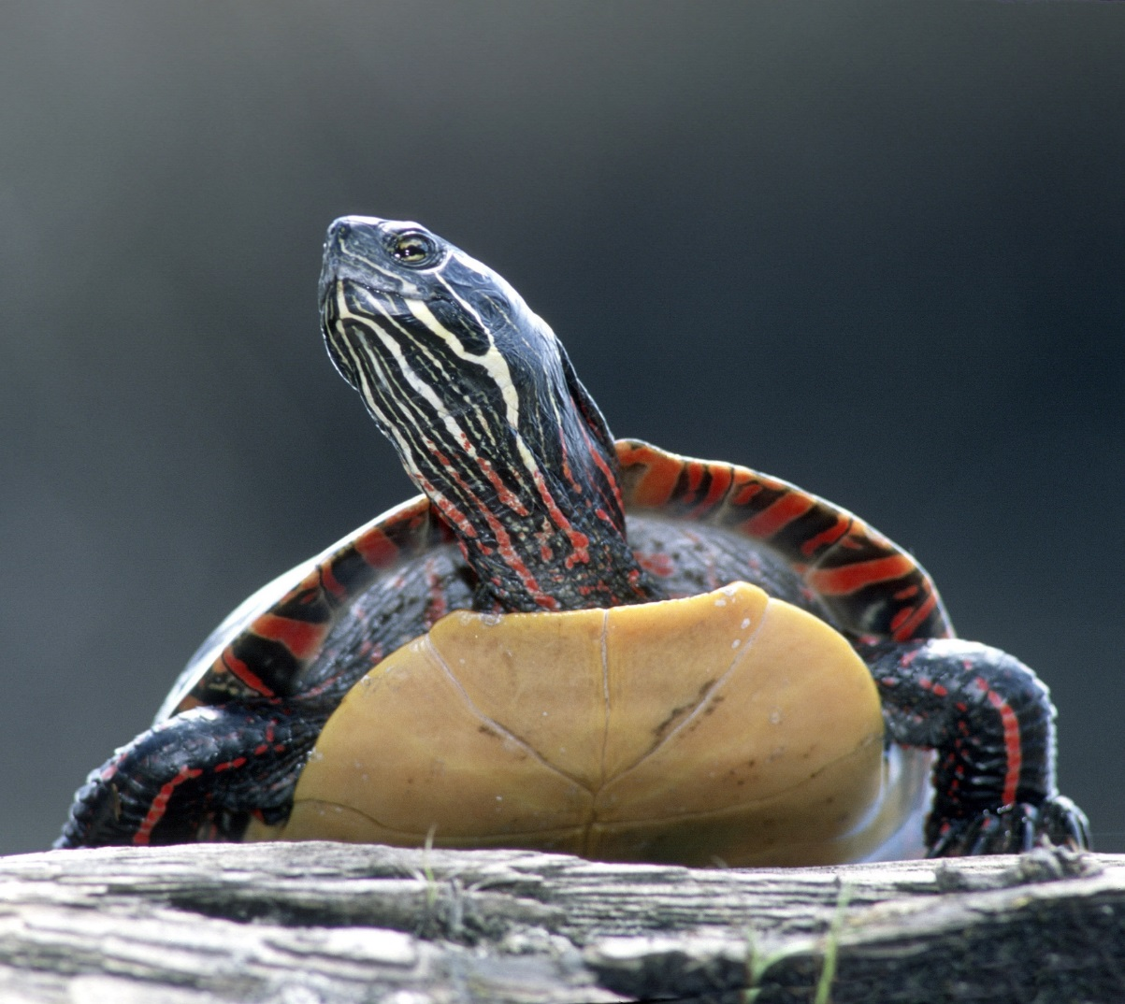
Painted Turtle
Picture from Ducks Unlimited Canada.
Notes:
Answer: Animalia

Slide 32
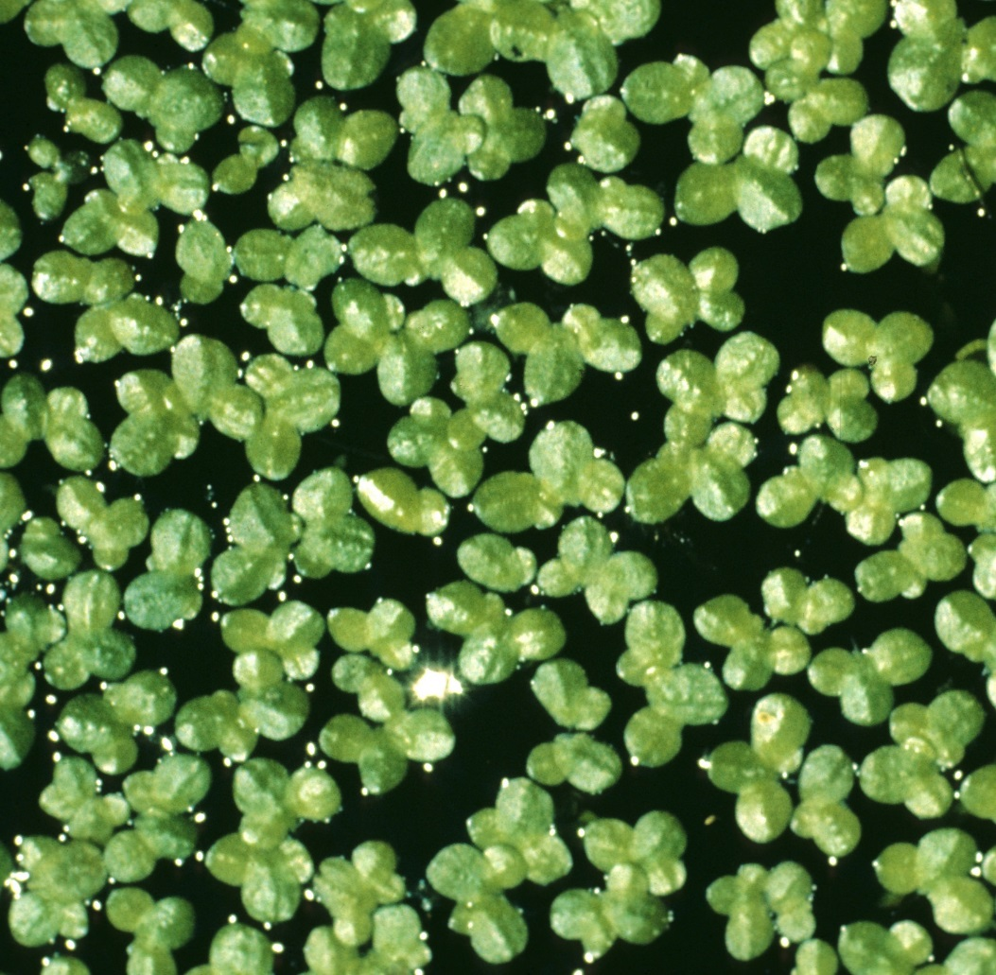
Duckweed
Picture from Ducks Unlimited Canada.
Notes:
Answer: Animalia

Slide 33
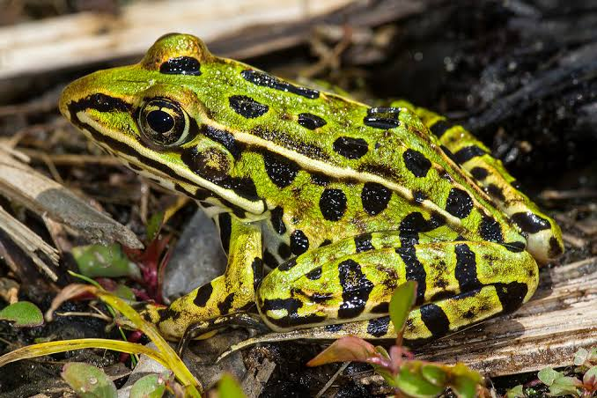
Northern Leopard Frog
Picture from Alan W. Wells.
Notes:
Answer: Animalia

Slide 34
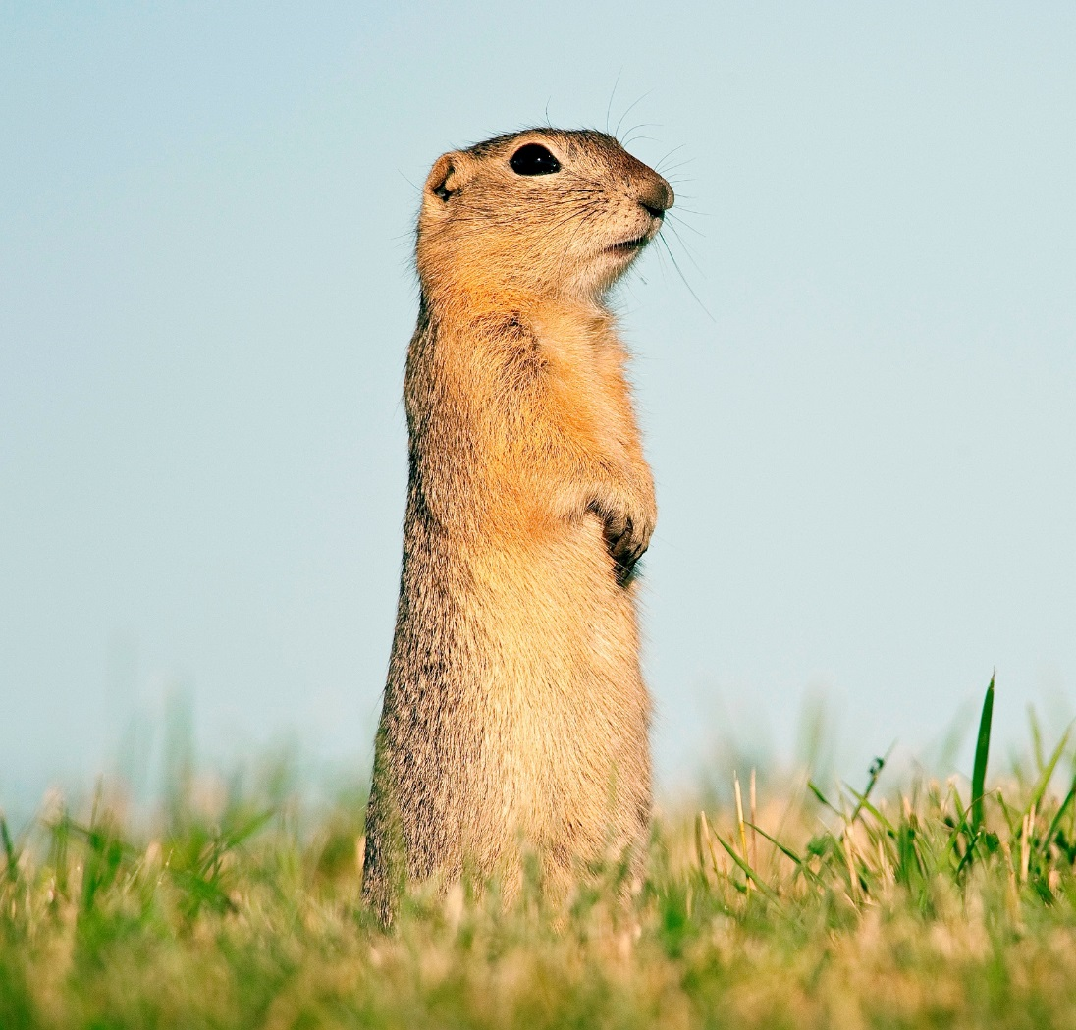
Richardson’s Ground Squirrel
Picture from Ducks Unlimited Canada.
Notes:
Answer: Animalia

Slide 35
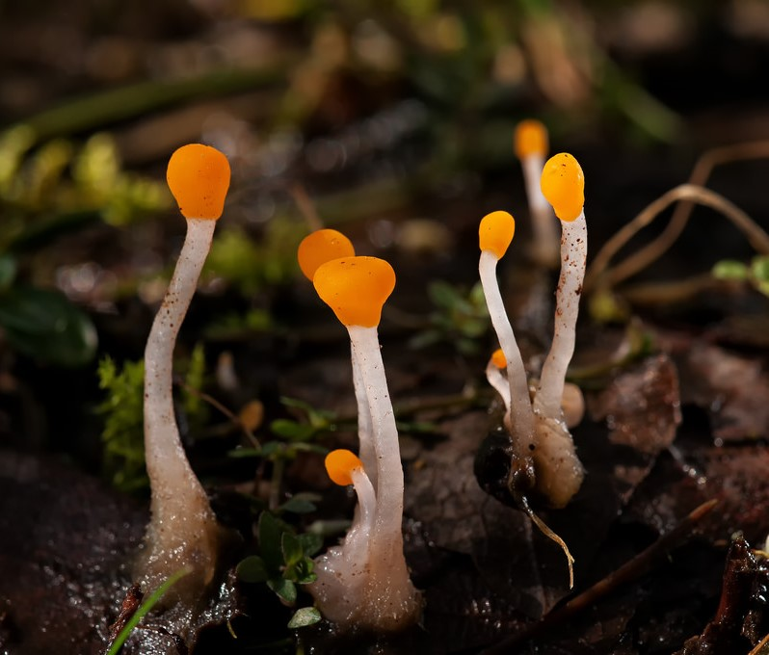
Swamp Beacon
Beacon photo by Les Coe, picssr.com.
Notes:
Answer: Fungi

Slide 36
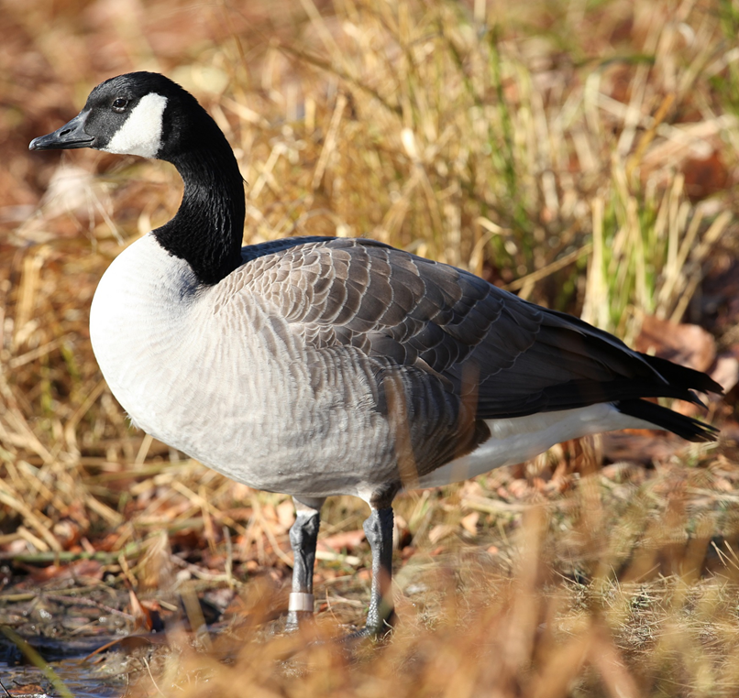
Canada Goose
Picture from Ducks Unlimited Canada.
Notes:
Answer: Animalia

Slide 37
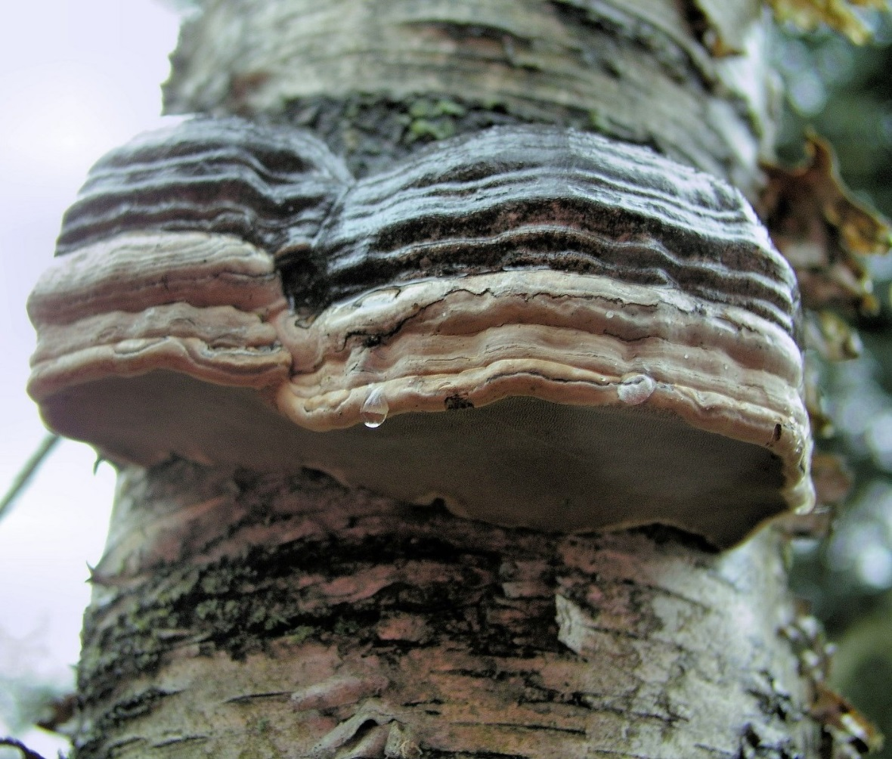
Tinder Conk
Conk photo from medicalmushrooms.net.
Notes:
Answer: Fungi

Slide 38
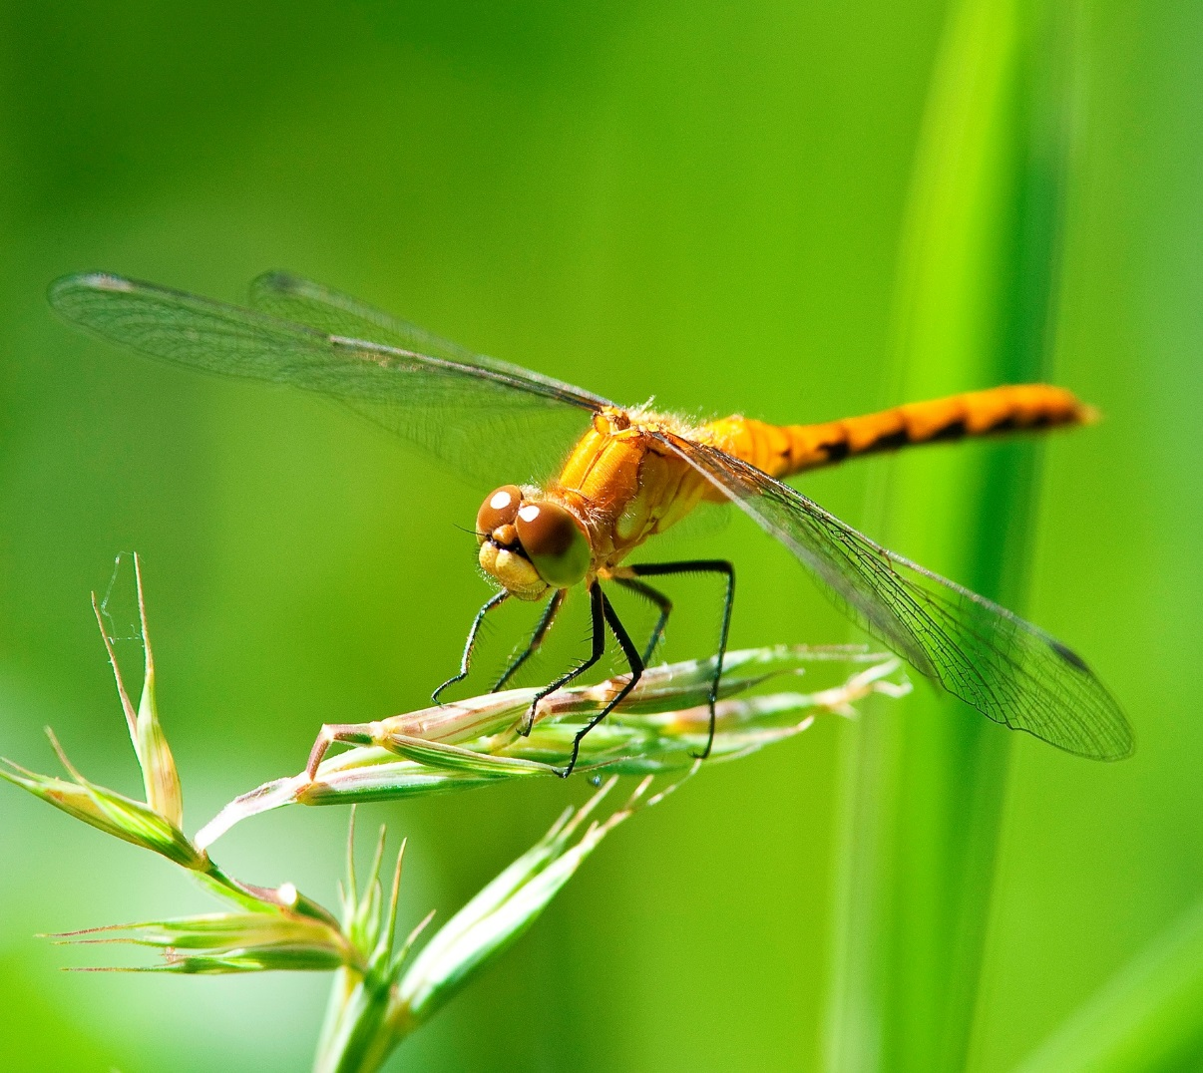
Meadowhawk - Dragonfly
Picture from Ducks Unlimited Canada.
Notes:
Answer: Animalia

Slide 39
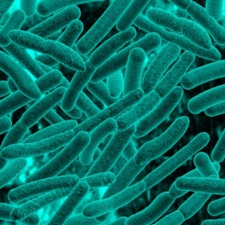
Methanogens - Archaebacteria
Picture by biology.tutorvista.com.
Notes:
Answer: Monera

Slide 40
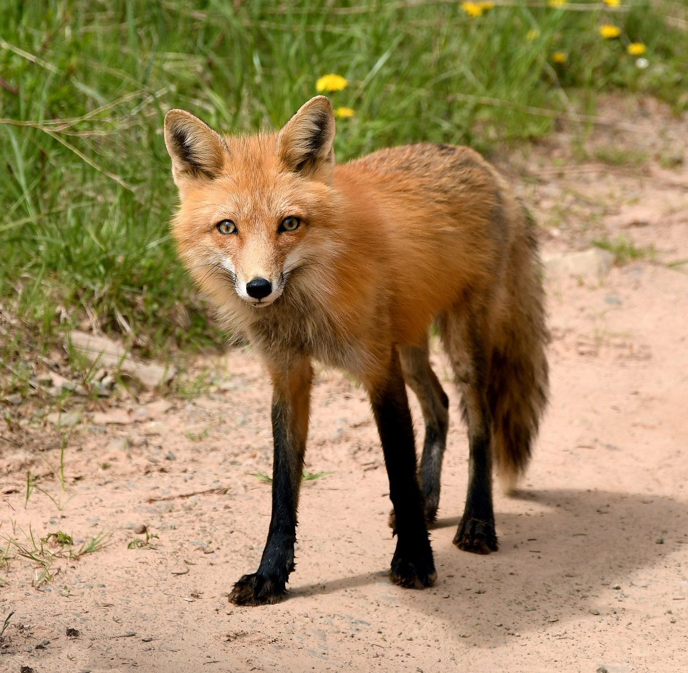
Red Fox
Picture from Ducks Unlimited Canada.
Notes:
Answer: Animalia

Slide 41
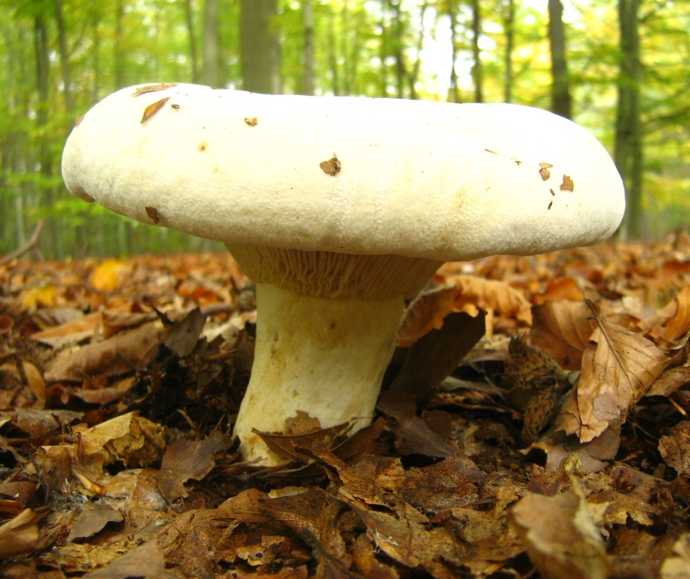
Fleecy Milkcap
Photo from Wikipedia.
Notes:
Answer: Fungi

Slide 42
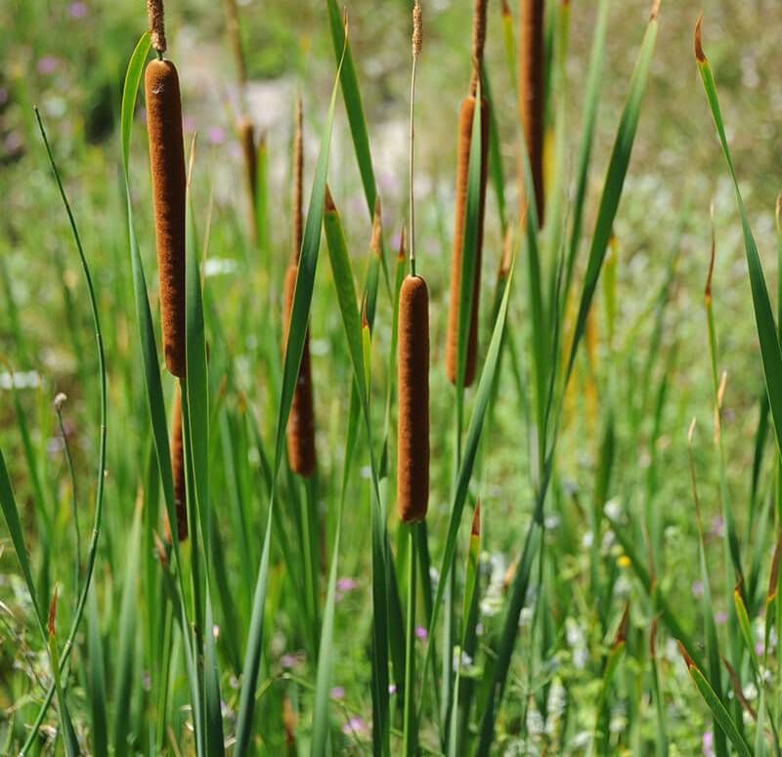
Narrow-leaved Cattail
Picture from sandiegozoo.org/animals/cattail.
Notes:
Answer: Plantae

Slide 43
Kingdom Chaos Bingo Answers

Slide 44
- Plantae
Western Red Lily
Picture from Ducks Unlimited Canada.
Notes:
Answer: Plantae

Slide 45
Red-winged Blackbird
- Animalia
Picture from Ducks Unlimited Canada.
Notes:
Answer: Animalia

Slide 46
- Protista
Diatoms
Picture from ucmp.berkeley.edu.
Notes:
Answer: Protista

Slide 47
- Fungi
Emetic russula
Russula photo from tcpermaculture.com.
Notes:
Answer: Fungi

Slide 48
Rhizobium leguminosarum bacteria
- Monera
Picture by Dr. Jeremy Burgess.
Notes:
Answer: Monera

Slide 49
Western Garter Snake
- Animalia
Picture from Ducks Unlimited Canada.
Notes:
Answer: Animalia

Slide 50
Pitcher Plant
- Plantae
Picture from Ducks Unlimited Canada.
Notes:
Answer: Plantae

Slide 51
Fathead Minnow
- Animalia
Picture from Ducks Unlimited Canada.
Notes:
Answer: Animalia

Slide 52
Paramecium Cilia - Protozoa
- Protista
Picture from youtube.com/channelUCC6In9V611vfs_yNC4SjRgQ.
Notes:
Answer: Protista

Slide 53
- Plantae
Black-eyed Susan
Picture from Ducks Unlimited Canada.
Notes:
Answer: Plantae

Slide 54
Snapping Turtle
- Animalia
Picture from Ducks Unlimited Canada.
Notes:
Answer: Animalia

Slide 55
Elephant Snot Algae
- Protista
Picture from potomacriverkeepernetwork.org.
Notes:
Answer: Protista

Slide 56
- Plantae
Prairie Crocus
Picture from Ducks Unlimited Canada.
Notes:
Answer: Animalia

Slide 57
- Animalia
Water Fleas
Picture from Ducks Unlimited Canada.
Notes:
Answer: Animalia

Slide 58
Blue-green Algae
- Monera
Picture from thesudburystar.com
Notes:
Answer: Monera
Blue-green algae is actually a bacteria (which has no nucleus, so it cannot be part of the Protista kingdom) that can photosynthesize (turning sun light into food energy).

Slide 59
Showy Lady Slipper
- Plantae
Picture from Ducks Unlimited Canada.
Notes:
Answer: Plantae

Slide 60
Green-winged Teal
- Animalia
Picture from Ducks Unlimited Canada.
Notes:
Answer: Animalia

Slide 61
Swamp Beacon
- Fungi
Beacon photo by Les Coe, picssr.com.
Notes:
Answer: Fungi

Slide 62
Freshwater Shrimp
- Animalia
Picture from Ducks Unlimited Canada.
Notes:
Answer: Animalia

Slide 63
Giardias - Protozoa
- Protista
Picture from www.cdc.gov.
Notes:
Answer: Protista

Slide 64
- Animalia
Painted Turtle
Picture from Ducks Unlimited Canada.
Notes:
Answer: Animalia

Slide 65
- Plantae
Duckweed
Picture from Ducks Unlimited Canada.
Notes:
Answer: Animalia

Slide 66
Northern Leopard Frog
- Animalia
Picture from Alan W. Wells.
Notes:
Answer: Animalia

Slide 67
- Fungi
Fleecy Milkcap
Photo from Wikipedia.
Notes:
Answer: Fungi

Slide 68
Richardson’s Ground Squirrel
- Animalia
Picture from Ducks Unlimited Canada.
Notes:
Answer: Animalia

Slide 69
Narrow-leaved Cattail
- Plantae
Picture from sandiegozoo.org/animals/cattail.
Notes:
Answer: Plantae

Slide 70
Canada Goose
- Animalia
Picture from Ducks Unlimited Canada.
Notes:
Answer: Animalia

Slide 71
- Fungi
Tinder Conk
Conk photo from medicalmushrooms.net.
Notes:
Answer: Fungi

Slide 72
Meadowhawk - Dragonfly
- Animalia
Picture from Ducks Unlimited Canada.
Notes:
Answer: Animalia

Slide 73
Methanogens - Archaebacteria
- Monera
Picture by biology.tutorvista.com.
Notes:
Answer: Monera

Slide 74
Red Fox
- Animalia
Picture from Ducks Unlimited Canada.
Notes:
Answer: Animalia

Slide 75
Thank You!

