Slide 1
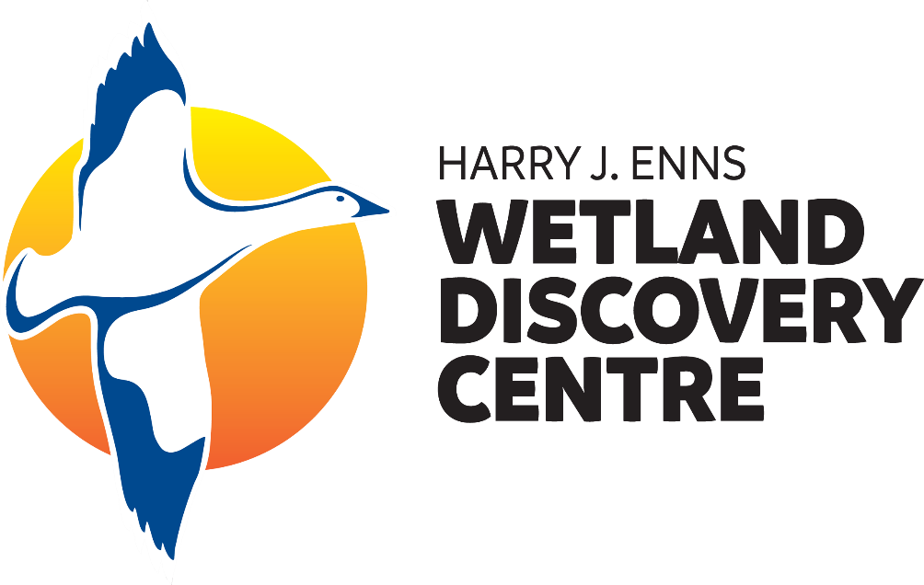
Invertebrate Inquiry
W e t l a n d I n v e r t e b r a t e s & T H E I R A d a p t a t I o n s

Slide 2
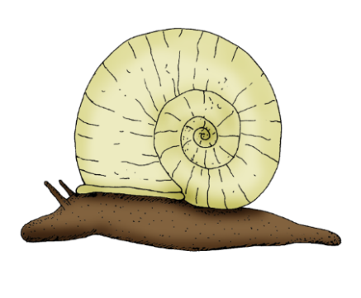
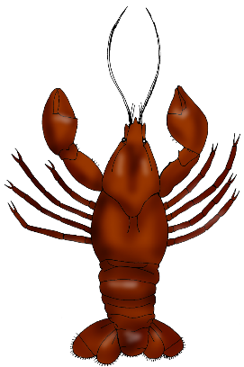
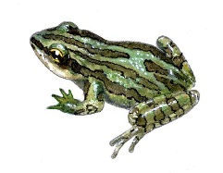
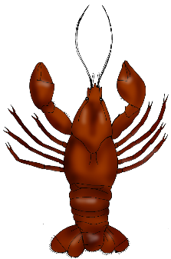
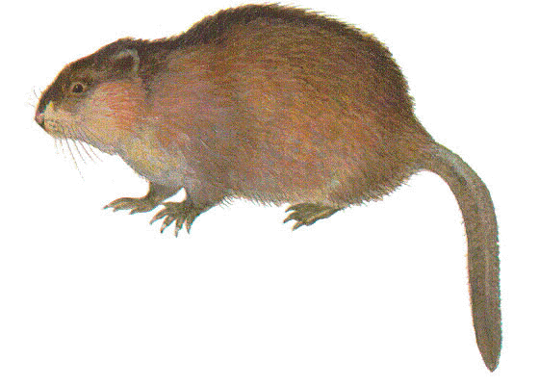
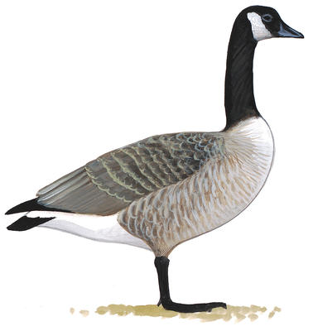
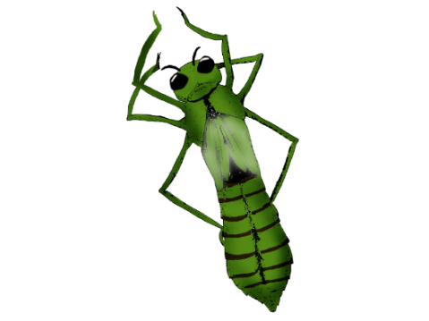
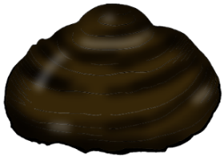
What are Invertebrates?
All animals can be divided into two groups:
vertebrates and invertebrates.
A vertebrate
is a living thing with a spine, used to support the body.
An invertebrate
is a living thing which does not have a spine.
Goose from audobon.org. Muskrat from naturalunseenhazards.wordpress.com. Boreal Chorus Frog from torontozoo.com. Mussel, Dragonfly Nymph, crayfish and Pond Snail developed by Oak Hammock Marsh Interpretive Centre.

Slide 3
The Diversity of Invertebrates
The majority of all living things are invertebrates. This great diversity is further classified in order to better understand this large group of living things.
A classification system is a means to sort, arrange and organize a large group, dividing the group into smaller subgroups.
Classification is used in science in order to:
Learn and better understand life’s diversity
Recognize the similarities and differences between living things
Help us identify living things
Taxonomic Rank image from 123rf.com.

Slide 4
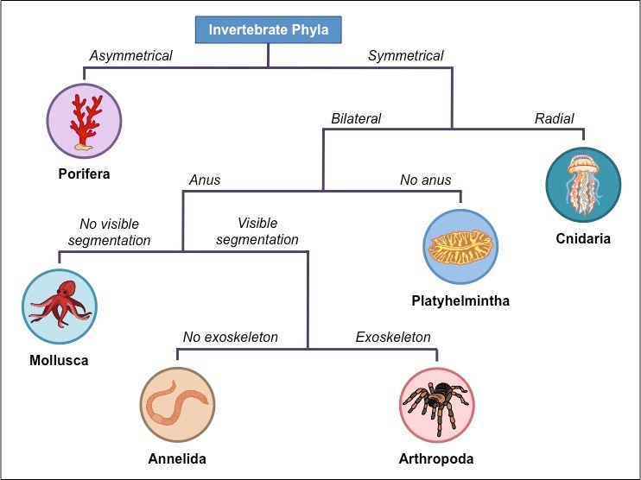
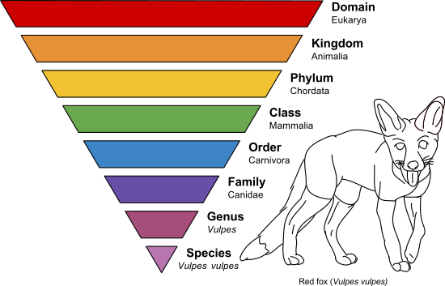
Classifying Invertebrates
Taxonomy is one way to classify living things.
All invertebrates will be classified under the Domain Eukarya (living things with a membrane-bound nucleus), and in Kingdom Animalia (are multicellular, and have locomotion abilities).
The rank of Phylum is where invertebrates greatly differ.
Today, we will focus on invertebrates from Phyla:
Porifera (Sponges),
Mollusca (Molluscs),
Annelida (Worms),
and Arthropoda (Arthropods).
Taxonomic Rank image from 123rf.com. Invertebrate Phyla image from ib.bioninja.com.au.

Slide 5
Phylum Porifera - Sponges
Structure:
Made up of complex tissue structures, no organs
Small pore-like holes cover their body
Immobile, permanently attached to a rock or other submerged object
Feeding Mechanism:
Filter feeders - eat particulates in the water as they pass through sponge body
Sponge Examples:
Spongilla Lacustris, Ephydatia fluviatilis, Freshwater sponge species attached to a rock
Bright green sponge (Spongilla Lacustris) image from Ephydatia fluviatilis image from psteinmann.net. Wikipedia, contributed by Kirt L. Onthank. Dark green sponge image from nps.gov.
Notes:
Porifera means pore-bearing as sponges are covered in small pore-like holes. Sponges are simple invertebrates that live in aquatic habitats. Although most sponges live in marine (salt water) habitats, some are freshwater based found in lakes, rivers, streams and wetlands. Sponges can serve as food for ducks and crayfish and other invertebrates like caddisfly larva and midges.

Slide 6
Phylum Mollusca - Molluscs
Structure:
Soft bodies, have organs
Some have a shell or partial shell to protect their bodies
Mobile, wide range of locomotion mechanisms
Aquatic molluscs breathe through gills, while terrestrial (land) molluscs breathe through their lungs
Feeding Mechanism:
Have a digestive system with a mouth and an anus
Can be herbivores, carnivores, or omnivores
Mollusc Examples:
Pond Snail, Octopus, Bivalve Clam
Snail photo by Ducks Unlimited Canada. Octopus photo from Wikipedia. Clam image from fishpondinfo.com.
Notes:
Molluscs are one of the most abundant and diverse invertebrates. They are divided into three sub-groups: the gastropods (like a snail), the bivalves (like a clam), and the cephalopods (like an octopus), each with their own unique structures. Cephalopods are exclusively found in salt water habitats, while gastropods and bivalves can live in freshwater habitats, like wetlands.

Slide 7
Phylum Annelida - Worms
Structure:
Bodies made up of a series of identical segments
Have tissues, organs, a nervous system, a circulatory system, but no respiratory system
Live in both terrestrial and aquatic habitats
Mobile, wide range of locomotion mechanisms
Feeding Mechanism:
Have a digestive system with a mouth and an anus
Can be herbivores, carnivores, or omnivores
Annelida Examples:
Leeches, Earthworm, Polychaetes
Snail photo by Ducks Unlimited Canada. Octopus photo from Wikipedia. Clam image from fishpondinfo.com.
Notes:
Annelida is divided into three sub-groups: Leeches, Earthworms, and Polychaetes (mostly marine inverts).

Slide 8
Phylum Arthropoda - Arthropods
Structure:
Exoskeleton – hard outer cover
Segmented bodies, open circulatory system
Have jointed appendages, creating a wide range of locomotion mechanisms (like flying, jumping, walking)
Live in both terrestrial and aquatic habitats
Feeding Mechanism:
Can be herbivores, carnivores, or omnivores
Have a digestive system with a mouth and an anus
Arthropod Examples:
Dragonfly, Dock Spider, Crayfish, Centipede
Snail photo by Ducks Unlimited Canada. Octopus photo from Wikipedia. Clam image from fishpondinfo.com.
Notes:
Arthropoda is divided into four sub-groups including: Insects (ants, dragonflies, bees), Arachnids (spiders and scorpions), Myriapods (centipedes), and Crustaceans (crabs, lobsters, shrimp).

Slide 9
Invertebrates in Wetlands
There are invertebrates from each of these phyla living in wetlands.
Wetlands are shallow bodies of water that promote rich vegetation growth. The type of wetland will also determine what kinds of invertebrates live in these freshwater habitats, for each wetland type provides different kinds of vegetation, nutrients and water levels.
Types of Wetlands:
Freshwater Marsh
Fen
Swamp
Bog
Shallow Open Water

Slide 10
Adaptations
Habitats, like wetlands, are so diverse and constantly changing. These changes can be seasonal (like winter) or unexpected (like habitat loss), so living things must use their adaptations to help them get the food, water, shelter, and space they need in order to survive.
Adaptations are special characteristics that help living things survive. There are two kinds of adaptations: structural and behavioural.
Structural adaptations include the physical features of the living thing.
Behavioural adaptations include how the living thing behaves or acts.
Examples: mosquito’s mouth piece (proboscis), wings, sharp teeth, a rabbit’s coat changing colour.
Examples: building a shell (like a caddisfly larva), hunting, running away from a predator, migrating.
Mosquito and Caddisfly larva image from Ducks Unlimited Canada.

Slide 11
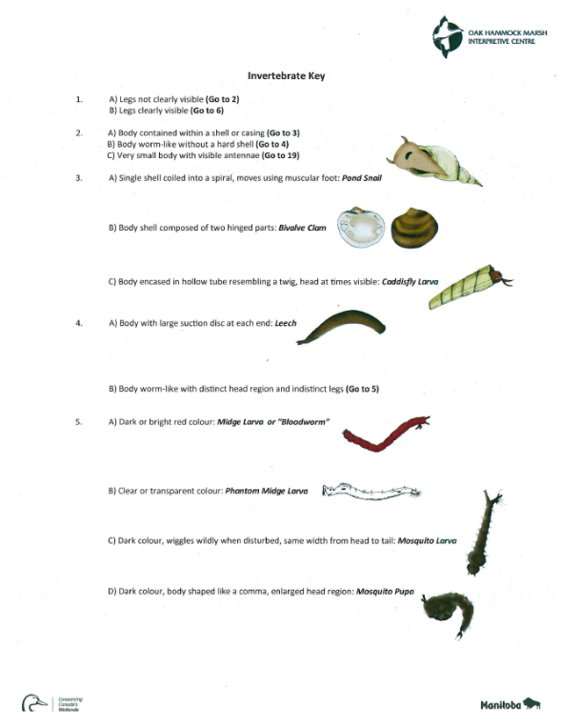
Classification Keys
Invertebrates have very diverse adaptations which can be used to help us identify them. Using classification tools, like a key, helps us better understand and distinguish one species from another.
A classification key is a tool that allows us to determine the identity of something using the process of elimination, referencing specific adaptations.
To use a classification key, follow these steps:
1. Read the first sentence numbered one.
2. Study the invert, looking for the features discussed in the sentences.
3. Pick the sentence which describes the invertebrate best, following the directions given in that sentence.
4. Continue with this process of reading the different sentences and choosing which describes your invertebrate best until a species name for your invertebrate is determined.
Bloodworm image from fynnmood.sg.

Slide 12
Invertebrate Inquiry Assignment:
Objective: To learn about a particular invertebrate and their adaptations that makes them suitable to live in a wetland, while practicing how to use a classification key.
1. Out of the thirty invertebrate pictures, you will choose four invertebrates to identify using the classification key.
2. Once you have identified all four species, pick one invertebrate to research. Use various sources to learn about the adaptations your chosen invertebrate has in order to help it survive in a wetland habitat.
3. Present your research results. You must include your invertebrate’s species name, phylum, and at least six different adaptations (three structural and three behavioural), including a description on how each adaptation helps the invert survive in a wetland.
4. With another student, compare and contrast the adaptations of the invertebrates you both researched, creating a Venn Diagram or a list of the differences and similarities.

Slide 13
Thank You!

