Slide 1
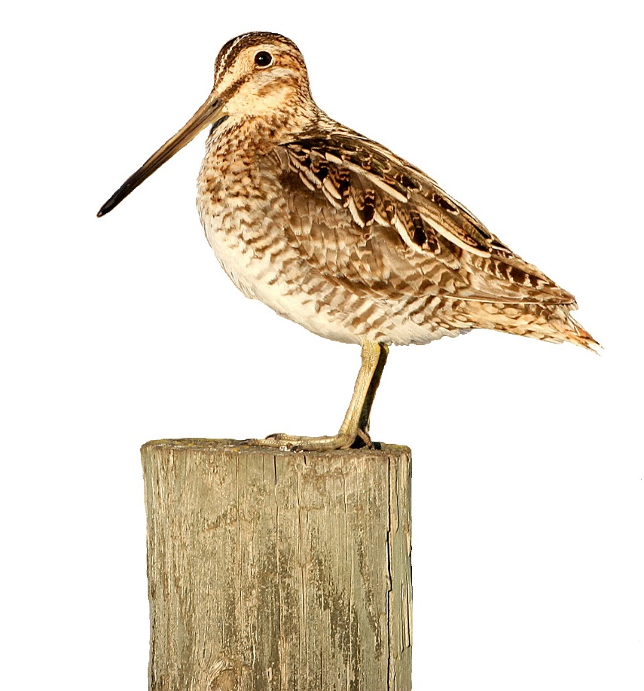
Classification Keys
L e a r n i n g H o w t o I d e n t i f y S h o r e b i r d s
Notes:
Shorebird shown on opening slide is a Wilson’s Snipe (however, you can practice your classification skills to discover which shorebird this may be).

Slide 2
Sorting, Arranging, Categorizing...
What does classification mean?
Classification is the action or process of classifying (sorting, arranging, categorizing, organizing) something according to shared characteristics or qualities.
What is a classification system?
A classification system is an approach to classification where a large group is divided into smaller subgroups and arranged in a particular way so one can better understand and differentiate between those in the group.
What are some examples of classification systems that we use everyday?
Books in a library, food in a grocery store, chapters in a textbook… etc.
Notes:
What does classification mean?
Classification is the action or process of classifying (sorting, arranging, categorizing, organizing) something according to shared characteristics or qualities.
What is a classification system?
A classification system is an approach to classification where a large group is divided into smaller subgroups and arranged in a particular way so one can better understand and differentiate between those in the group.
There are many kinds of classification systems that we use in our everyday lives.
What are some examples of classification systems that we use everyday?
Some examples are books in a library (categorized by reading level, theme, author’s name etc.), food in a grocery store (organized by food type), or chapters in a textbook (categorized by the content’s themes). Each item is sorted in a way to help the user find what they need amongst the great number of items.

Slide 3
Classifying Livings Things
There are billions of species living on Earth. To make sense of this overwhelming amount of diversity, we classify living things to better understand them.
For example, there are 10 000 species of birds
Sorted into groups based on similar physical and behavioural character traits
Birds are classified further into smaller groupings, such as the group called Shorebirds (with a little over 200 species included in this group)
Important to develop our skills in classification in order to better understand living things, recognize the differences between similar living things, and learn more about earth’s diversity
Today we will be learning how to use a specific kind of classification system called a classification key in order to identify shorebirds.
Notes:
There are billions of species living on Earth. To make sense of this overwhelming amount of diversity, we classify living things to better understand them.
One very common way of classifying is sorting living things into groups based on similar physical and behavioural character traits.
For example, there are 10 000 species of birds (according to Avibase, an extensive database information system on the world’s birds).
Birds are classified further into smaller groupings, such as the group called Shorebirds (with only a little over 200 species included in this group according to the Waterbird Society).
In order for us to better understand living things it is important that we learn how to differentiate between living things by classifying them.
Today we will be learning how to use a specific kind of classification system called a classification key using shorebirds as our example.

Slide 4
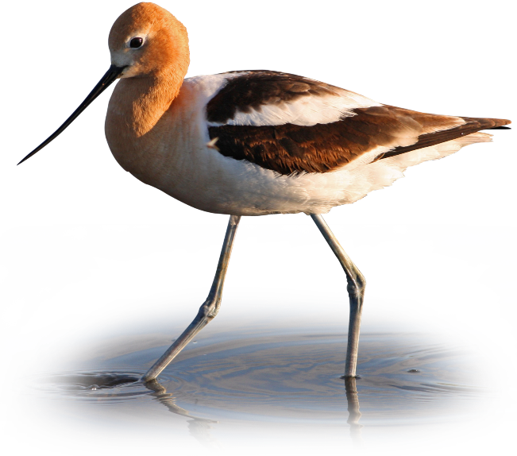
Identifying Shorebirds
Main features of Shorebirds:
Prefer to live in wet habitats and shorelines
Carnivorous, eating a range of insects, crustaceans, worms, tad poles etc.
Generally have long legs
Bills that probe mud, sand, gravel and water for food
Notes:
Before we can learn how to use the classification key, it is important we know what is considered a shorebird.
Shorebirds generally all have similar traits both physically and behaviourally that result in them being classified within a group. The main features of this bird group include:
Prefer to live in wet habitats and shorelines
Carnivorous, eating a range of insects, crustaceans, worms, tad poles etc.
Long legs, and bills that probe in mud, sand, gravel and water for food
Shorebird shown here is an American Avocet.

Slide 5
Types of Shorebirds
Avocets
Plovers
Sandpipers
American Avocet
Semipalmated Plover
Dunlin
Upturned bill
Straight, stout bill
Longer, slim build
Long, skinny legs
Shorter legs
Most diversity within this group of shorebirds
Small head to body ratio
Smaller in size
Notes:
A little over 200 species is still a high number of possible answers when trying to identify a particular shorebird, and requires further sorting. That is why shorebirds are grouped into smaller, more distinct groups including Avocets, Plovers, and Sandpipers.
Avocets generally have an upturned bill, long skinny legs, and smaller heads compared to their bodies, such as an American Avocet (pictured).
Plovers are generally smaller, with straight, stout bills and shorter legs, such as a Semipalmated Plover (pictured) or a Killdeer.
Sandpipers are the most diverse within their group, with a range of colours, and sizes. Generally they all have longer, slim bills. Godwits, Willets, Dunlins (pictured), Greater and Lesser Yellowlegs are all examples of a sandpiper.

Slide 6
What is a Classification Key?
A classification key is a tool that allows us to determine the identity of something in the natural world, like birds, through the process of elimination.
The key gives you choices based on structural or behavioural features, and as you select one it narrows down the possibilities until you get to a species.
If you have correctly used the key and have chosen the right key(s), you arrive at the correct name of the species you are trying to identify.
Choices in a key can be word or pictured-based, or a combination of both
Keys can be found in books, websites, and even apps
Important tool used by many Ornithologist (a person who studies birds) and bird watchers
Notes:
Now that we have an idea of what a shorebird looks like, what do you think a classification key is?
A classification key, also known as a Dichotomous Key, is a tool that allows us to determine the identity of something in the natural world, like birds, through the process of elimination.
The key gives you choices based on structural or behavioural features, and as you select one it narrows down the possibilities until you get to a species.
If you have correctly used the key and have chosen the right key(s), you arrive at the correct name of the species you are trying to identify.
Choices in a key can be word or pictured-based, or a combination of both
Keys can be found in books, websites, and even apps
Important tool used by many scientists, including Ornithologist (a person who studies birds) and bird watchers; classification keys are made for all kinds of living things

Slide 7
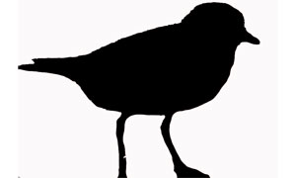
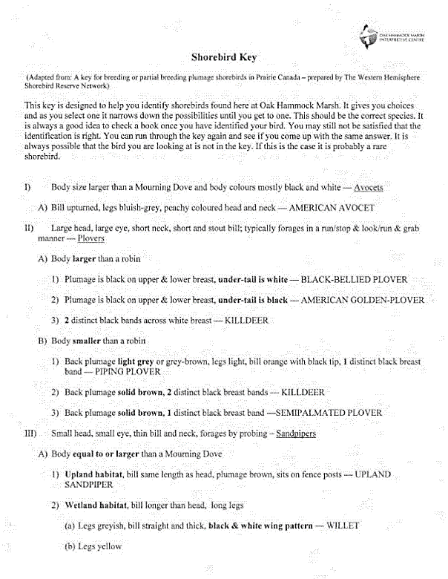
How to Use a Classification Key
Read sentences I, II and III of the key.
2. Study the shorebird, looking for the features discussed in the sentences.
I
3. Pick the sentence which describes the shorebird best.
II
A
4. Read sentences A, B, and C that fall under the sentence you chose.
B
5. Continue with this process of reading the different sentences and choosing which describes your shorebird best until a species name for your shorebird is determined.
1, 2, 3
III
Plover image from pinterest.com.
Notes:
Refer to the Shorebird Key included in this activity (shown on the slide), each student having their own key to refer to (they will be needing it for the next part of the activity).
Note: Another activity which uses keys to which you can refer to is the This Plant Key is All Wet! activity from WOW! The Wonders of Wetlands book (page 123).

Slide 8
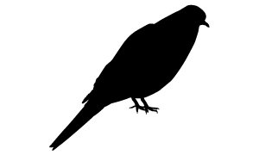
Let’s Do One Together
I. Body size larger then a Mourning Dove and body colours mostly black and white – Avocets group.
II. Large head, large eye, short neck, short and stout bill; typically forages in a run/stop & look/run & grab manner – Plovers group.
III. Small head, small eye, thin bill and neck, forages by probing – Sandpipers group.
Dove image from allaboutbirds.org.
Notes:
Read sentences I, II and III of the key. Study the shorebird, looking for the features discussed in the sentences. Pick the sentence which describes the shorebird best. (The correct answer will be circled, with the following slide showing the next set of questions).

Slide 9
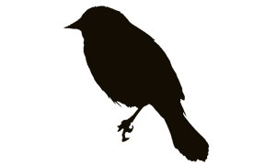
Let’s Do One Together
III. Small head, small eye, thin bill and neck, forages by probing – Sandpipers group:
A. Body equal to or larger than a Mourning Dove
B. Body smaller than a Mourning Dove and larger than a Red-winged Blackbird.
C. Body smaller than a Red-winged Blackbird.
Blackbird image from pinterest.com.
Dove image from allaboutbirds.org.
Notes:
Read sentences A, B and C of the key. Study the shorebird, looking for the features discussed in the sentences. Pick the sentence which describes the shorebird best. (The correct answer will be circled, with the following slide showing the next set of questions).

Slide 10
Let’s Do One Together
III. Small head, small eye, thin bill and neck, forages by probing – Sandpipers group.
A. Body equal to or larger than a Mourning Dove:
1. Upland habitat (dry area alongside rivers), bill same length as head, plumage brown, sits on fence posts.
2. Wetland habitat (wet area with vegetation growing in and around the water), bill longer than head, long legs.
Notes:
Read sentences 1 and 2 of the key. Study the shorebird, looking for the features discussed in the sentences. Pick the sentence which describes the shorebird best. (The correct answer will be circled, with the following slide showing the next set of questions).

Slide 11
Let’s Do One Together
III. Small head, small eye, thin bill and neck, forages by probing – Sandpipers group.
A. Body equal to or larger than a Mourning Dove.
2. Wetland habitat (wet area with vegetation growing in and around the water), bill longer than head, long legs:
(a) Legs greyish, bill straight and thick, black & white wing pattern - WILLET
(b) Legs yellow
(c) Legs dark, bill curves up

Slide 12
Let’s Do One Together
III. Small head, small eye, thin bill and neck, forages by probing – Sandpipers group.
A. Body equal to or larger than a Mourning Dove.
2. Wetland habitat (wet area with vegetation growing in and around the water), bill longer than head, long legs.
(b) Legs yellow:
Bill less than 1.25X the head length – LESSER YELLOWLEGS
(ii) Bill greater than 1.25X the head length – GREATER YELLOWLEGS
Notes:
Read sentences (i) and (ii) of the key. Study the shorebird, looking for the features discussed in the sentences. Pick the sentence which describes the shorebird best. (The correct answer will be circled).

Slide 13
First Classification Key Completed!
III. Small head, small eye, thin bill and neck, forages by probing – Sandpipers group.
A. Body equal to or larger than a Mourning Dove.
2. Wetland habitat (wet area with vegetation growing in and around the water), bill longer than head, long legs.
It’s a Lesser Yellowlegs!
(b) Legs yellow:
Bill less than 1.25X the head length – LESSER YELLOWLEGS
Notes:
After finding an answer by using a key, double check with a bird book or looking up online, like the allaboutbirds.org resource, to make sure you have the correct answer.

Slide 14
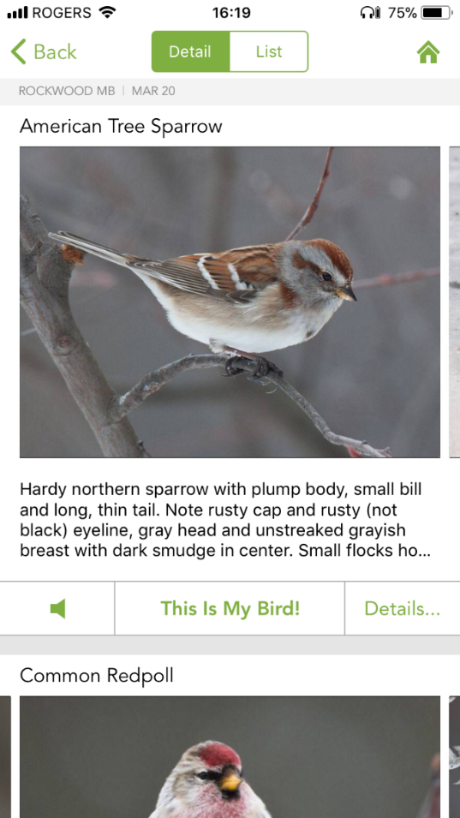
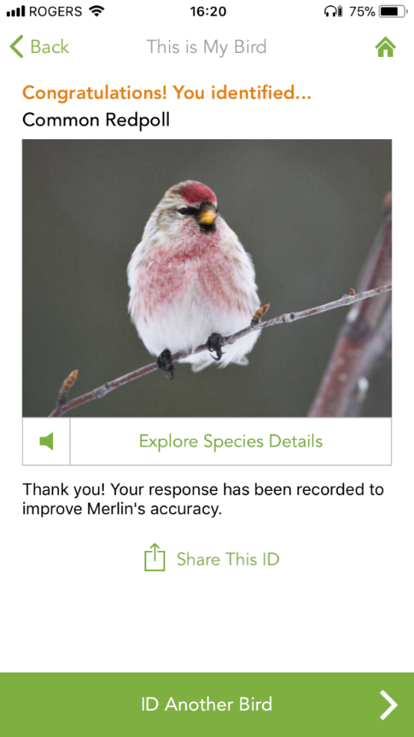
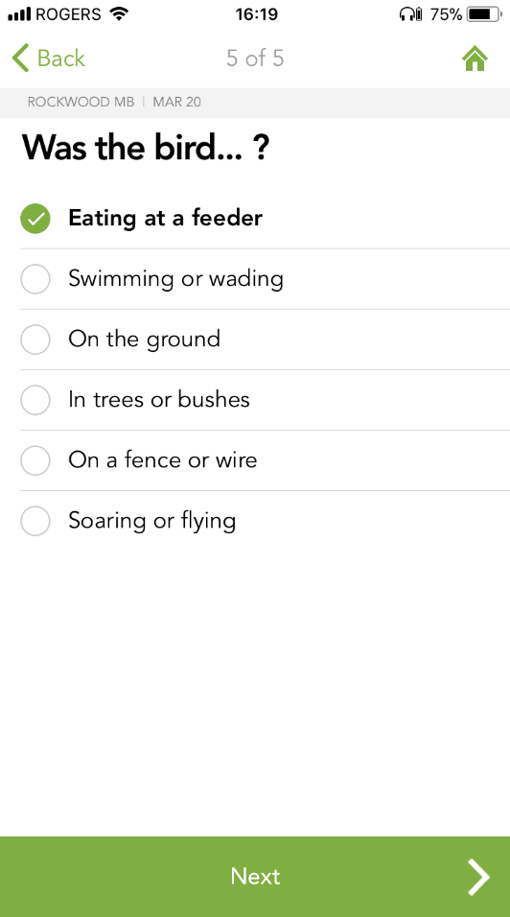
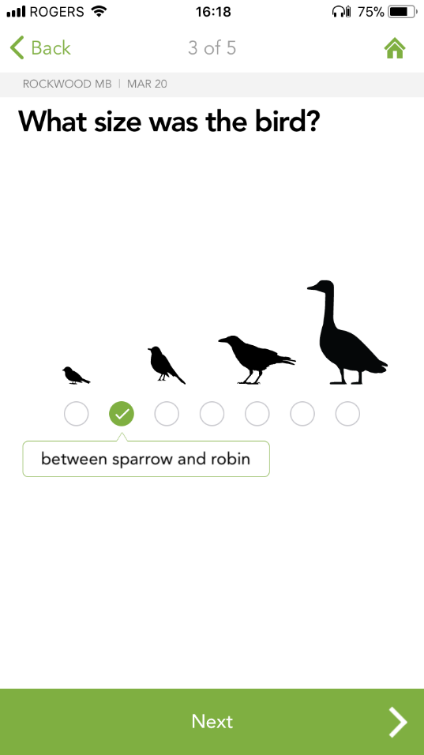
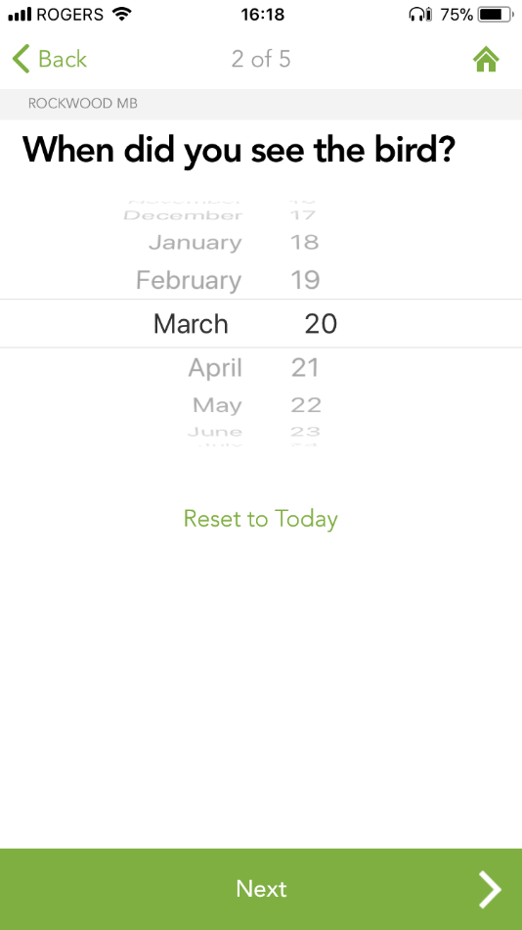
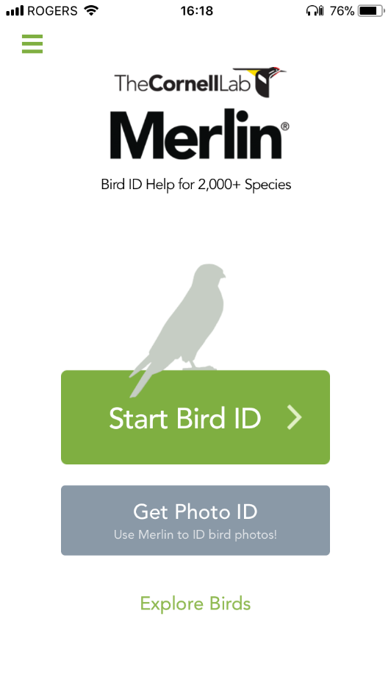
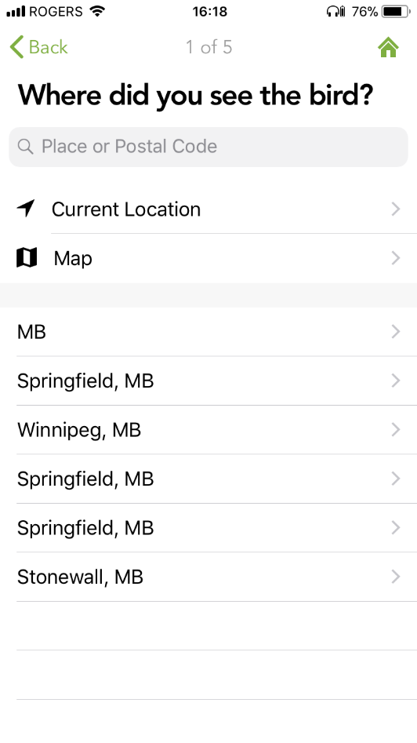
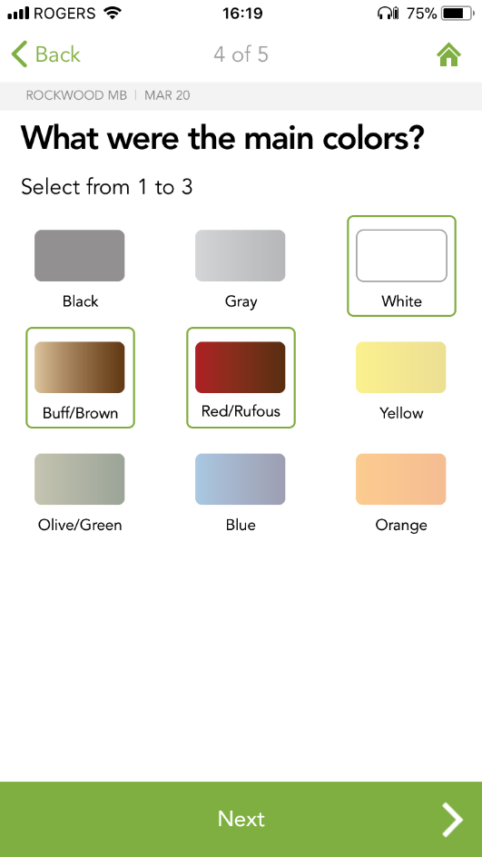
Merlin Bird ID by Cornell Lab
Another version of a classification key is the Merlin Bird ID app. The user answers five questions about the bird including its location, the date when you saw it, its size, colours, and what it was doing at the time (on the ground, swimming, at a feeder, etc.) and through the process of elimination the app will then show you the likely birds it could be.
What am I?
Notes:
Example of an app that uses a classification key to help the user identify birds. The images show the app in action when trying to identify a bird.
Optional Extension activity: download the app; show a picture or video of a Manitoba bird, having students use iPads/tablets to open the app and follow the steps, trying to see who can identify the bird in the picture or video. See next slide for an example of how to use the app.
Otherwise you may skip this slide.

Slide 15
How was that?
What are some advantages for using a classification system, like a key?
Simplifies the diversity, helps you identify/find something, and there are many different classification system options to choose from.
What are some disadvantages?
Takes time to become familiar with a classification system, they are not perfect and require updating, and one may not choose the right classification system to use for their particular purpose.
Notes:
What are some advantages for using these classification systems?
Classification systems can simplify the diversity, help with identification or with finding something, and there are many different classification system options to choose from that can help you with your specific purpose or question.
What are the disadvantages? It takes time to become familiar with a classification system, and in some cases, requires the user to practice using the system several times before it becomes most useful. These systems are not perfect and require updating as new scientific evidence is found, so the answer you maybe looking for may not even be registered in the system yet. There is also a possibility for the user to have chosen the wrong classification system for their particular task or question which can confuse or frustrate the user.
It is important to remember that one key is not the ‘end all be all’ and may require the user to use multiple keys before they find their answer. Note that a classification system is not a search engine; although search engines may use classification keys within their algorithms, the user is not using a key themselves when accessing Google for instance.

Slide 16
Summary
A classification system:
approach to classification, large group is divided into smaller subgroups then arranged in a particular way, used to better differentiate between those in a group.
A classification key:
tool that helps determine the identity of something in the natural world through the process of elimination.
Importance of classification:
billions of species on Earth; to make sense of this overwhelming amount of diversity in nature we classify living things to better understand them, recognize the differences between similar living things, and learn more about earth’s diversity.
simplifies diversity, helps user identify living things, many different key options to choose from.
Advantages:
Disadvantages:
requires practice, not perfect, require updating, may choose the wrong classification system for user’s particular purpose.

Slide 17
Thank You!

