Slide 1
Wetland Invasive Species Trivia!
Learning about wetland invasive Species
Notes:
Today we will be learning about wetlands, invasive species and their effects through a trivia game.

Slide 2
Round 1 Wetlands
Notes:
Image from DUC.
Resources
Hinterland Who’s Who (HWW): https://www.hww.ca/en/wild-spaces/wetlands.html
Ducks Unlimited Canada: https://www.ducks.ca/our-work/wetlands/
Ducks Unlimited Canada: https://www.ducks.ca/assets/2014/12/field-guide-low-res.pdf
Canadian Wetland Classification (CWC): https://www.gret-perg.ulaval.ca/fileadmin/fichiers/fichiersGRET/pdf/Doc_generale/Wetlands.pdf

Slide 3
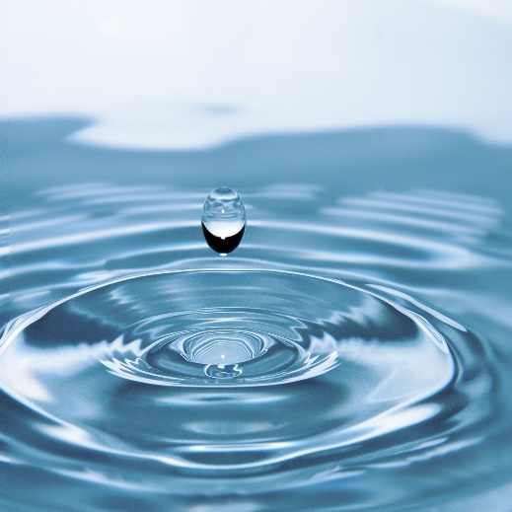
Question #1
What two things make up a wetland?
water & sun
water & plants
water & animals
water & land
Image from https://www.pexels.com/photo/water-drop-40784/
Notes:
Source:
CWC:
What is a Wetland? A wetland is defined as: land that is saturated with water long enough to promote wetland or aquatic processes as indicated by poorly drained soils, hydrophytic vegetation and various kinds of biological activity which are adapted to a wet environment (National Wetlands Working Group 1988)
OR
HWW
A wetland is simply any area of land that is covered with water for a part of the day or year.
A wetland is an area of land that is permanently or periodically saturated with water. The water is 2 metres deep or less, allowing the water-loving plants to get enough sunlight to grow.

Slide 4
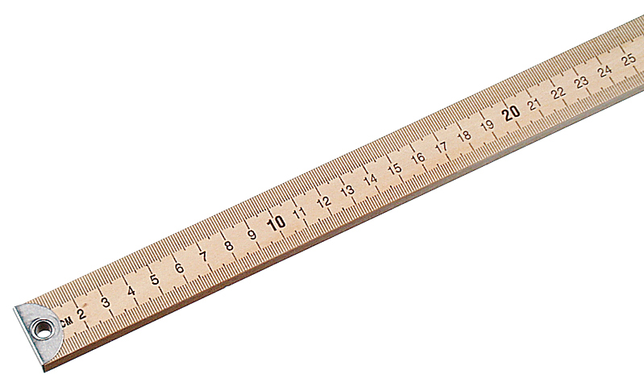
Question #2
What is the maximum depth a wetland can be?
0.5 m
1 m
2 m
2.5 m
Image from https://www.flinnsci.com/meter-sticks-hardwood-englishmetric/
Notes:
Source:
CWC
Mineral wetlands are found in mineral soil areas associated with shallow water, which is generally less than 2 m deep.

Slide 5
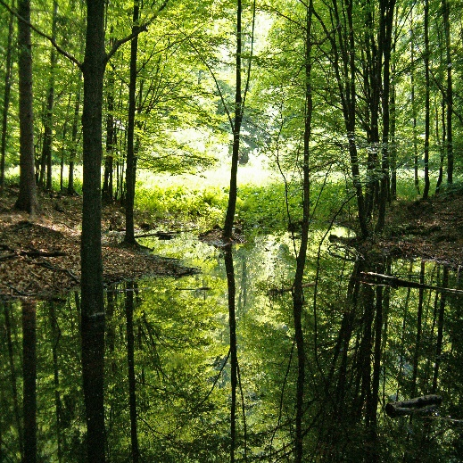
Question #3
Bogs, fens, marshes and swamps are types of _________.
ponds
wetlands
lakes
plants
Image from DUC.
Notes:
Source:
HWW
A marsh is subject to periodic flooding, particularly if located near a river or lake, or in the case of saltwater marshes, near tidal waters. Consequently, its water level can change drastically. Its boundaries are not as well defined as those of a pond, and a marsh may dry out completely by late summer. A marsh is overgrown with coarse grasses, sedges, and rushes.
The water-filled potholes and sloughs of the prairies may resemble ponds or marshes, depending on their characteristics and specific locations.
A swamp is essentially a wooded marsh, a waterlogged area supporting trees, tall shrubs, herbs, and mosses. Still or gently flowing water covers much of the surface during wetter seasons.
A peatbog is a poorly drained area covered by mats of moss. The moss slowly decomposes in successive layers to eventually form a material called peat. There are two types of peatbogs: bogs and fens. In bogs, the process of decomposition and peat formation is further advanced than in fens, making the soil and water more acidic. The most common moss found on the surface of a bog is sphagnum moss. Other bog plants are sedges and low-growing shrubs of the heath family and sometimes trees such as spruce.
In fens, sedges are the predominant vegetation and sphagnum moss is not common, although other mosses that require less acidic conditions may grow there. Fens also support reeds, grasses, and low-to-medium-height shrubs. Occasionally, too, there may be a sparse scattering of trees—tamarack or cedar. In northern Canada, a large expanse of bog or fen is called muskeg.

Slide 6
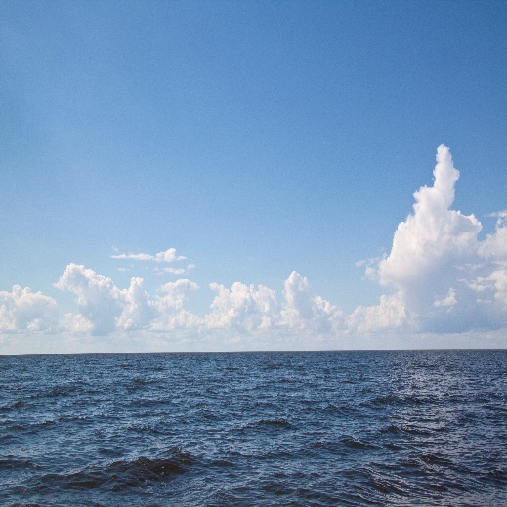
Question #4
True or False.
A lake is a type of wetland.
Image from DUC.
Notes:
Water is too deep.

Slide 7
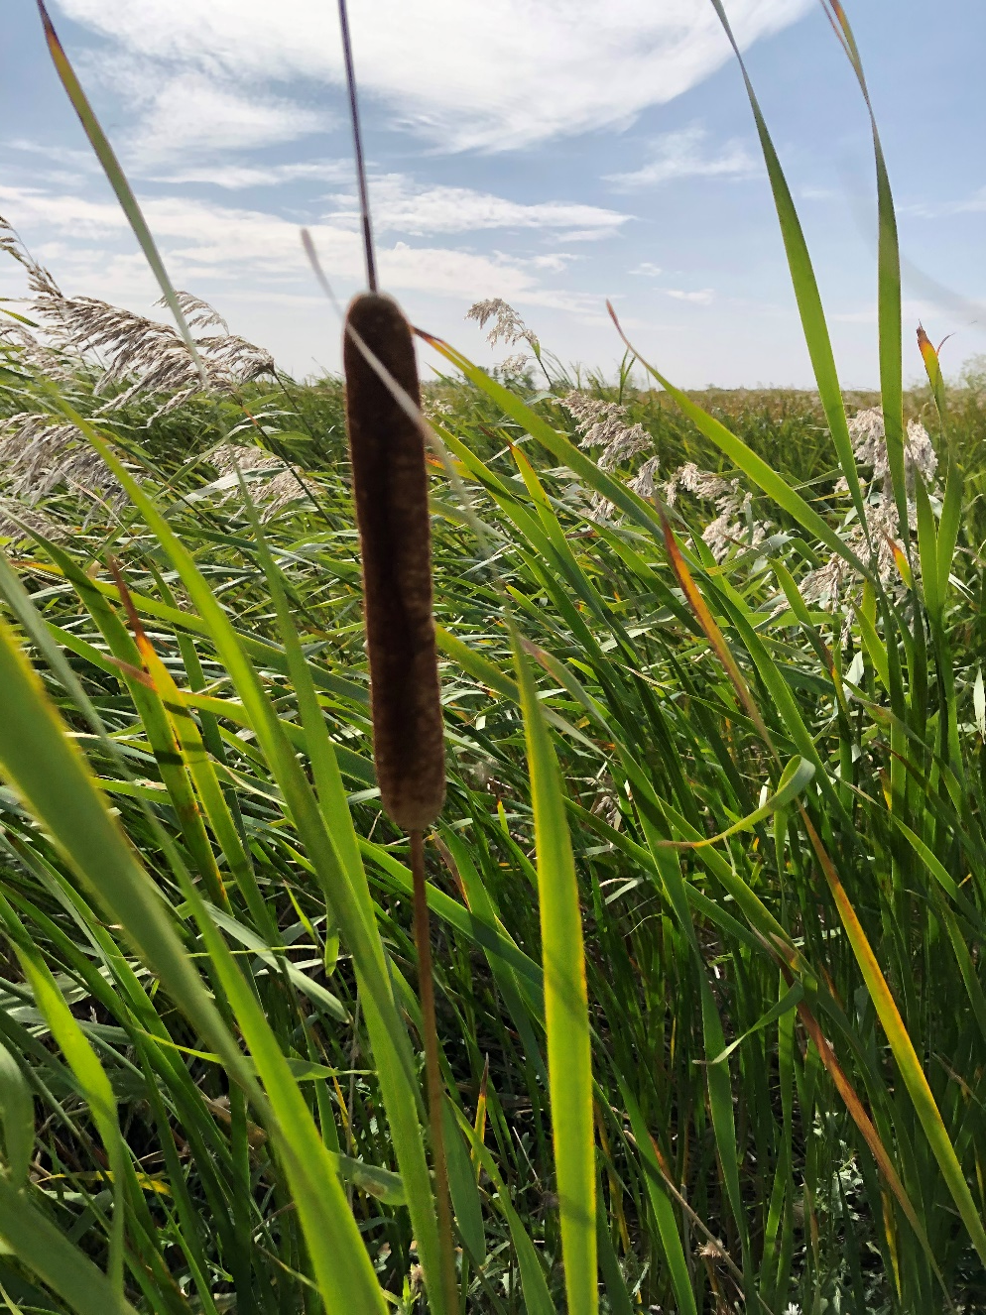
Question #5
Name this plant.
cattail
willow
bulrush
grass
Image from DUC.
Notes:
NEED TO INSERT PART OF NATURE NOTE HERE
Cattails are common plants throughout marshes and are often confused with bulrushes. The identifying feature of these plants is a dense brown cylindrical spike, which is three to six inches long and about an inch in diameter (looks like a hotdog on a stick). In the month of July, a pale green spike occurs on top of the brown hotdog shape (which is the seeds). This green spike is made up of male flowers. Leaves are a light olive green, parallel-veined, 10 to 20 inches in length and merge with the stem at the base of the plant. The height of these plants can reach about three to four feet tall. (In comparison, bulrushes are roughly the same height (much thinner stem), have cylindrical leaves, and are dark green in colour with seed pouches hanging of the top of the leaf (looks like a tassel). Often compared to a green onion. The bulrush is a member of the sedge family). Cattails are a favourite food of the muskrat and used in building its lodge (home).
The tender whitish leaf base of cattails has been collected in spring as a fresh vegetable. Rhizomes (a thickened, usually horizontal underground stem or branch of a plant that stores food, producing roots below and leafy shoots above, and that differs from a root in having buds and scaly leaves) were also gathered in spring, peeled and eaten raw or roasted or ground into meal for porridge. The young flowering spikes are also edible. Male flowers (at the top of the spike, above the ‘hot dog’ portion) produce large quantities of pollen, which can be mixed with equal parts of flour for muffins, biscuits, etc. The green female flowers (at bottom of spike, the ‘hot dog’ portion) can be boiled or roasted and eaten like corn on the cob. They are said to taste like olives, globe artichokes or sweet corn. In more southern areas, care must be taken not to confuse cattail leaves with those of poisonous irises.

Slide 8
Question #6
Canada has __% of the world’s wetlands.
5
15
25
35
Image from https://www.goodfreephotos.com/canada/nova-scotia/other-nova-scotia/satellite-image-of-nova-scotia.jpg.php.
Notes:
Source:
https://www.canada.ca/en/environment-climate-change/services/environmental-indicators/extent-wetlands.html
Canada has about 1.29 million km² of wetlands, covering 13% of Canada's terrestrial^{Footnote [1]} area. This is close to one quarter of the world's remaining wetlands.^{Footnote [2]} Where wetlands have been monitored, they generally show declines in extent due to conversion to agriculture and other development.^{Footnote [3]}
Most of Canada's wetlands occur in the Boreal Shield (25% of Canadian wetland area), Hudson Plains (21%) and Boreal Plains (18%). Wetlands form almost 80% of the Hudson Plains, and very low proportions of mountainous regions such as the Arctic Cordillera (less than 0.5%) and Montane Cordillera (less than 2%).

Slide 9
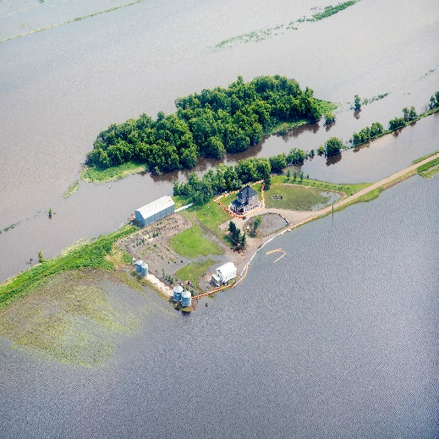
Question #7
Why are wetlands important?
filter water
place for food
prevent floods
prevent erosion
all of the above
Image from DUC.
Notes:
Source:
HWW
What good are wetlands?
It’s easy to regard wetlands as mere wastelands, of little or no value. We don’t build houses or factories in swamps, bogs, or marshes, and we don’t plant wheat or many other crops on land submerged in water. Wetlands are generally unsuitable for boating and swimming—in fact, for most human activities.
So it’s not surprising that many people "reclaim" our wetlands, by draining them or filling them in. To do so is a serious mistake.
Wetlands act like giant sponges, soaking up rain and snowmelt and slowly releasing water in drier seasons. Thus, they help to reduce floods and to ease the worst effects of drought. Draining ponds, sloughs, and marshes often lowers the water table and dries up wells. Wetlands also reduce soil erosion by checking or slowing the runoff from storms and thaws.
Without wetlands we would no longer have a ready supply of fresh drinking water. Much like our kidneys, wetlands filter the waters of our lakes, rivers, and streams, reducing pollution. The vegetation in wetlands removes phosphates and other plant nutrients washed in from the surrounding soil, thereby slowing the growth of algae and aquatic weeds. This growth is a serious problem in some of Canada’s major waterways where dead and decaying algae rob the deeper waters of their oxygen.
Wetlands are also the homes for at least some part of the year for many fish, birds, and other animals, meeting essential breeding, nesting, nursery, and feeding needs. Without wetlands, some wildlife species would disappear.
Wetlands contribute to the growth and economy of the country. Some of the smaller mammals, such as the beaver and muskrat, that dwell in wetlands are important to the fur trade, and the millions of game birds and fish reared in and around our wetlands support a growing recreation and tourist industry.

Slide 10
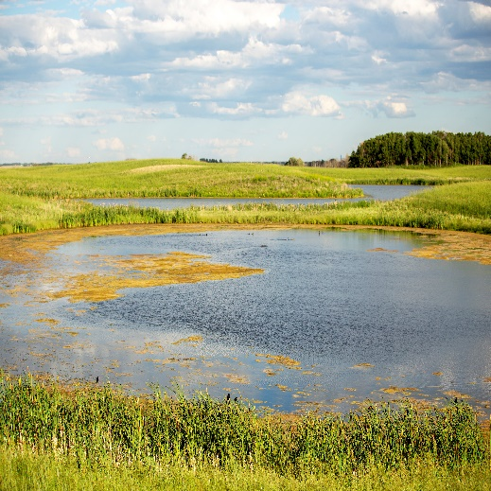
Question #8
True or False.
A pond is a type of wetland.
Image from DUC.
Notes:
Source:
HWW
A pond is a well-defined basin, filled with stagnant water and fringed with vegetation. It is fed mainly by rain and snowmelt and loses water through seepage, direct evaporation, and plant transpiration. During the summer, parts of a pond may dry out, exposing mudflats. The shallow depth of a pond allows water lilies and other bottom-rooted plants to reach the surface, while milfoils, pondweeds, and other submergent plants flourish beneath.

Slide 11
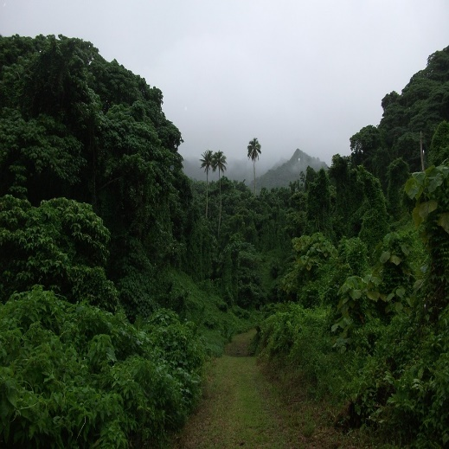
Question #9
The biodiversity of a wetland is ____ to that of the rainforest.
second
third
fourth
fifth
Image from https://www.goodfreephotos.com/public-domain-images/fog-and-forest-of-indonesia.jpg.php.
Notes:
Source:
https://en.wikipedia.org/wiki/Wetland
It is usually thought of as second so sources put it equal to rainforests.

Slide 12
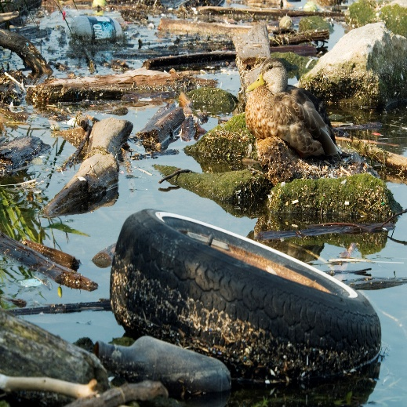
Question #10
Which of the following are threats to wetlands?
pollution
development
drainage
invasive species
none of the above
all of the above
Image from DUC.
Notes:
Source:
HWW
A threatened resource
The natural, reversible changes in wetlands may be almost insignificant compared with the disruption caused by human interference. Dredging a pond can make it unsuitable for birds that require shallow water. Draining or filling in wetlands permanently destroys entire communities of plants and wildlife. Burning off or cutting down surrounding weeds, brush, or other vegetation eliminates, at least temporarily, vital nesting places and escape cover. Building a highway through a coastal marsh or erecting a small dock at the marshy edge of a lake where you moor your rowboat is also damaging.
Air and water pollution are serious problems. Insecticides, weed killers, and industrial wastes take a heavy toll on plants, fish, and other wildlife.

Slide 13
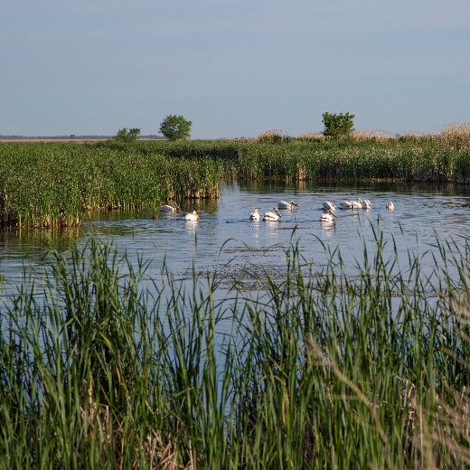
Answers – Round 1
d) water & land
c) 2 m
b) wetlands
false
a) cattail
c) 25%
e) all of the above
true
a) second
f) all of the above
Image from DUC.

Slide 14
Round 2 Invasive Species
Notes:
Image from DUC.
Resources
Invasive Species Council of Manitoba: http://invasivespeciesmanitoba.com/site/
Invasive Species in Manitoba: River, Lake and Wetland Invaders; a pocket field guide by the Invasive Species Council of Manitoba
www.invasivespeciesinfo.gov: https://www.invasivespeciesinfo.gov/what-are-invasive-species
https://www.invasivespeciescentre.ca/learn/

Slide 15
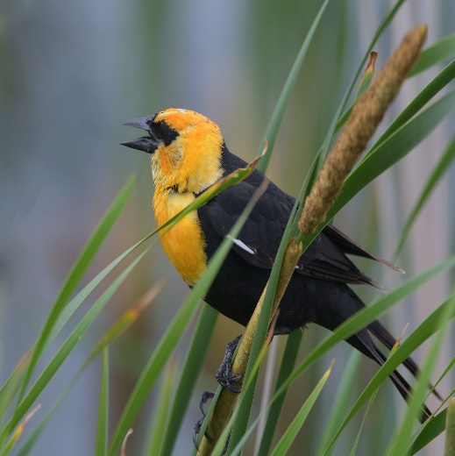
Question #1
A species indigenous to a given region or ecosystem is called:
native
introduced
natural
accidental
Image from Harry J. Enns Wetland Discovery Centre.
Notes:
Image is a Yellow-headed Blackbird.
Source:
https://lakes.grace.edu/native-non-native-invasive-species/
Native: a species that originated and developed in its surrounding habitat and has adapted to living in that particular environment.

Slide 16
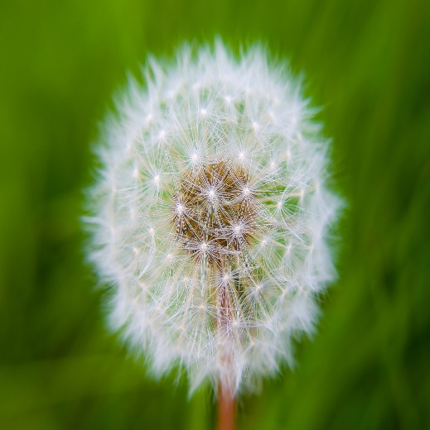
Question #2
A species that is not native to an area is called:
non-native
extraordinary
introduced
endemic
a & c
Image from Bing Images – public domain.
Notes:
Image is a Dandelion.
Source:
https://lakes.grace.edu/native-non-native-invasive-species/
Non-native: a species that originated somewhere other than its current location and has been introduced to the area where it now lives (also called exotic species).

Slide 17
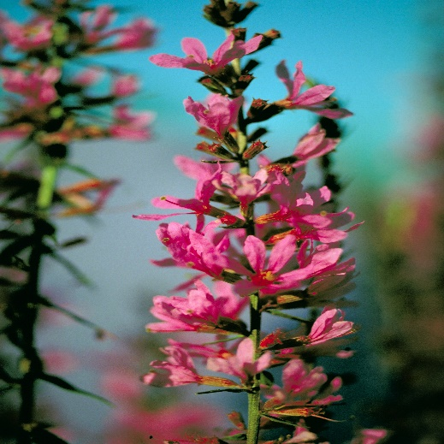
Question #3
A species that is not native to an area and does harm is called:
native
invasive
natural
symbiotic
Image from DUC.
Notes:
Image is Purple Loosestrife.
Source:
https://lakes.grace.edu/native-non-native-invasive-species/
Invasive: a species of plant or animal that outcompetes other species causing damage to an ecosystem – this can be a native (rarely) or non-native (exotic) species.

Slide 18
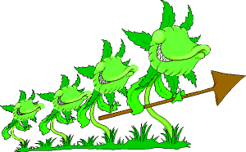
Question #4
True or False.
Invasive species don’t harm native species that are beneficial to the environment.
Image from http://www.eppo.org/PUBLICATIONS/EPPONews/images/alien.gif.
Notes:
Source:
https://www.thinktrees.org/wp-content/uploads/2020/02/Manitoba-Envirothon-Forest-and-Plant-Ecology-Regional-Resource_2020_min.pdf
An invasive species is an exotic (originating from another region of the world) species whose introduction causes or is likely to cause economic harm, environmental harm, and/or harm to native species (including human) health. Species include plants, seeds, eggs, spores, other propagules, and animals (e.g., mammals, reptiles, amphibians, fish, insects and other invertebrates). T

Slide 19
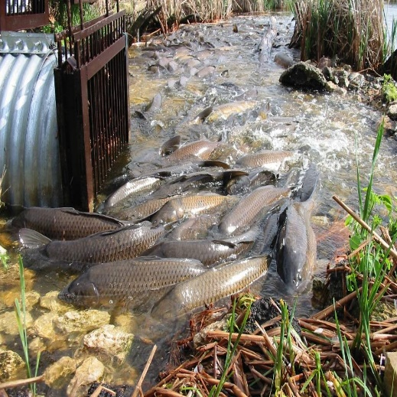
Question #5
Why do populations of invasive species grow so quickly?
They keep the ecosystem in equilibrium.
They are prey to many animals.
They are native to an area.
They have no predators.
Image from DUC.
Notes:
Source:
https://www.thinktrees.org/wp-content/uploads/2020/02/Manitoba-Envirothon-Forest-and-Plant-Ecology-Regional-Resource_2020_min.pdf
Few natural enemies Many invasive species do not have any natural enemies (e.g., predators, competitors, parasites, and pathogens) in the area they invade. A lack of predators and pathogens may allow the invasive species population to spiral out of control.
http://invasivespeciesmanitoba.com/site/
Invasive species are plants, animals or other organisms that are growing outside of their country or region of origin and are out-competing or even replacing native organisms. Since they come from ecosystems in other parts of the world,"unwanted invaders" escape their natural enemies. They have a distinct advantage over our native species whose populations are kept in check by native predators, competitors, or disease.

Slide 20
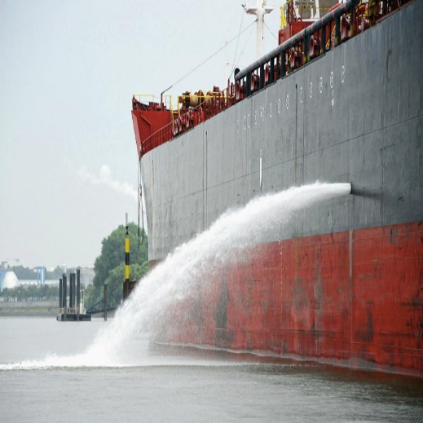
Question #6
The primary cause of invasive species introduction is:
too much food
human activities
migration
weather events
Image from Bing Images – public domain.
Notes:
Source:
http://invasivespeciesmanitoba.com/site/index.php?page=how-do-they-spread
How do invasive plants or animals spread into Manitoba?
Increased global trade and travel have created many new pathways for the international and incidental spread of invasive aquatic species. The growing trade in aquatic ornamental plants for water gardening and aquariums is also cause for concern. Many of the currently known invasive exotic plant species in North America have been imported and planted as ornamentals.
Dispersal: Humans are most often directly responsible for introducing a species to a new region, whether intentionally or unintentionally.
Hitchhikers: Species can become unintentionally transported globally, by catching a ride in places like ship ballast water, or locally, by attaching to boats or other equipment used by anglers and hunters.
Imported: Intentionally imported species are not usually intended for widespread distribution into the environment. However, plants, brought in for gardeners as ornamentals, or exotic pets can become invasive pests in regions where they were never intended to be released.
Illegal Trade: Illegal smuggling/trading of fruits and vegetables across borders can introduce not only potentially harmful new plant species but also any insects and parasites that may live in them.
Natural Dispersal: Through time, species are able to expand ranges naturally, establishing in areas they previously did not exist in.

Slide 21
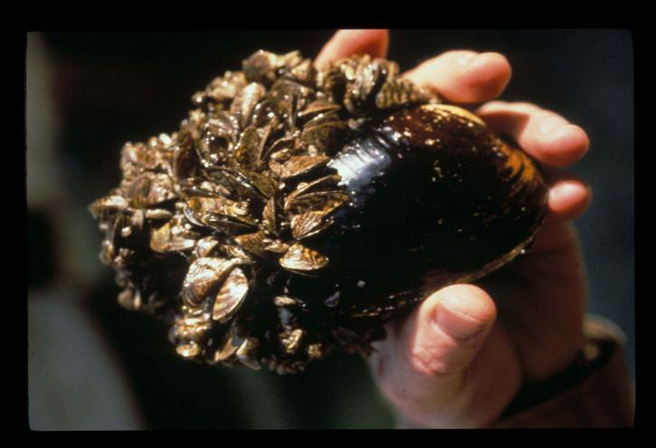
Question #7
What invasive species was brought to the Great Lakes in the ballast water of ships?
mayflies
stoneflies
zebra mussels
yellow perch
Image from Bing Images – public domain.
Notes:
Source:
http://invasivespeciesmanitoba.com/site/index.php?page=zebra-mussels
History
Native to the Black and Caspian Sea region of Eurasia. A cargo ship traveling to the Great Lakes in the 1980s is the likely point of introduction to North America. By 1990, Zebra Mussels had been found in all the Great Lakes. The invertebrate was reported in 2010 in the United States portion of the Red River watershed in Wahpeton, North Dakota. In October, 2013, zebra mussel adults were confirmed in the southwest section of Lake Winnipeg in Manitoba.

Slide 22
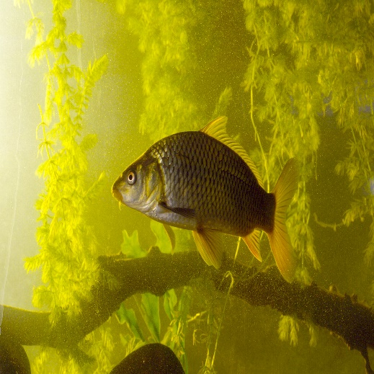
Question #8
This invasive species stir up the bottom of a wetland.
zebra mussels
common carp
spiny waterflea
rusty crayfish
Image from DUC
Notes:
Source:
http://invasivespeciesmanitoba.com/site/index.php?page=common-carp
Threat
Carp are constantly stirring up the substrate when they feed, meaning that they can greatly decrease the clarity of the water. This makes waterways unattractive, destroys habitat, reduces the abundance of aquatic plants, and can make the water unsuitable for swimming or drinking. They also release phosphorus normally locked up in bottom sediments and aquatic fauna, and lower the abundance of insects by predation and loss of habitat.

Slide 23
Question #9
This invasive species is best controlled by introducing another species.
purple loosestrife
Eurasian watermilfoil
flowering rush
rainbow smelt
Image from DUC.
Notes:
Source:
http://invasivespeciesmanitoba.com/site/index.php?page=purple-loosestrife
Control Methods
Purple Loosestrife management in wetlands has involved four general control approaches: cultural, mechanical, chemical, and biological. Current efforts in Manitoba focus on the use of beetles (Galerucella calmariensis L.) as a long term biological control. While other control methods have met with little success, the use of beetles has proven effective.

Slide 24
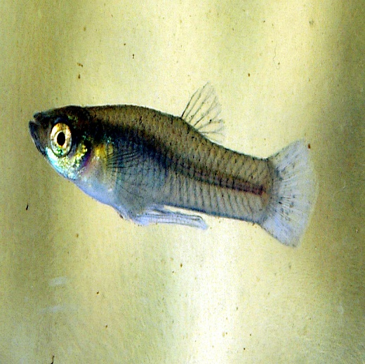
Question #10
This species has been designated as being among the world’s worst invasive species.
rainbow smelt
rusty crayfish
zebra mussels
mosquitofish
Image from https://en.wikipedia.org/wiki/Mosquitofish.
Notes:
Source:
http://invasivespeciesmanitoba.com/site/index.php?page=mosquitofish
Habitat
Shallow areas in streams, ponds and ditches, with and without vegetation. The mosquitofish can tolerate low levels of dissolved oxygen and high temperatures. It may thrive in degraded and artificial habitats.
Range
In the United States, they are established widely in the west, midwest and northeast, including several states bordering the Great Lakes. Established on all continents except Antarctica.
The eastern Mosquitofish is found in the eastern United States in Atlantic and Gulf of Mexico slope drainages, west through Alabama. The western Mosquitofish is native to watersheds draining into the Gulf of Mexico, from Alabama through Texas, including much of the Mississippi River drainage as far north as Indiana and Illinois.
Pathway of Introduction and Spread
Intentionally introduced in other parts of the world as an agent of Mosquito control; subsequent spread resulted through population growth and dispersal. The aquarium and ornamental pond industries are potential vectors of accidental or unlawful release into open waters, particularly given ongoing public concern about Mosquito-borne disease.
Impacts
As opportunistic predators, mosquitofish readily consume zooplankton and the eggs and larvae of other aquatic vertebrates. This has led to the reduction of populations of amphibians and other fishes, as well as changes to food web structure and water chemistry.
The Invasive Species Specialist Group of the IUCN Species Survival Commission designated the Mosquitofishes as being among the world's worst invasive species.

Slide 25
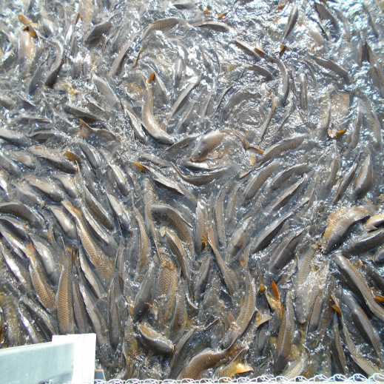
Answers – Round 2
a) a native species
e) a & c non-native or introduced
b) an invasive species
false
d) They have no predators.
b) human activities
c) zebra mussels
b) common carp
a) purple loosestrife
d) mosquitofish
Image from DUC.

Slide 26
Round 3 Effects of Invasive Species
Notes:
Image: https://globalnews.ca/news/4223683/growing-invasion-of-lake-winnipeg-evident-as-countless-shells-wash-ashore/
Sources:
https://www.canada.ca/en/environment-climate-change/services/biodiversity/why-invasive-alien-species-are-problem.html
https://www.invasivespeciescentre.ca/learn/

Slide 27
Question #1
True or False.
Invasive species can have a major impact on the ecosystem.
Image from Bing Images – public domain.
Notes:
Source: https://www.canada.ca/en/environment-climate-change/services/biodiversity/why-invasive-alien-species-are-problem.html#_envImpact
Environmental impacts
Can negatively impact biodiversity
Can cause species extirpation and even extinction
Can cause soil degradation, and erosion
Can alter fire cycles
Look at Table 1 (Types of species and their impacts to Canada) for examples impacts by species
Zebra mussels as an example: https://www.gov.mb.ca/stopais/zebra-mussels.html
Why are they an issue?
Zebra Mussels are a concern to Manitoba because they can:
reproduce quickly. A single female Zebra Mussel can produce up to one million eggs per year
impact fish populations by consuming large quantities of algae, which is the base of the aquatic food chain
clog water intake systems increasing costs to communities and industries. This includes power generating stations, water supply facilities and drinking water infrastructure
reduce water-front property values of homes and cottages
block watercraft engines cooling systems possibly causing engine damage
kill native mussels by attaching themselves in enormous numbers (Figure 2.) so the host mussel cannot open its shell and it starves
increase water clarity, allowing sunlight to reach deeper into a water body which stimulates more aquatic plant growth, thereby changing the local aquatic habitat.
be associated with larger and more frequent algal blooms
litter shorelines and beaches with sharp shells
interfere with swimming and beach-going activities by cutting the feet of swimmers and pets with their sharp-edged shells

Slide 28
Question #2
When introduced to a new habitat, non-native plants often threaten native plants in the new habitat. Why do they do this?
They are able to mutate rapidly
They are able to be used for medicine
They cause native animals to relocate
They compete with native plants for resources
Image from Google.ca/maps.
Notes:
Source: https://invasivespeciesmanitoba.com/site/index.php?page=purple-loosestrife
Example – Purple Loosestrife
Impacts
Purple Loosestrife degrades natural habitats such as wetlands and riparian areas reducing biological diversity by out-competing native vegetation. This affects the entire wetland community of both plants and animals. The estimated cost of control, losses and damages associated with Purple Loosestrife is $45 million US dollars annually
https://purpleloosestrife.org/index.php?page=faq#4
4. What's so bad about Purple Loosestrife?
The nicknames for purple loosestrife - beautiful killer, marsh monster and exotic invader - are telling. An invasive, weedy species, loosestrife readily establishes in a variety of urban and rural wetland habitats. Once it's present, it has a tendency to dominate, outcompeting native vegetation. The result is solid (monotypic) stands of purple loosestrife. This drastic change in species composition and decrease in biodiversity has been reported to affect the nutrient cycling regime of wetlands and the sue of the area by wildlife.
The displacement of native vegetation by purple loosestrife has many far reaching ecological implications, many of which still remain unknown. In urban areas loosestrife commonly takes hold in ditches and can block or disrupt water flow. In agricultural regions it can clog irrigation canals and reduces the value of forage. Once established, it is extremely difficult to eradicate. No herbicides are currently approved to control loosestrife growing in or near waterways. Small outbreaks can be removed by hand digging, but for large scale infestations this is too costly and time consuming. Since purple loosestrife can regenerate from even the smallest piece of root tissue left in the soil, digging is not a viable long term solution.

Slide 29
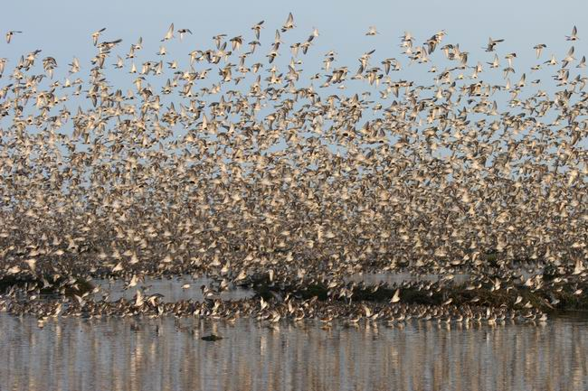
Question #3
True or False
Invasive species grow quickly due to the lack of predators, this leads to a decline or extinction of the native population.
Image from https://whsrn.org/whsrn_sites/fraser-river-estuary/.
Notes:
Source:
https://www.canada.ca/en/environment-climate-change/services/biodiversity/why-invasive-alien-species-are-problem.html
https://canadainvasives.ca/invasive-species/#:~:text=Invasive%20species%20threaten%20and%20can,reduce%20soil%20productivity
Degradation of Our Natural Environment
Natural areas such as forests, prairies, wetlands and lakes provide many ecosystem services and benefits. Natural areas provide shelter and food for wildlife, remove pollutants from air and water, produce oxygen and provide valuable recreational and educational opportunities.
Invasive species threaten and can alter our natural environment and habitats and disrupt essential ecosystem functions. Invasive plants specifically displace native vegetation through competition for water, nutrients, and space. Once established, invasive species can:
reduce soil productivity
impact water quality and quantity
degrade range resources and wildlife habitat
threaten biodiversity
alter natural fire regimes
introduce diseases
Invasive species threaten many rare and endangered species and now those species are at risk of extinction. Once established, invasive species become costly and difficult to eradicate. Often, the impacts are irreversible to the local ecosystem.

Slide 30
Question #4
Invasive species have been identified by the World Conservation Union as the ______ most significant threat to biodiversity.
first
second
third
fourth
fifth
Image from Bing Images – public domain.
Notes:
Source:
https://www.canada.ca/en/environment-climate-change/services/biodiversity/why-invasive-alien-species-are-problem.html
According to the World Conservation Union, invasive alien species are the second most significant threat to biodiversity, after habitat loss. In their new ecosystems, invasive alien species become predators, competitors, parasites, hybridizers, and diseases of our native and domesticated plants and animals.
It takes the right conditions for an alien species to become established and grow. In fact, most introduced species do not become permanently established in their newly found environment. They either find the wrong type of conditions for survival, or there they are unable to produce enough offspring to maintain a viable population. For those species that are able to reproduce and survive, most never cause significant problems. They survive, spread and reproduce but generally do not pose a risk to Canada’s economy, environment or society.
Some introduced species however, are able to thrive and even flourish at their new location. They have the right biological properties that allow then to grow in numbers quickly. In addition, they are usually able to reproduce and spread quickly, often out-competing native plant and animal species for food water and space.

Slide 31
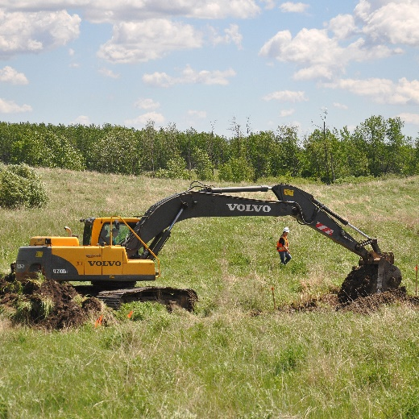
Question #5
Invasive species lead to all these problems except:
increased biodiversity
loss of biodiversity
disease
loss of native species
Image from Ducks Unlimited Canada
Notes:
Source:
https://www.canada.ca/en/environment-climate-change/services/biodiversity/why-invasive-alien-species-are-problem.html

Slide 32
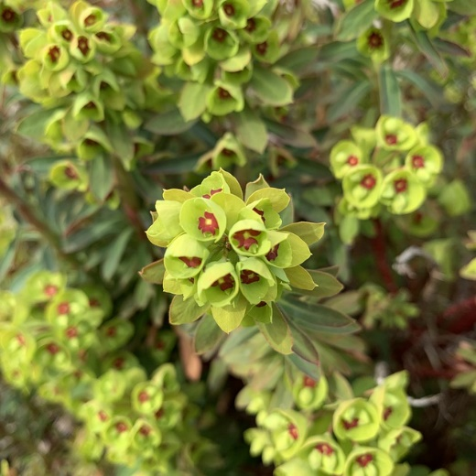
Question #6
Leafy spurge infests 340,000 acres of land in Manitoba, costing taxpayers an estimated $___ million per year to protect grazing land, public land, and rights-of-way.
3
7
13
19
25
Image from OHMIC.
Notes:
Source:
https://canadainvasives.ca/invasive-species/
Economic Impacts
Invasive plants can have a large economic impact on individual landowners and municipalities. A recent study shows that property values for shoreline residences in Vermont affected with Eurasian water-milfoil (Myriophyllum spicatum) were down as much as 16.4 % (OMNRF, 2012). Due to the explosion of leafy spurge (Euphorbia esula), Manitoba has experienced a $30 million reduction in land values (CFIA, 2008). Leafy spurge infests 340,000 acres of land in Manitoba, costing taxpayers an estimated $19 million per year to protect grazing land, public land, and rights-of-way (CFIA, 2008). In Ontario, the MNRF has been involved with invasive Phragmites control pilot projects since 2007 and to date control costs range between $865 and $1,112 per hectare (OMNRF, 2012). Invasive species have an impact on approximately 20% of Species at Risk in Ontario (OMNRF, 2012).
Invasive plants directly affect municipalities with reforestation projects and recreational trails. They increase management costs (e.g. project planning and monitoring) and they increase operational costs (e.g. mowing, pruning and hand pulling). They also complicate reforestation projects as they need to first be removed, and then the gaps created through removal must be addressed by using large, potted plant stock, or additional site maintenance to prevent the risk of re-invasion.
The economic impact of invasive species in Canada is significant. According to Environment Canada and Climate Change:
The estimated annual cumulative lost revenue caused by just 16 invasive species is between $13 to $35 billion.
Invasive species that damage the agricultural and forestry industries results in an estimated $7.5 billion of lost revenue annually.

Slide 33
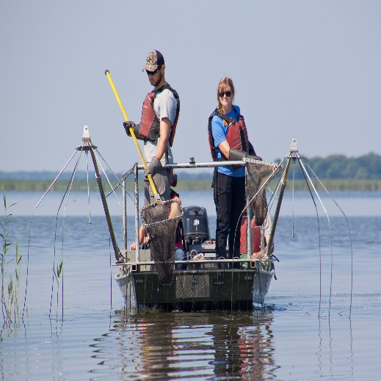
Question #7
What Manitoba wetland has Ducks Unlimited Canada worked in to exclude the Common Carp?
Oak Hammock Marsh
Whitewater Lake
Delta Marsh
Netley-Libau Marsh
Image from Ducks Unlimited Canada.
Notes:
Source:
https://www.ducks.ca/stories/science/cleaning-common-carp/
Pod Cast of Ducks Unlimited Inc.:
Episode 1: https://www.youtube.com/watch?v=uoAajWZnRu0 (focus is on decline of marsh)
Episode 2: https://www.youtube.com/watch?v=sWmgfA87lz4 (focus is on carp project)
YouTube video: https://www.youtube.com/watch?v=Spy0XSwcfXA

Slide 34
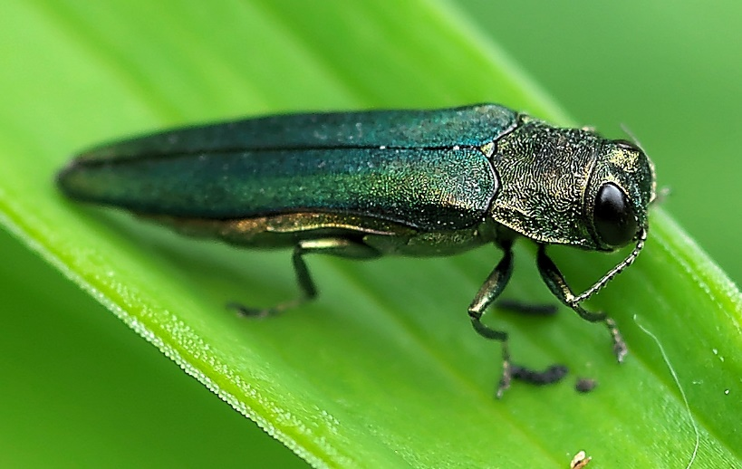
Question #8
Emerald Ash Borers kill 99% of ash trees. Winnipeg has 356 000 ash trees. It costs about $1000/tree to treat or remove and replace it. What is the total cost to deal with this invasive species?
$303 million
$327 million
$352 million
$373 million
Image from https://bugspray.com/emerald-ash-borer-control.html.
Notes:
Source:
https://www.canada.ca/en/environment-climate-change/services/biodiversity/why-invasive-alien-species-are-problem.html
The cost of eradication and control efforts associated with this invasive insect have totalled in the millions per year.
http://treeswinnipeg.org/emerald-ash-borer/
Emerald Ash Borer in Winnipeg, Manitoba
On November 30, 2017, EAB was officially confirmed in Winnipeg. It is still uncertain the extent EAB will impact Winnipeg, however, in other cities up to 99 percent of ash trees have been lost. It is estimated that there are approximately 356,000 ash trees, making up about 40% of Winnipeg’s urban forest.
Other cities that have experienced EAB have lost up to 99 per cent of untreated ash trees within two to 10 years. It is still uncertain how much EAB will impact Winnipeg. However, once an ash tree dies from EAB, it dries out quickly and can become unstable and hazardous. Many of Winnipeg’s ash trees are large, mature shade trees, meaning once they start to decay, there may be risk to people, property and vehicles.
http://invasiveinsects.ca/eab/costs_h.html
Estimated costs:
Tree removal and replacement costs
Ash trees that are not treated with an appropriate insecticide usually die of EAB attack, and need to be removed before they become hazardous. The cost of ash tree removal depends on factors such as the size of the tree and how complicated it is to remove (e.g. trees close to buildings or overhead wires are more expensive to remove). The tree stump will also need to be removed, this may be at an additional cost. Ash trees that are not removed promptly after they die can become fragile and more expensive to remove. In urban areas, the cost of removing an ash tree and replacing it with a new tree can be expensive - current estimates in southern Ontario are $700-1500 per tree.
Tree treatment costs
The costs of treating a tree with TreeAzin™ insecticide will depend on the size of the tree, and how many trees are to be treated. Each TreeAzin™ service provider sets their own price, however, as of 2013 the cost was approximately $5 per cm of tree diameter (measured at chest height), per treatment. For example, a 30 cm diameter tree would cost approximately $150 to treat once. The provider may charge a minimum price for a treatment visit, so it may be more economical to treat more than one tree. Trees may need to be treated yearly at first, and then are treated every other year until the EAB population decreases (the current estimate is treatment over a 6-10 year span).
To obtain an accurate quote for treatment, provide the TreeAzin™ provider with the diameter at chest height of each tree to be treated. To measure the diameter at chest height of your tree, use a flexible measuring tape to measure the circumference of the tree at 1.3 metres above the ground. Multiply the circumference by 0.32 to obtain the tree diameter at chest height.

Slide 35
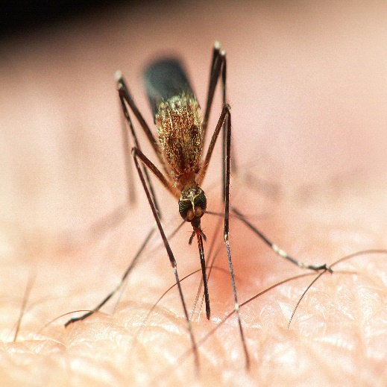
Question #9
Which animals are used to monitor for West Nile Virus?
people, mosquitos, birds & horses
people, flies, amphibians & horses
people, mosquitos, fish & horses
people, flies, birds & horses
Image from DUC.
Notes:
Source:
https://www.canada.ca/en/environment-climate-change/services/biodiversity/why-invasive-alien-species-are-problem.html
West Nile Virus
The West Nile Virus originated in Africa and Europe. Since its discovery in North America, public health agencies have been waging an aggressive campaign to inform the public about the risks associated with contracting this disease
https://ipac-canada.org/west-nile-virus-resources.php
https://www.canada.ca/en/public-health/services/diseases/west-nile-virus/surveillance-west-nile-virus.html
Human surveillance
During the West Nile virus season (mid-April to November), Canada conducts ongoing human case surveillance across the country.
Monitoring West Nile virus nationally is a joint effort between the Government and its partners, including:
provincial and territorial ministries of health
First Nations authorities
blood supply agencies
The Government relies on the provinces and territories to report the number of West Nile virus cases.
To accurately reflect the annual occurrence of West Nile virus cases in Canada, health professionals need to remain vigilant in:
diagnosing West Nile virus
reporting cases to their public health regional authorities
Surveillance information is reported to the Government by its partners.
Mosquito surveillance
Mosquito surveillance depends on the level of anticipated or current West Nile virus activity in a particular area.
In areas where West Nile virus has not been found, surveillance of mosquitoes focuses on:
which kinds of mosquitoes are present
how abundant the mosquitoes are
whether West Nile virus has entered the mosquito population
In areas where West Nile virus has already been found, mosquitoes may still be tested for West Nile virus. This information can help to:
anticipate new outbreaks
monitor ongoing outbreaks
identify different kinds of mosquitoes that could spread the virus to:
birds
animals
people
It can also be used to decide if, when, where and how to act to reduce the risk of infection by applying mosquito control measures
Bird surveillance
When West Nile virus first came to North America, bird surveillance was used as an early indicator of the virus in animals.
Experience from past outbreaks showed the following birds were highly susceptible to West Nile virus:
crows
jays
magpies
ravens
Infected dead birds are a good indicator to determine whether people in particular areas are at risk.
Some provinces and territories no longer conduct dead bird surveillance. Instead, they focus efforts on other surveillance activities.
The Canadian Wildlife Health Cooperative tests dead birds for West Nile virus in geographical areas with a sufficiently high risk. They do this in collaboration with:
provincial laboratories
the Government's National Microbiology Laboratory
Testing focuses on the detection of West Nile virus in the early season (late April to July).
Horse surveillance
Among large animals, horses are especially at risk for West Nile virus infection and disease. Horses can also be early indicators of West Nile virus in a region. The Canadian Food Agency of Canada monitors West Nile virus in horses with the help of:
provincial veterinary laboratories
veterinarians
other members of the animal health community
Vaccination may be used to prevent infection in horses. Currently, there are three West Nile virus vaccines registered for use in horses in Canada. Local veterinarians should be contacted for guidance on appropriate vaccination products and strategies.

Slide 36
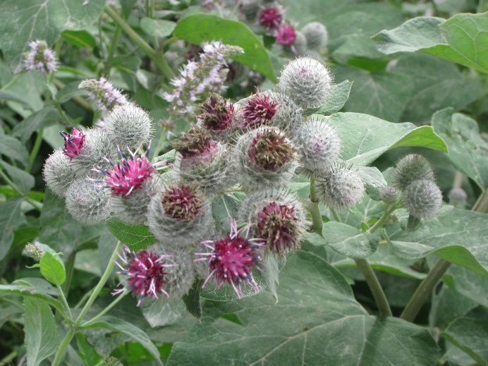
Question #10
This invasive species can lower the health and market value of livestock.
yellow toadflax
ox-eye daisy
common burdock
bird vetch
Image from Bing Images – public domain.
Notes:
Source:
http://invasivespeciesmanitoba.com/site/index.php?page=burdock
Threat
Burrs can bother and lower the health and market value of livestock. Its large leaves can shade out smaller plants. It also acts as a secondary host for pathogens that affect economically important plants.

Slide 37
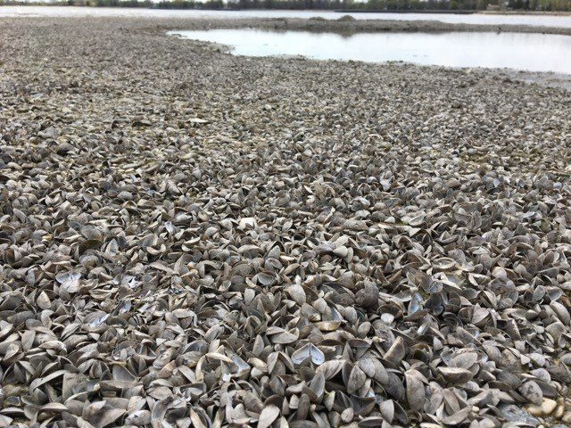
Answers – Round 3
true
d) they compete with native plants for resources
true
b) second
a) increased biodiversity
d) 19
c) Delta Marsh
c) $352 million
a) people, mosquitos, birds & horses
c) common burdock
Image from https://globalnews.ca/news/4223683/growing-invasion-of-lake-winnipeg-evident-as-countless-shells-wash-ashore/.

Slide 38
Thank You!

