Slide 1
Invasive Species project
An in depth study of an invasive species
Notes:
Today we will be learning about invasive species, their effect and how to control them.

Slide 2
Wetlands
Wetlands are ecosystems that have specific biotic and abiotic characteristics that make it distinct from other ecosystems.
A wetland is an area of land that is permanently or periodically saturated with water. The water can only be 2 metres or less in depth, due to the water-loving plants that grow in and around the water.
Types of Wetlands:
Freshwater Marsh
Fen
Swamp
Bog
Shallow Open Water
Shallow water image from geograph.org.uk. All other images from Ducks Unlimited Canada.
Notes:
Wetlands cover almost half of Manitoba, and can be found in every region (ecozone) in the province.
The main biotic and abiotic characteristics of a wetland are:
An area of land that is permanently or periodically saturated with water
The water is 2 metres or less in depth
Water-loving plants grow in and around the water
Each type of wetland has slightly different biotic and abiotic characteristics that make it distinct from other types of wetlands, all while still following the overall characteristics of a wetland. Note to Teachers: There is a complete description of unique characteristics for each type of wetland shown here included in the Grade 11 pre- and post-visit activity guide.

Slide 3
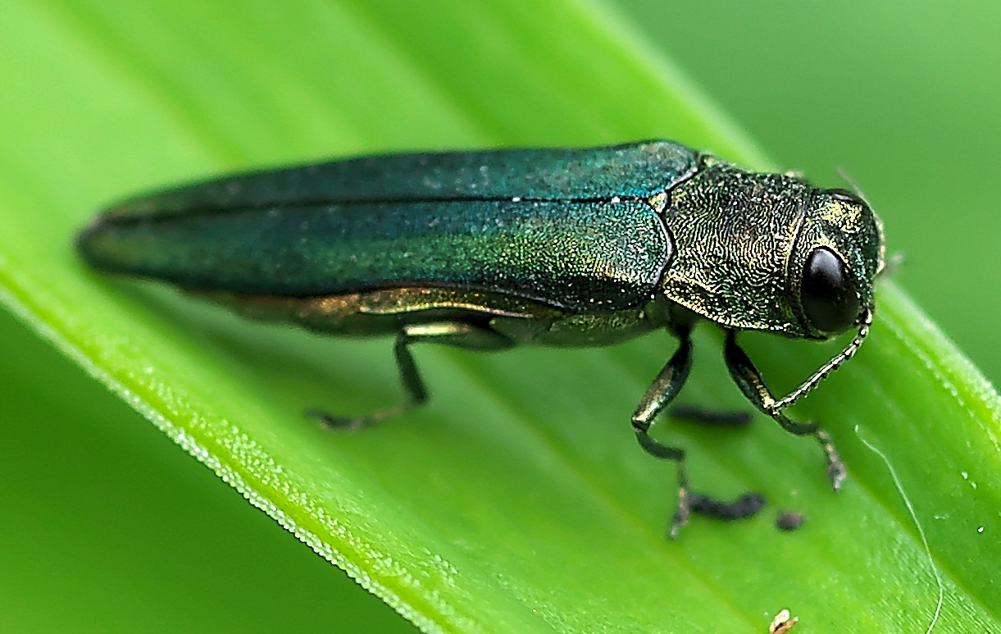
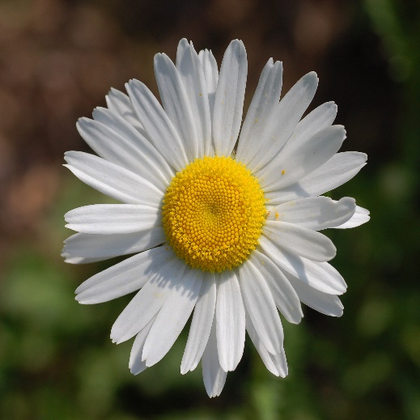
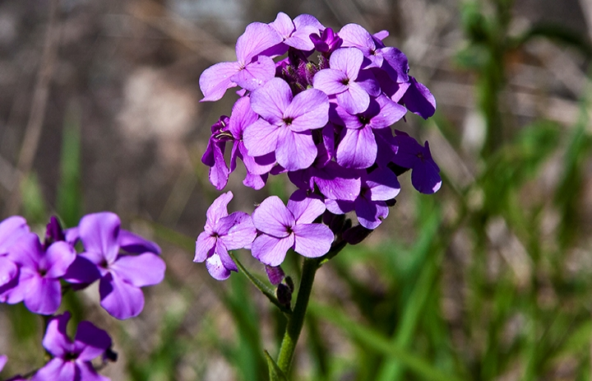
What is an invasive species?
Introduced species or organism which causes damage to biodiversity, agricultural production or human health
No natural enemies/predators here in Manitoba
Outcompetes native species
See notes for image sources.
Notes:
Emerald Ash Borer image from: https://bugspray.com/emerald-ash-borer-control.html
Ox-eyed Daisy image from: https://en.wikipedia.org/wiki/Leucanthemum_vulgare
Dame’s Rocket image from: https://en.wikipedia.org/wiki/Hesperis_matronalis
Resources
Invasive Species Council of Manitoba: http://invasivespeciesmanitoba.com/site/
Invasive Species in Manitoba: River, Lake and Wetland Invaders; a pocket field guide by the Invasive Species Council of Manitoba
www.invasivespeciesinfo.gov: https://www.invasivespeciesinfo.gov/what-are-invasive-species
https://www.invasivespeciescentre.ca/learn/

Slide 4
Wetland Invasive Species
Notes:
The following slide highlight the wetland invasive species that the students will research in depth. They will select one of the six and answer a series of questions (slide 11).

Slide 5
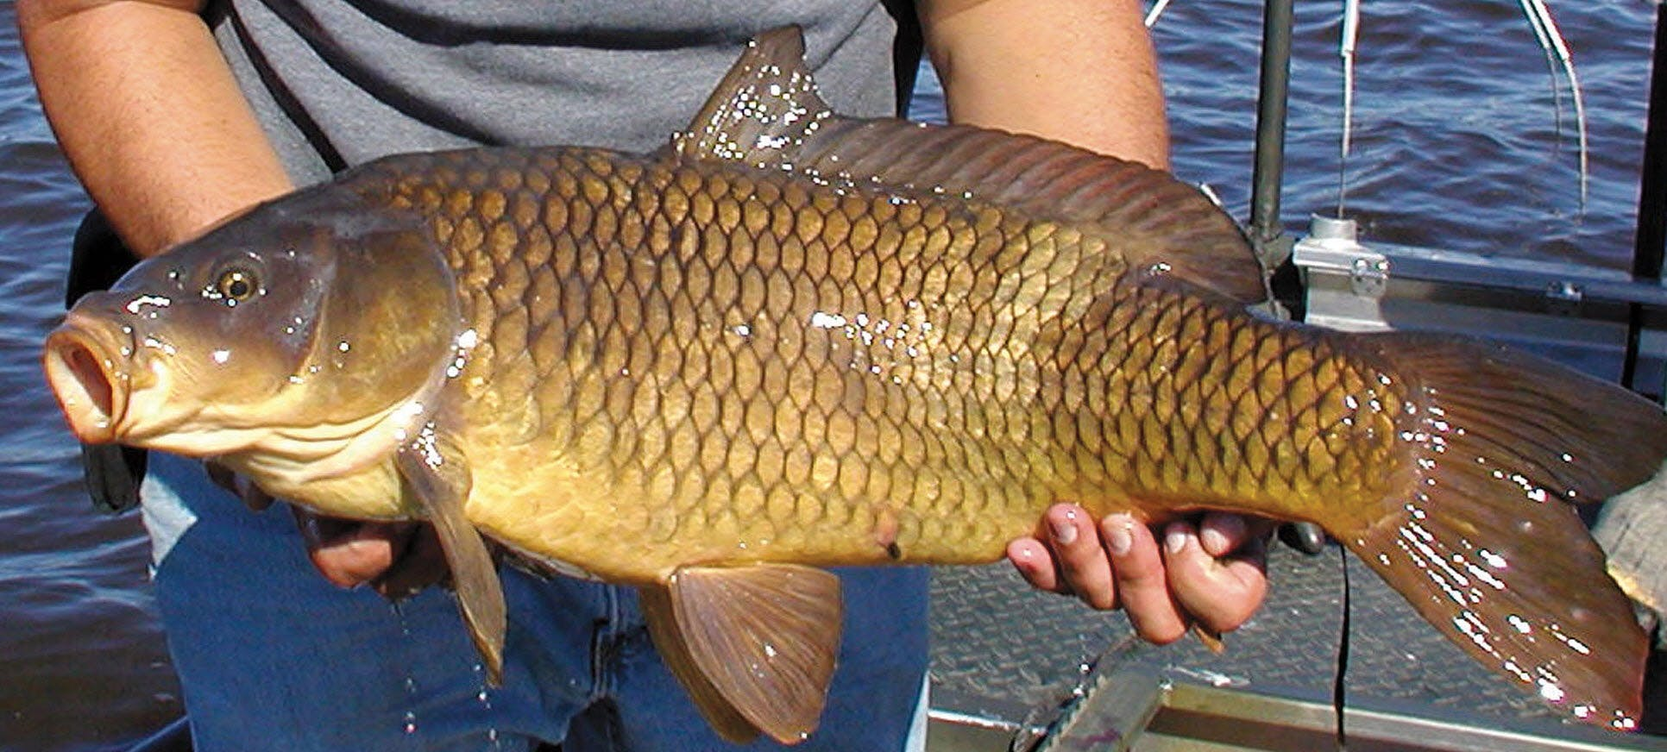
Common Carp
Common Carp is native in Asia and parts of Europe.
Carp are constantly stirring up the substrate when they feed, meaning that they can greatly decrease the clarity of the water. This makes waterways unattractive, destroys habitat, reduces the abundance of aquatic plants, and can make the water unsuitable for swimming or drinking.
Image from https://www.startribune.com/why-some-anglers-love-carp/270345611/.
Notes:
Invasive Species Council of Manitoba: http://invasivespeciesmanitoba.com/site/index.php?page=common-carp
Ducks Unlimited Canada: https://www.ducks.ca/stories/conservator/ducs-fight-against-invasive-species/

Slide 6
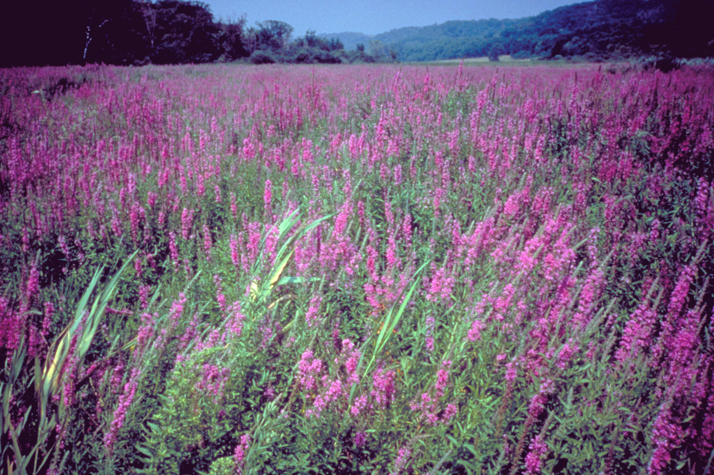
Purple Loosestrife
Native to Eurasia
Degrades natural habitats such as wetlands and riparian areas reducing biological diversity by out-competing native vegetation.
Image from DUC.
Notes:
Invasive Species Council of Manitoba: http://invasivespeciesmanitoba.com/site/index.php?page=purple-loosestrife
Ducks Unlimited Canada: https://www.ducks.ca/stories/conservator/ducs-fight-against-invasive-species/

Slide 7
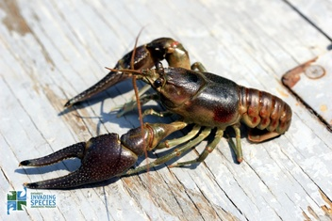
Rusty Crayfish
Originating in the Ohio River Basin, USA.
Rusty Crayfish, especially juveniles, feed heavily on aquatic plants, small fish and water insects, often twice as much as a native Crayfish. This puts strain on the food sources for young fish and other invertebrates.
Image from http://www.manitoulinstreams.com/rusty-crayfish.html/.
Notes:
Invasive Species Council of Manitoba: http://invasivespeciesmanitoba.com/site/index.php?page=rusty-crayfish

Slide 8
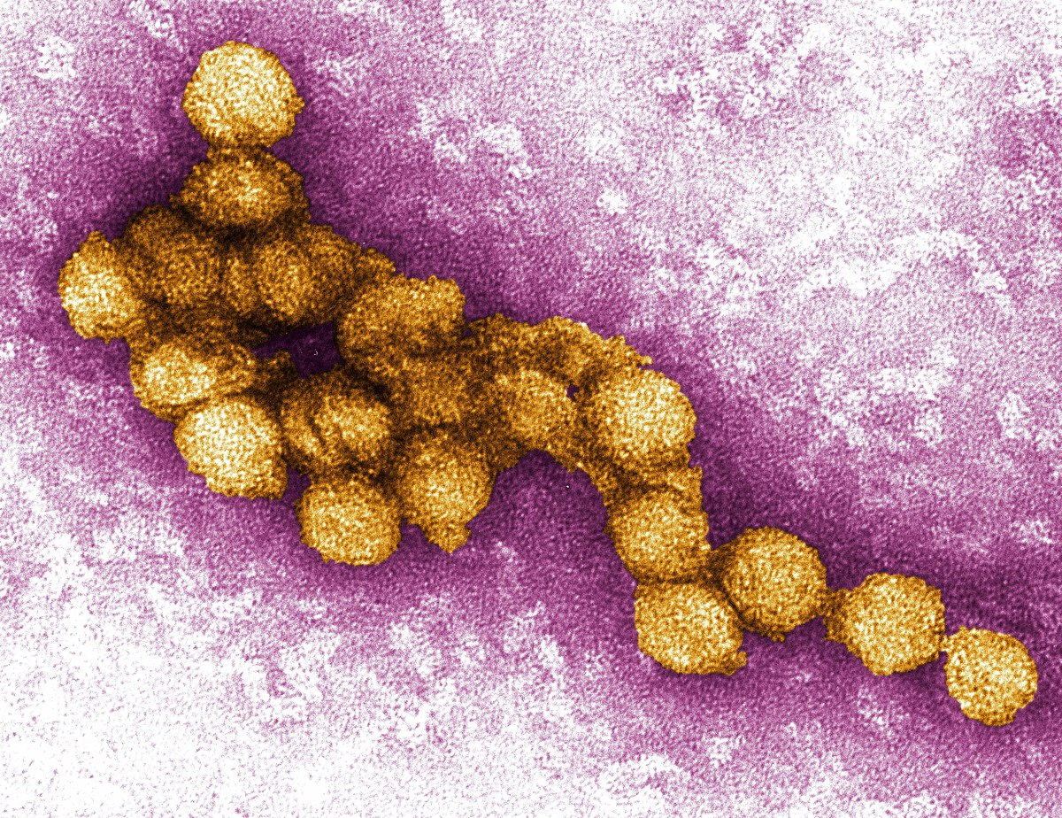
West Nile Virus
West Nile Virus is native to Africa.
Is the leading cause of mosquito-borne disease in the continental U.S. It is most commonly spread to people by the bite of an infected mosquito. Cases of WNV occur during mosquito season, which starts in the summer and continues through fall. There are no vaccines to prevent or medications to treat WNV in people.
Image from https://en.wikipedia.org/wiki/West_Nile_virus.
Notes:
https://en.wikipedia.org/wiki/West_Nile_virus
https://www.cdc.gov/westnile/

Slide 9
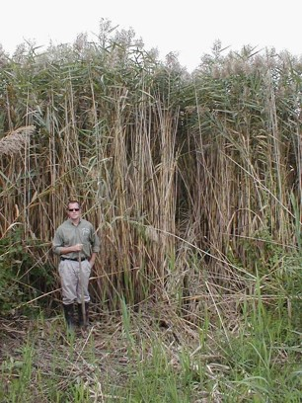
Invasive Phragmites
Native to Europe
Dense monocultural stands eliminate habitat for wildlife species altering ecological function of wetlands.
Image from DUC.
Notes:
Invasive Species Council of Manitoba: http://invasivespeciesmanitoba.com/site/index.php?page=common-reed-phragmites

Slide 10
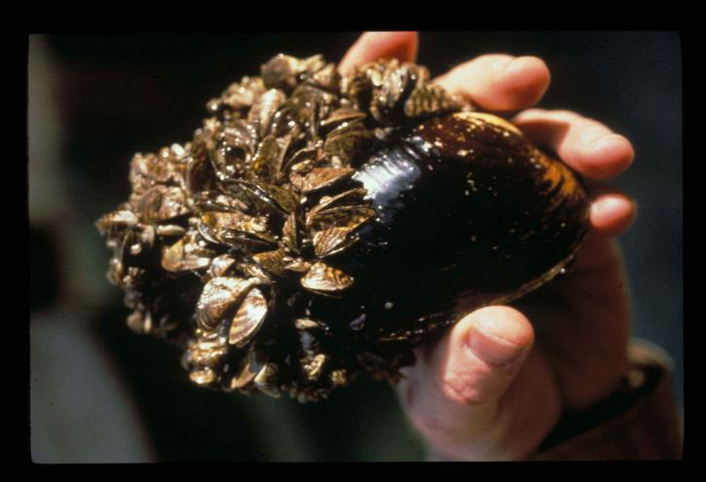
Zebra Mussels
Native to the Black and Caspian Sea region of Eurasia.
Zebra Mussels are notorious for colonizing and constricting flow through water supply pipes of power plants and industrial facilities.
They can also have profound effects on the ecosystems they invade through reducing the amount of food available to other species.
Image from Bing Images – public domain.
Notes:
Invasive Species Council of Manitoba: http://invasivespeciesmanitoba.com/site/index.php?page=zebra-mussels

Slide 11
Invasive Species project
You will be researching one of the wetland invasive species just discussed. You must answer the following questions:
Where is the species native to?
When and how was it introduced?
What are its effects on wetlands and their inhabitants?
What are its effects on the economy?
What are its effects on society?
What are possible control or eradication measures?
How does science play a role?
How does technology play a role?
Which solution would you select and why?
Notes:
Individually or in groups, students will be researching and presenting a wetland invasive species. Students will need to answer these questions..

Slide 12
Thank You!

