Slide 1
Common Carp at Delta Marsh
What ducks unlimited Canada did
Notes:
Today we will be learning about the solution Ducks Unlimited Canada came up with.

Slide 2
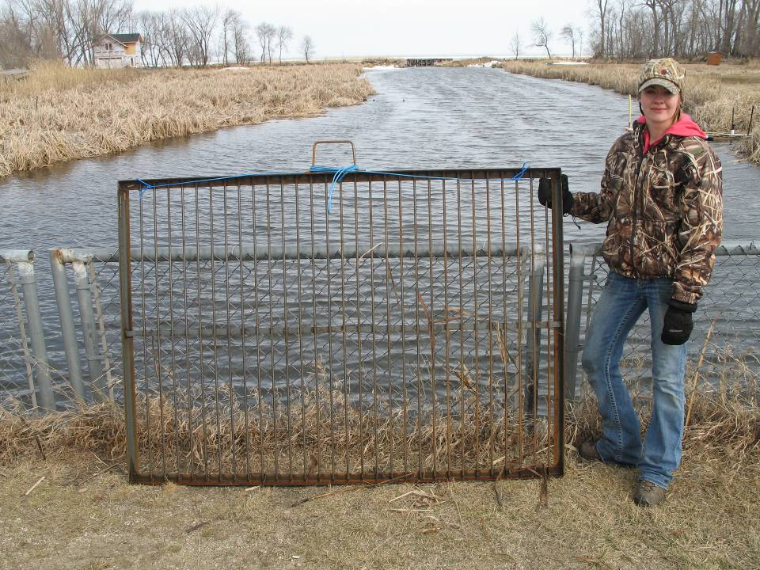
What did Ducks Unlimited Canada (DUC) do?
They elected to put screens over the inflows into the marsh to try and keep carp out
Image from DUC
Notes:
Image is an example of the screen
Source:
Ducks Unlimited Canada. Unpublished data.
Options for reducing the number of Carp in a large wetland such as Delta Marsh are limited, especially for a coastal wetland connected to a much larger water body such as Lake Manitoba. In such situations where fish migrate seasonally to access wetland habitat, exclusion screens placed at marsh entry points are a viable management option. This was the control measure considered best for Delta Marsh. A working example of this approach is Cootes Paradise Marsh, a 250 ha coastal wetland adjoining Lake Ontario. Permanent 50 mm vertical bar screens are used on the single channel connecting the marsh to the lake (Theysmeyer 2001). Large fish unable to pass through the screens are captured, hand sorted, and native fish are released into the marsh while Carp are released back on the lake side of the structure. Hand sorting of large fish is a costly option that is not practical for a wetland as Delta Marsh, with multiple entry channels.
The goal of Carp exclusion at Delta Marsh was the exclusion of large Carp; as large Carp at high densities have been reported to be most destructive to shallow water ecosystems (Crivelli 1983, Driver et al. 2005, Kloskowski 2011). Many of the fish species that use Delta Marsh are small (Table 1.1) and would be able access the marsh through any screen opening size targeted at the exclusion of large Carp. However, large individuals of some species, such as White Sucker, Northern Pike and Walleye may be unable to access the marsh while exclusion screens are in place. To minimize the possible negative impacts on these species, screen opening size must be a compromise between preventing the largest, most destructive Carp from entering the marsh while allowing as many large native fish access to the marsh as possible. It is recognized that it will not be possible to keep all Carp out of the marsh, not even all large Carp, but by significantly reducing their numbers we hypothesized that there should be an improvement in marsh conditions, specifically increased water clarity and submersed aquatic vegetation.
Exclusion screens are only needed when Carp are actively trying to access the marsh in the spring and early summer. The timing of exclusion screen placement in relation to the timing of species-specific fish migration into the marsh can be used to advantage. Lapointe (1986) found the earliest arriving mature females at Cram Creek were White Sucker, Northern Pike and Yellow Perch (Table 2.1). Mature female Carp arrived almost three weeks after the first native fish was captured. Carp congregate in deeper waters to overwinter, and then move into shallow vegetated habitats during the spring and summer to spawn when water temperatures warm (e.g., Swee and McCrimmon 1966, Penne and Pierce 2008, Bajer and Sorensen 2010). At Delta Marsh, rather than permanent structures, exclusion screens only need to be in place seasonally. The rest of the year they would not be needed, allowing all fish unimpeded movement between the marsh and the lake. A combination of appropriate screen opening size and screen placement timing was thought to be sufficient to significantly reduce the abundance of large Carp at Delta Marsh.

Slide 3
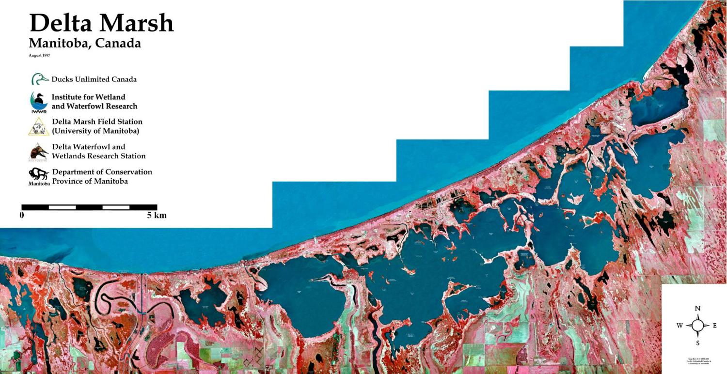
Delta Marsh, Manitoba
sheet pile weirs (Deep, Cram, Crooked & Waterhen Creeks)
Robertson
Creek
screens over existing culverts (Delta Channel, Fish Creek)
dyke and culvert (Robertson Creek)
Crooked
Creek
Waterhen
Creek
Deep
Creek
Cram
Creek
Fish
Creek
Delta
Channel

Slide 4
 | Screen Size (mm)
Species | 50 | 60 | 70 | 80
Yellow Perch | 99% | 100% | 100% | 100%
Northern Pike | 88% | 96% | 98% | 100%
Freshwater Drum | 32% | 72% | 96% | 99%
Quillback Sucker | 5% | 29% | 66% | 88%
White Sucker | 1% | 25% | 77% | 98%
Walleye | 8% | 8% | 27% | 62%
Common Carp | 2% | 3% | 5% | 18%
They tested to see which size screen would keep out the most carp but let other species in.
Selected 70mm
Put screens in 25 days after ice is off inlets
Remove screens September 1st each year.
Image from DUC

Slide 5
DUC built screens during the winter

Slide 6
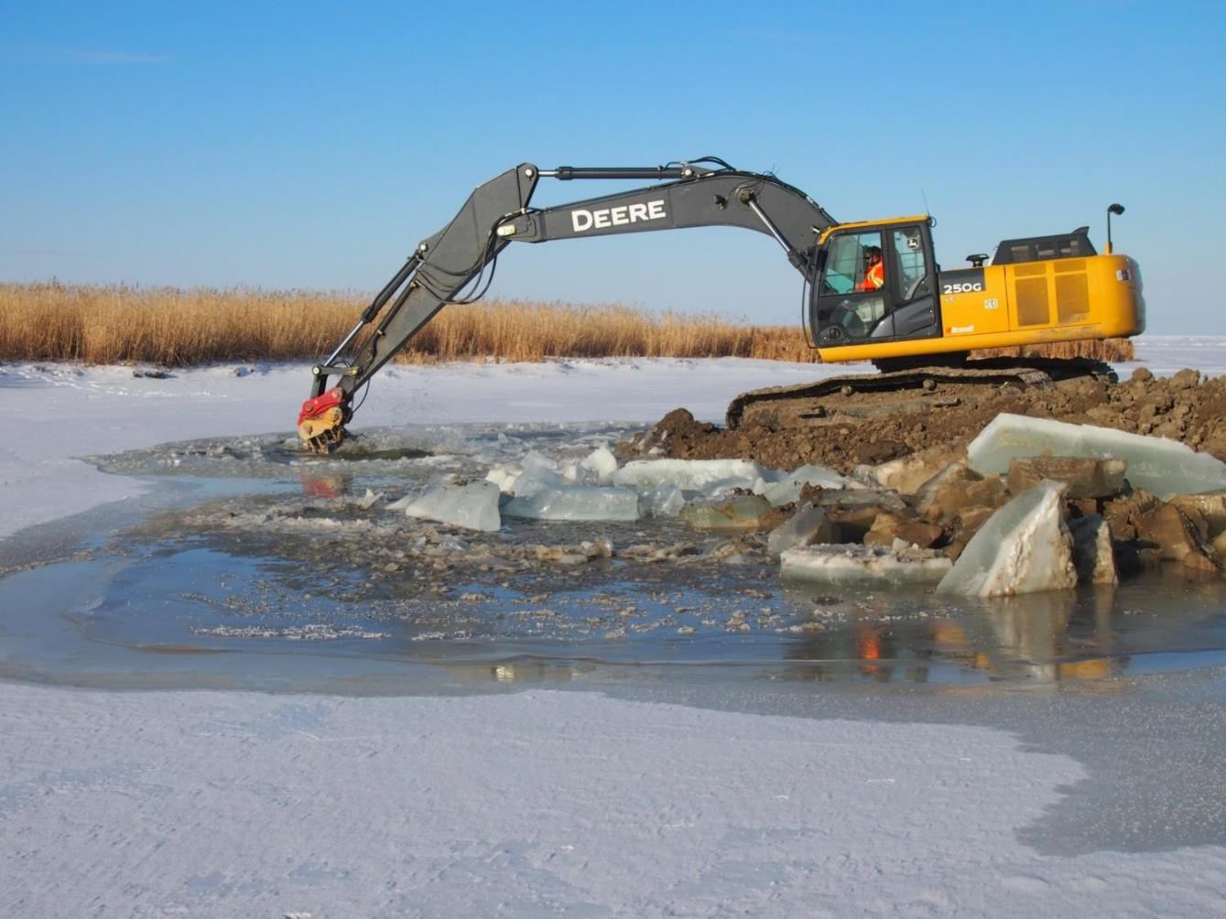
Cram Creek coffer dam construction – 10 December 2012
Image from DUC
Notes:
In some places they had to put in the culverts or weirs so that screens could then be installed.

Slide 7
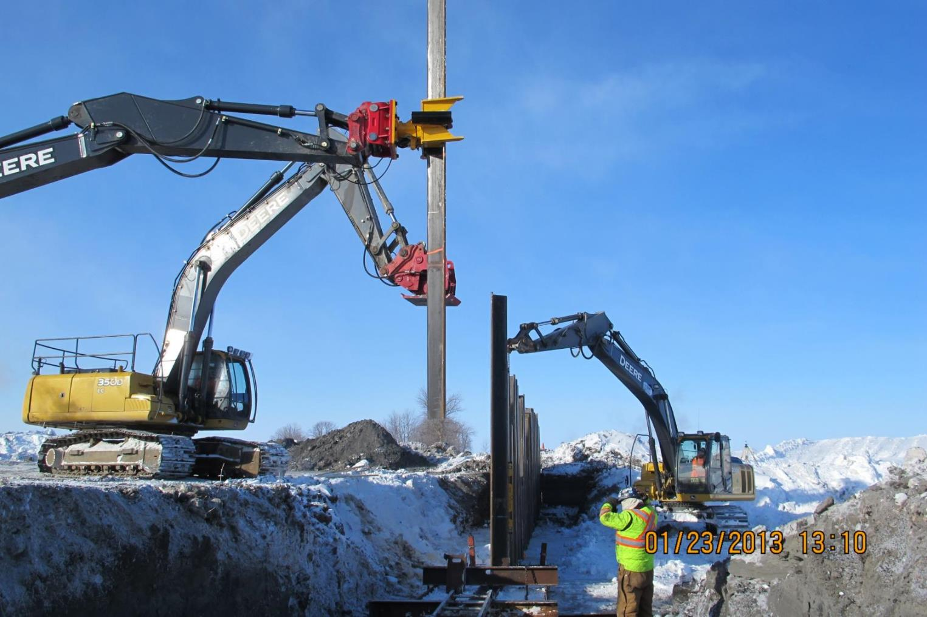
Cram Creek construction 23 January 2013
Image from DUC
Notes:
Construction photo

Slide 8
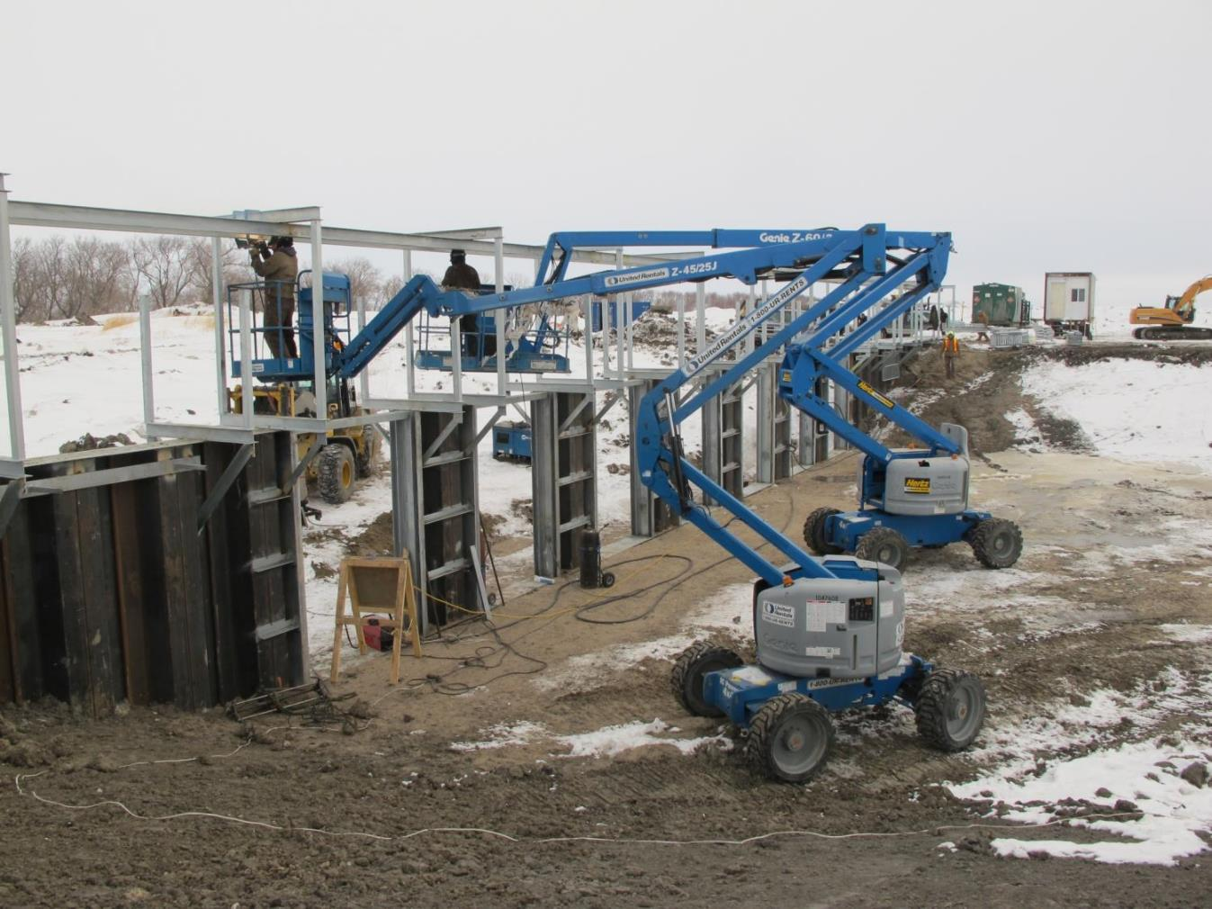
Cram Creek construction 11 March 2013
Image from DUC
Notes:
Construction photo

Slide 9
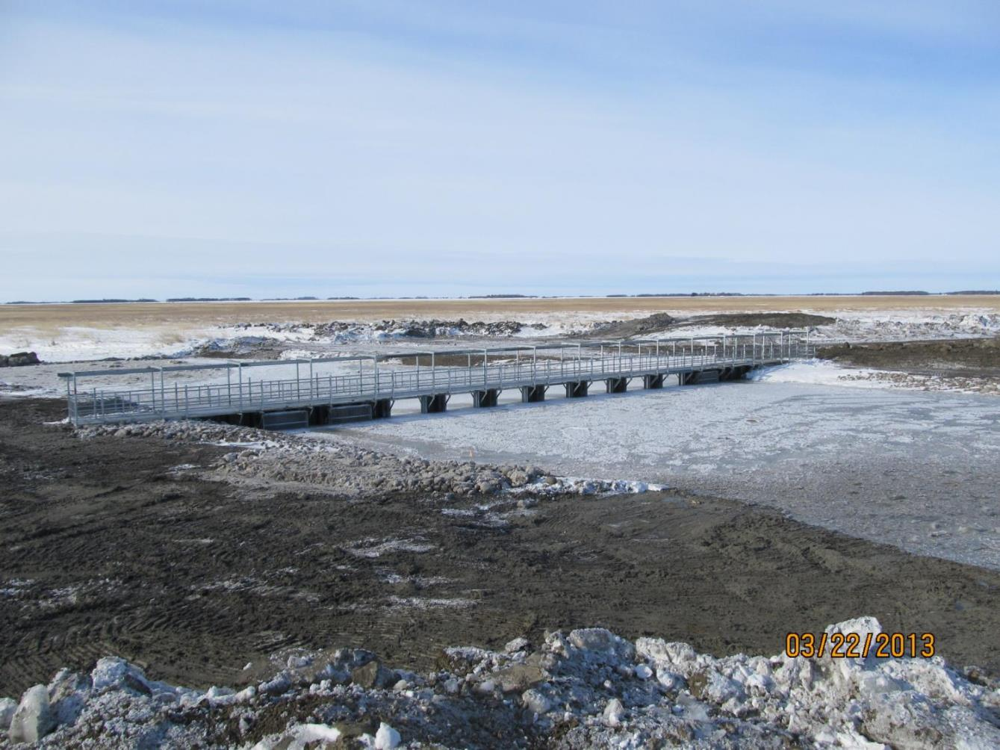
Cram Creek completed - 22 March 2013
Image from DUC
Notes:
Completed weir

Slide 10
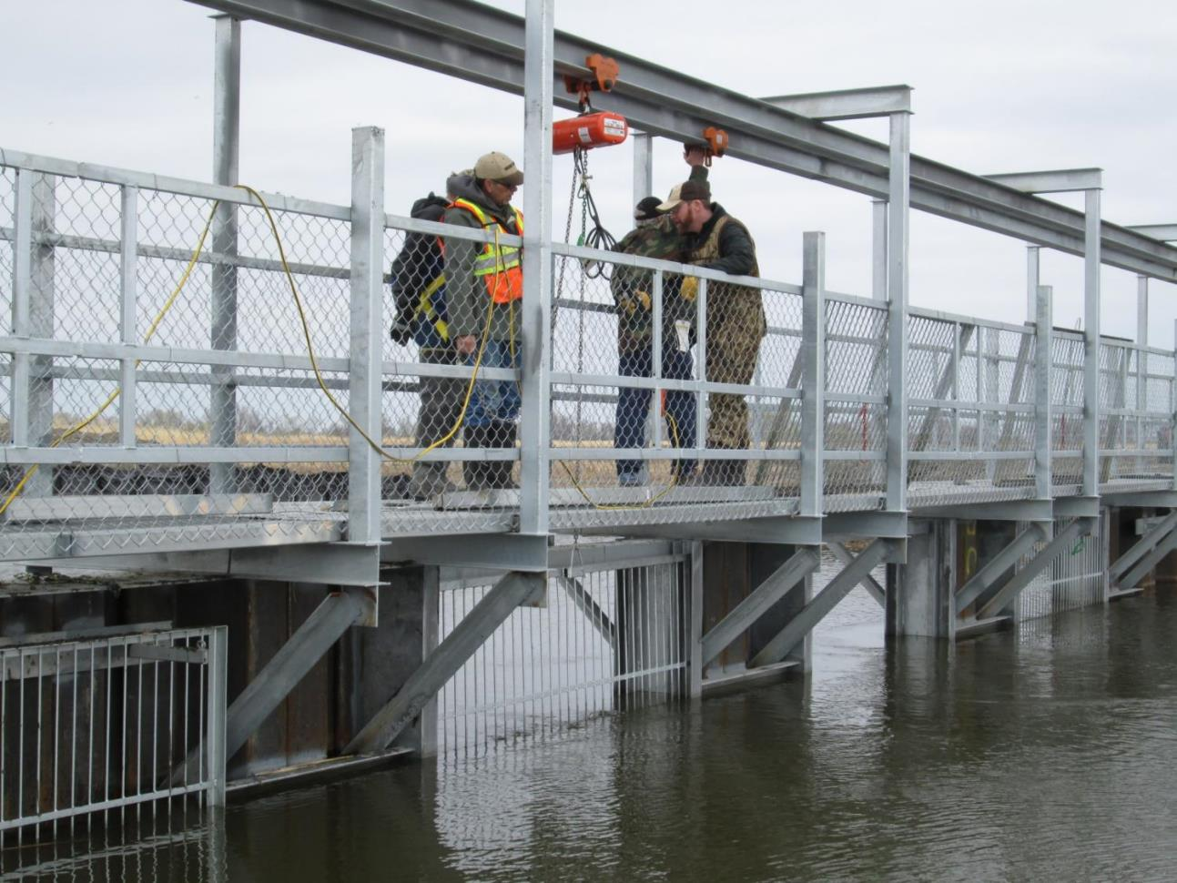
Crooked Creek – 27 May 2013
Image from DUC
Notes:
Completed weir

Slide 11
Results

Slide 12
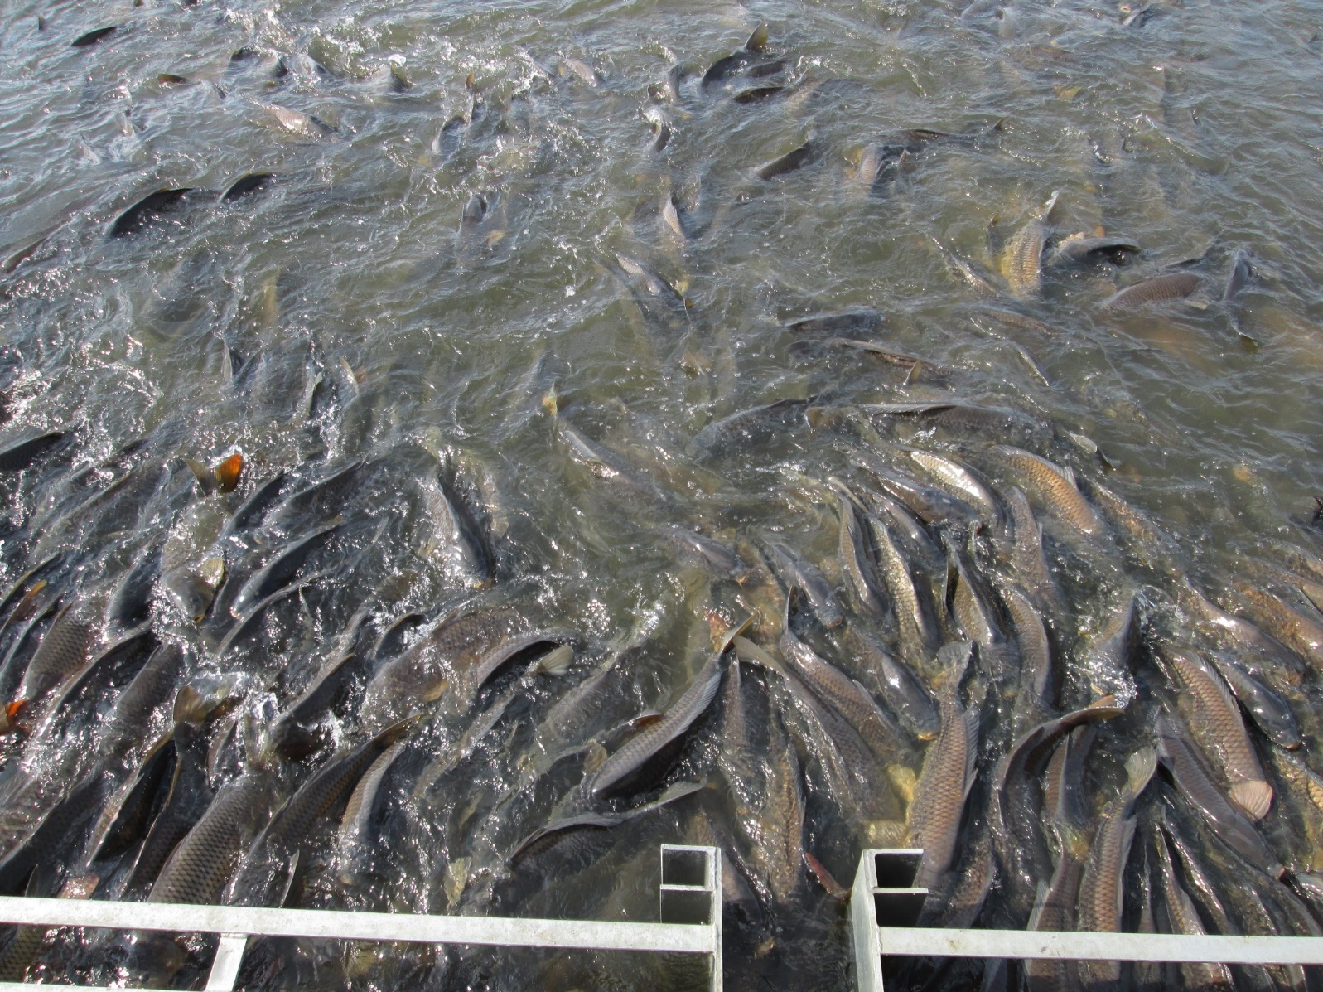
Common Carp being kept out
Image from DUC

Slide 13
Notes:
Short video to show carp being excluded (YouTube video: https://www.youtube.com/watch?v=Spy0XSwcfXA)
Pod Cast of Ducks Unlimited Inc.:
Episode 2: https://www.youtube.com/watch?v=sWmgfA87lz4 (focus is on carp project)

Slide 14
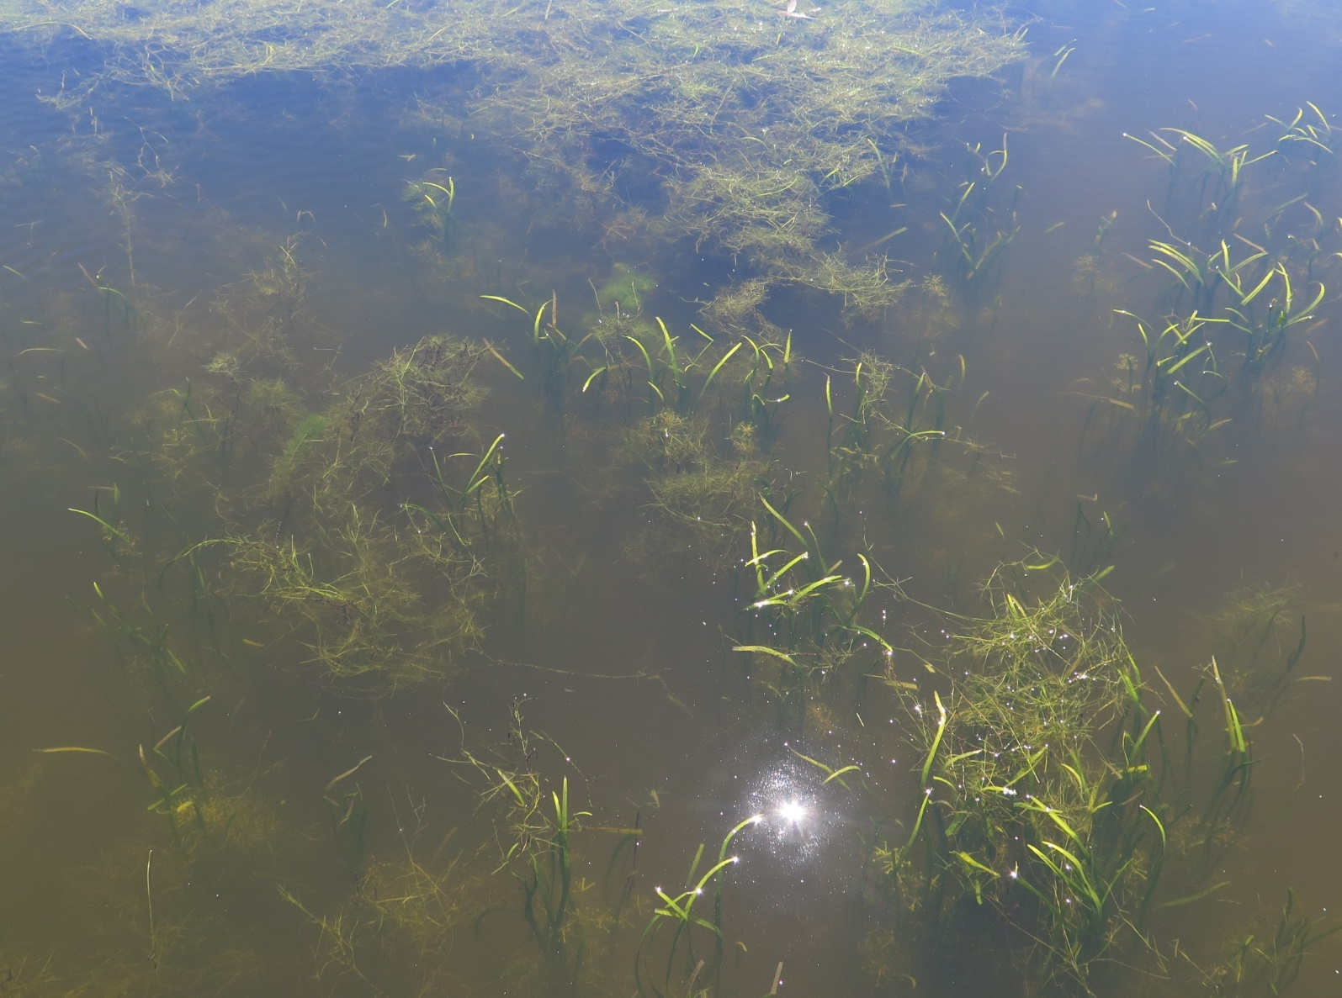
Submersed vegetation coming back
Image from DUC
Notes:
Sampled plants living in the water before the screens went in and carp were kept out and then again after the screens were in place.

Slide 15
Carp
exclusion
*Note: Areas calculated only in east marsh unit within survey transects (excluding Clandeboye Bay)
Notes:
-Vegetation loss in mapped years since 1974
-Sharp gain in recent years (2009-2014 [2x], 2016-2017 [1.5x]

Slide 16
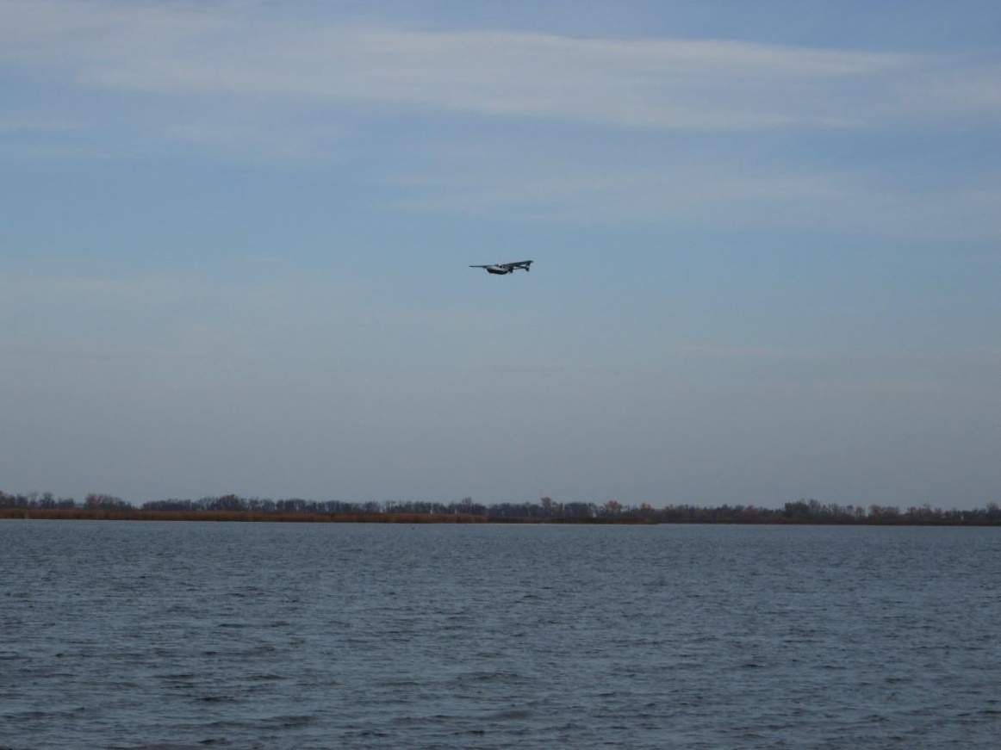
Waterfowl coming back
Image from DUC
Notes:
Did waterfowl surveys (from planes) before the screens went in and carp were kept out and then again after the screens were in place.

Slide 17
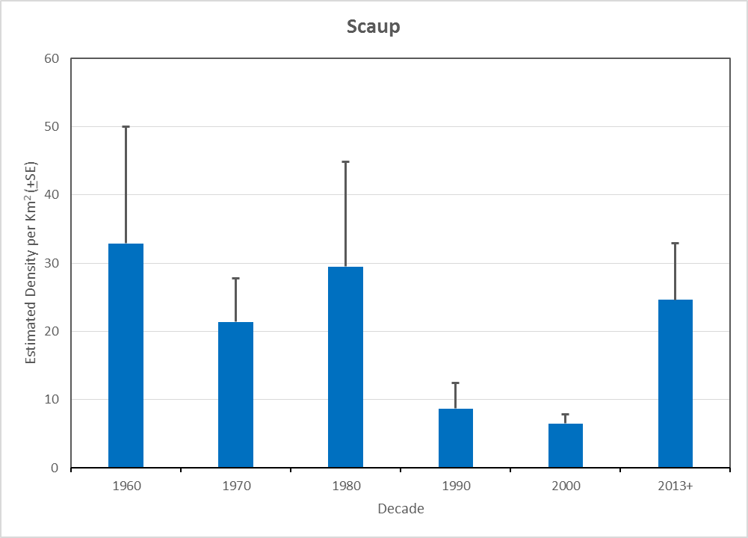
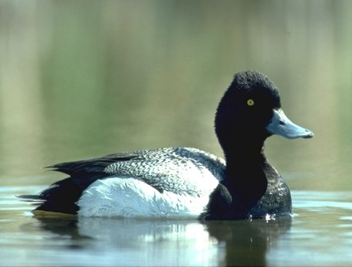
A
A
A
A
AB
B
No statistical differences among decades with the same letters.
Notes:
Common carp were introduced into Delta Marsh in the late 1950s. The effects on vegetation were being seen by the 1970s and then it took a few more years before waterfowl numbers started to be affected. By the 1990’s duck numbers had dropped substantially. When the screens went in in 2013 and the carp was excluded the vegetation came back quickly and the response of waterfowl was almost immediate.

Slide 18
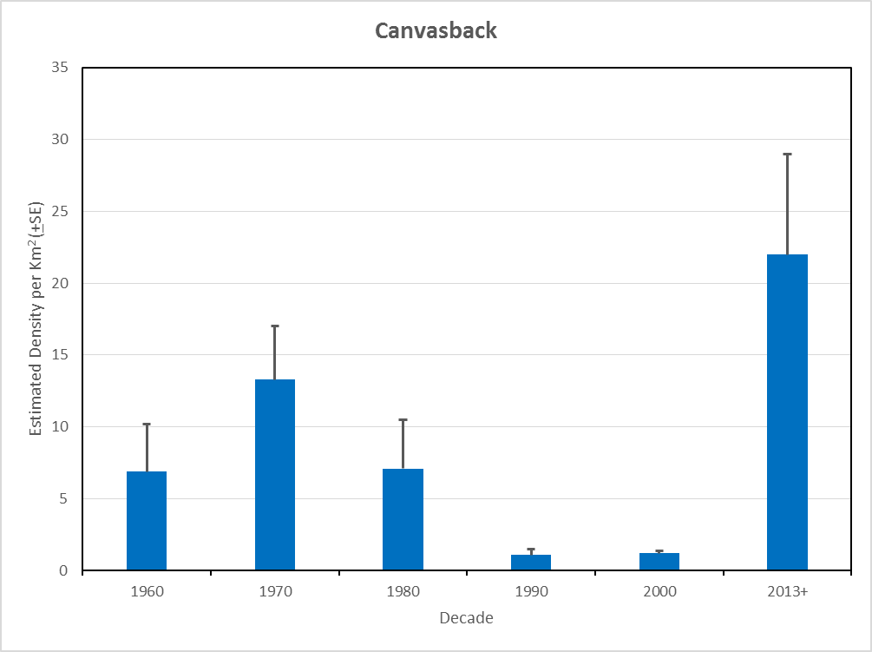
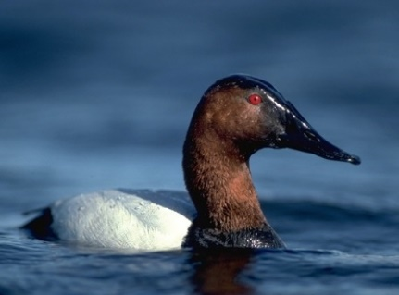
A
A
A
A
B
B
No statistical differences among decades with the same letters.

Slide 19
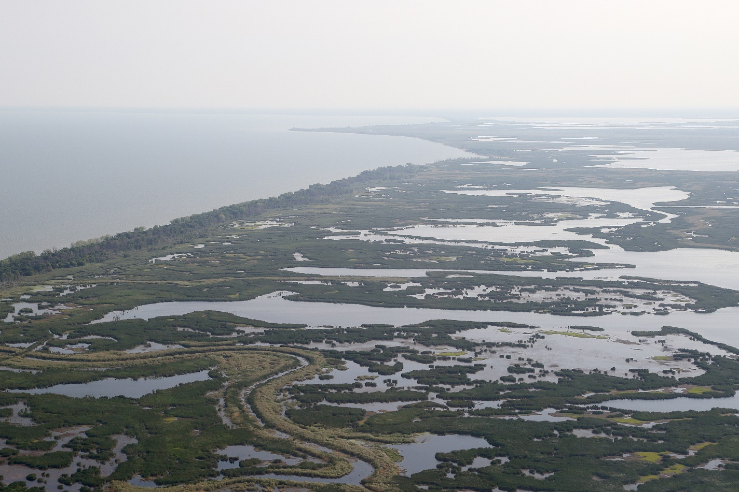
Was successful!
Excluded carp
Allowed other fish to enter marsh
Water is clearer
Submersed vegetation came back
Waterfowl came back
Image from DUC

Slide 20
Thank You!

