Slide 1
Common Carp Trivia!
Learning about wetlands & Carp
Notes:
Today we will be learning about wetlands, invasive species and their effects through a trivia game.

Slide 2
Round 1 Wetlands
Notes:
Image from DUC.
Resources
Hinterland Who’s Who (HWW): https://www.hww.ca/en/wild-spaces/wetlands.html
Ducks Unlimited Canada: https://www.ducks.ca/our-work/wetlands/
Ducks Unlimited Canada: https://www.ducks.ca/assets/2014/12/field-guide-low-res.pdf
Canadian Wetland Classification (CWC): https://www.gret-perg.ulaval.ca/fileadmin/fichiers/fichiersGRET/pdf/Doc_generale/Wetlands.pdf

Slide 3
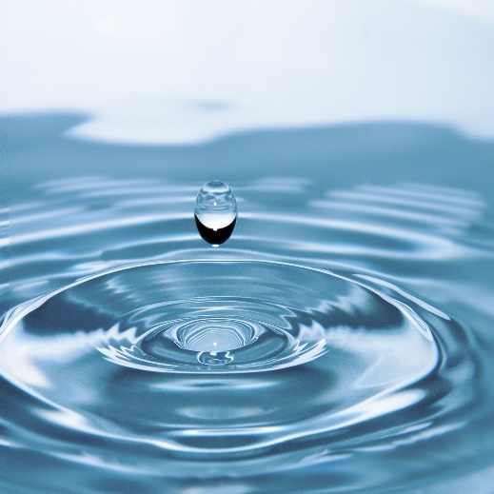
Question #1
What two things make up a wetland?
water & sun
water & plants
water & animals
water & land
Image from https://www.pexels.com/photo/water-drop-40784/
Notes:
Source:
CWC:
What is a Wetland? A wetland is defined as: land that is saturated with water long enough to promote wetland or aquatic processes as indicated by poorly drained soils, hydrophytic vegetation and various kinds of biological activity which are adapted to a wet environment (National Wetlands Working Group 1988)
OR
HWW
A wetland is simply any area of land that is covered with water for a part of the day or year.
A wetland is an area of land that is permanently or periodically saturated with water. The water is 2 metres deep or less, allowing the water-loving plants to get enough sunlight to grow.

Slide 4
Question #2
What is the maximum depth a wetland can be?
0.5 m
1 m
2 m
2.5 m
Image from https://www.flinnsci.com/meter-sticks-hardwood-englishmetric/
Notes:
Source:
CWC
Mineral wetlands are found in mineral soil areas associated with shallow water, which is generally less than 2 m deep.

Slide 5
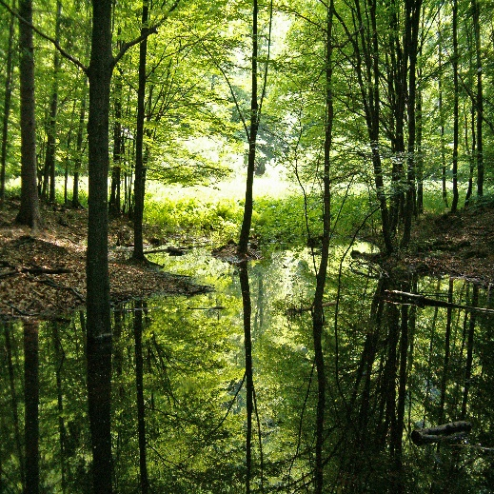
Question #3
Bogs, fens, marshes and swamps are types of _________.
ponds
wetlands
lakes
plants
Image from DUC.
Notes:
Source:
HWW
A marsh is subject to periodic flooding, particularly if located near a river or lake, or in the case of saltwater marshes, near tidal waters. Consequently, its water level can change drastically. Its boundaries are not as well defined as those of a pond, and a marsh may dry out completely by late summer. A marsh is overgrown with coarse grasses, sedges, and rushes.
The water-filled potholes and sloughs of the prairies may resemble ponds or marshes, depending on their characteristics and specific locations.
A swamp is essentially a wooded marsh, a waterlogged area supporting trees, tall shrubs, herbs, and mosses. Still or gently flowing water covers much of the surface during wetter seasons.
A peatbog is a poorly drained area covered by mats of moss. The moss slowly decomposes in successive layers to eventually form a material called peat. There are two types of peatbogs: bogs and fens. In bogs, the process of decomposition and peat formation is further advanced than in fens, making the soil and water more acidic. The most common moss found on the surface of a bog is sphagnum moss. Other bog plants are sedges and low-growing shrubs of the heath family and sometimes trees such as spruce.
In fens, sedges are the predominant vegetation and sphagnum moss is not common, although other mosses that require less acidic conditions may grow there. Fens also support reeds, grasses, and low-to-medium-height shrubs. Occasionally, too, there may be a sparse scattering of trees—tamarack or cedar. In northern Canada, a large expanse of bog or fen is called muskeg.

Slide 6
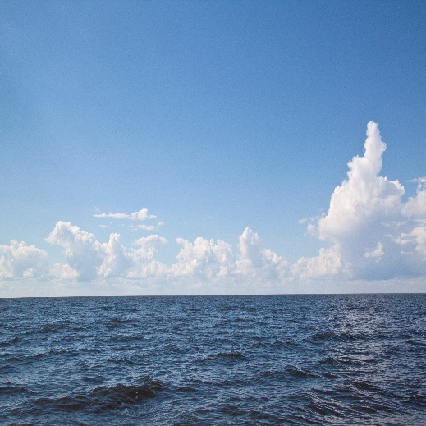
Question #4
True or False.
A lake is a type of wetland.
Image from DUC.
Notes:
Water is too deep.

Slide 7
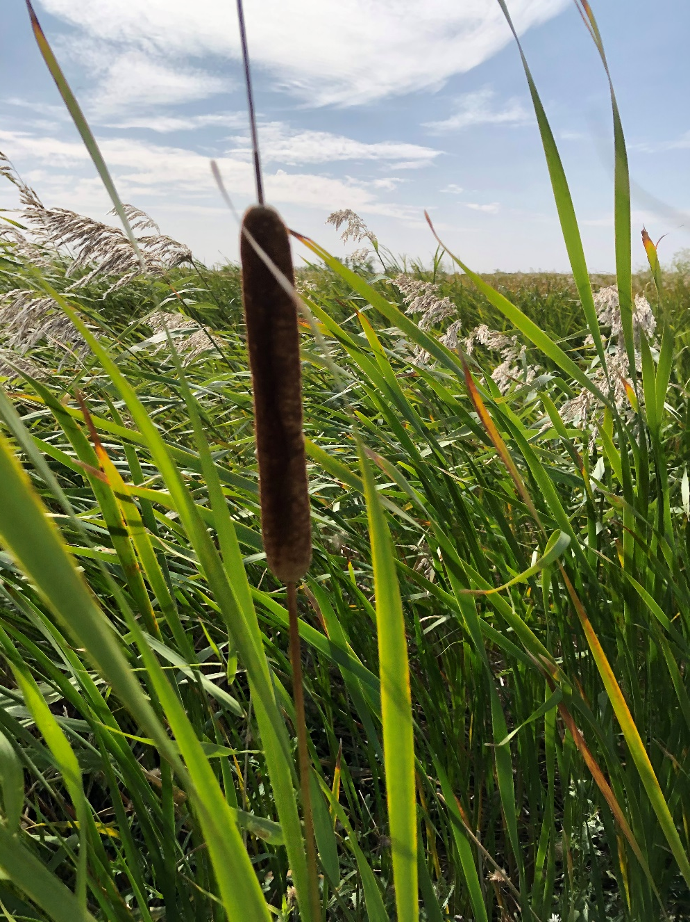
Question #5
Name this plant.
cattail
willow
bulrush
grass
Image from DUC.
Notes:
NEED TO INSERT PART OF NATURE NOTE HERE
Cattails are common plants throughout marshes and are often confused with bulrushes. The identifying feature of these plants is a dense brown cylindrical spike, which is three to six inches long and about an inch in diameter (looks like a hotdog on a stick). In the month of July, a pale green spike occurs on top of the brown hotdog shape (which is the seeds). This green spike is made up of male flowers. Leaves are a light olive green, parallel-veined, 10 to 20 inches in length and merge with the stem at the base of the plant. The height of these plants can reach about three to four feet tall. (In comparison, bulrushes are roughly the same height (much thinner stem), have cylindrical leaves, and are dark green in colour with seed pouches hanging of the top of the leaf (looks like a tassel). Often compared to a green onion. The bulrush is a member of the sedge family). Cattails are a favourite food of the muskrat and used in building its lodge (home).
The tender whitish leaf base of cattails has been collected in spring as a fresh vegetable. Rhizomes (a thickened, usually horizontal underground stem or branch of a plant that stores food, producing roots below and leafy shoots above, and that differs from a root in having buds and scaly leaves) were also gathered in spring, peeled and eaten raw or roasted or ground into meal for porridge. The young flowering spikes are also edible. Male flowers (at the top of the spike, above the ‘hot dog’ portion) produce large quantities of pollen, which can be mixed with equal parts of flour for muffins, biscuits, etc. The green female flowers (at bottom of spike, the ‘hot dog’ portion) can be boiled or roasted and eaten like corn on the cob. They are said to taste like olives, globe artichokes or sweet corn. In more southern areas, care must be taken not to confuse cattail leaves with those of poisonous irises.

Slide 8
Question #6
Canada has __% of the world’s wetlands.
5
15
25
35
Image from https://www.goodfreephotos.com/canada/nova-scotia/other-nova-scotia/satellite-image-of-nova-scotia.jpg.php.
Notes:
Source:
https://www.canada.ca/en/environment-climate-change/services/environmental-indicators/extent-wetlands.html
Canada has about 1.29 million km² of wetlands, covering 13% of Canada's terrestrial^{Footnote [1]} area. This is close to one quarter of the world's remaining wetlands.^{Footnote [2]} Where wetlands have been monitored, they generally show declines in extent due to conversion to agriculture and other development.^{Footnote [3]}
Most of Canada's wetlands occur in the Boreal Shield (25% of Canadian wetland area), Hudson Plains (21%) and Boreal Plains (18%). Wetlands form almost 80% of the Hudson Plains, and very low proportions of mountainous regions such as the Arctic Cordillera (less than 0.5%) and Montane Cordillera (less than 2%).

Slide 9
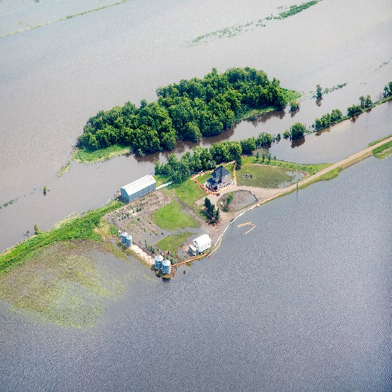
Question #7
Why are wetlands important?
filter water
place for food
prevent floods
prevent erosion
all of the above
Image from DUC.
Notes:
Source:
HWW
What good are wetlands?
It’s easy to regard wetlands as mere wastelands, of little or no value. We don’t build houses or factories in swamps, bogs, or marshes, and we don’t plant wheat or many other crops on land submerged in water. Wetlands are generally unsuitable for boating and swimming—in fact, for most human activities.
So it’s not surprising that many people "reclaim" our wetlands, by draining them or filling them in. To do so is a serious mistake.
Wetlands act like giant sponges, soaking up rain and snowmelt and slowly releasing water in drier seasons. Thus, they help to reduce floods and to ease the worst effects of drought. Draining ponds, sloughs, and marshes often lowers the water table and dries up wells. Wetlands also reduce soil erosion by checking or slowing the runoff from storms and thaws.
Without wetlands we would no longer have a ready supply of fresh drinking water. Much like our kidneys, wetlands filter the waters of our lakes, rivers, and streams, reducing pollution. The vegetation in wetlands removes phosphates and other plant nutrients washed in from the surrounding soil, thereby slowing the growth of algae and aquatic weeds. This growth is a serious problem in some of Canada’s major waterways where dead and decaying algae rob the deeper waters of their oxygen.
Wetlands are also the homes for at least some part of the year for many fish, birds, and other animals, meeting essential breeding, nesting, nursery, and feeding needs. Without wetlands, some wildlife species would disappear.
Wetlands contribute to the growth and economy of the country. Some of the smaller mammals, such as the beaver and muskrat, that dwell in wetlands are important to the fur trade, and the millions of game birds and fish reared in and around our wetlands support a growing recreation and tourist industry.

Slide 10
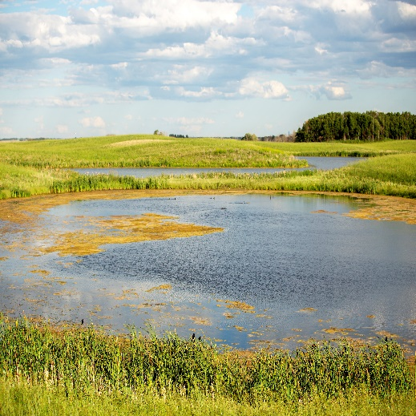
Question #8
True or False.
A pond is a type of wetland.
Image from DUC.
Notes:
Source:
HWW
A pond is a well-defined basin, filled with stagnant water and fringed with vegetation. It is fed mainly by rain and snowmelt and loses water through seepage, direct evaporation, and plant transpiration. During the summer, parts of a pond may dry out, exposing mudflats. The shallow depth of a pond allows water lilies and other bottom-rooted plants to reach the surface, while milfoils, pondweeds, and other submergent plants flourish beneath.

Slide 11
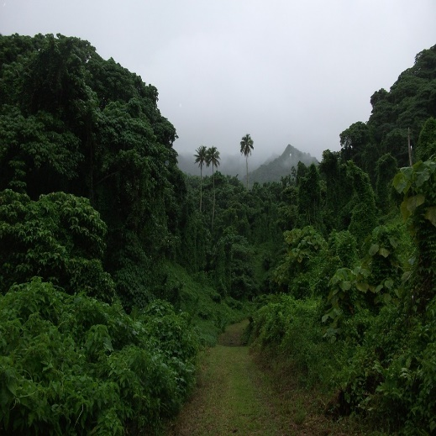
Question #9
The biodiversity of a wetland is ____ to that of the rainforest.
second
third
fourth
fifth
Image from https://www.goodfreephotos.com/public-domain-images/fog-and-forest-of-indonesia.jpg.php.
Notes:
Source:
https://en.wikipedia.org/wiki/Wetland
It is usually thought of as second so sources put it equal to rainforests.

Slide 12
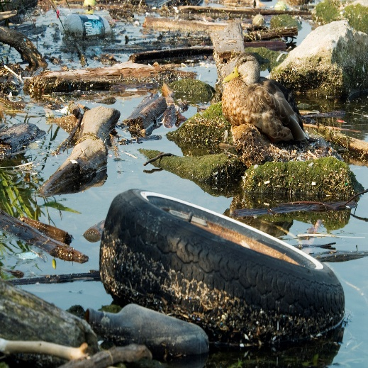
Question #10
Which of the following are threats to wetlands?
pollution
development
drainage
invasive species
none of the above
all of the above
Image from DUC.
Notes:
Source:
HWW
A threatened resource
The natural, reversible changes in wetlands may be almost insignificant compared with the disruption caused by human interference. Dredging a pond can make it unsuitable for birds that require shallow water. Draining or filling in wetlands permanently destroys entire communities of plants and wildlife. Burning off or cutting down surrounding weeds, brush, or other vegetation eliminates, at least temporarily, vital nesting places and escape cover. Building a highway through a coastal marsh or erecting a small dock at the marshy edge of a lake where you moor your rowboat is also damaging.
Air and water pollution are serious problems. Insecticides, weed killers, and industrial wastes take a heavy toll on plants, fish, and other wildlife.

Slide 13
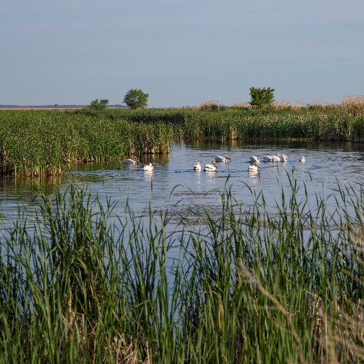
Answers – Round 1
d) water & land
c) 2 m
b) wetlands
false
a) cattail
c) 25%
e) all of the above
true
a) second
f) all of the above
Image from DUC.

Slide 14
Round 2 Invasive Species & Common Carp
Notes:
Image from DUC.
Resources
Invasive Species Council of Manitoba: http://invasivespeciesmanitoba.com/site/
Invasive Species in Manitoba: River, Lake and Wetland Invaders; a pocket field guide by the Invasive Species Council of Manitoba
www.invasivespeciesinfo.gov: https://www.invasivespeciesinfo.gov/what-are-invasive-species
https://www.invasivespeciescentre.ca/learn/

Slide 15
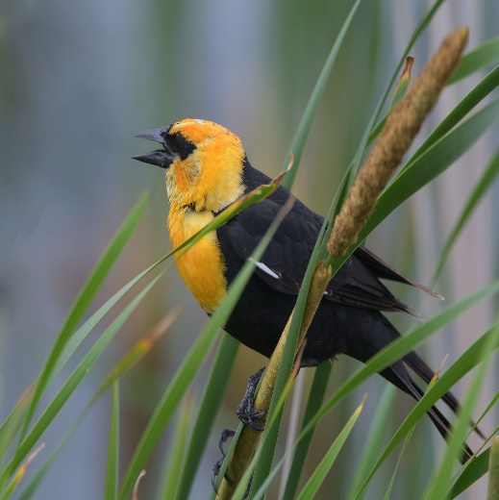
Question #1
A species indigenous to a given region or ecosystem is called:
native
introduced
natural
accidental
Image from Harry J. Enns Wetland Discovery Centre.
Notes:
Image is a Yellow-headed Blackbird.
Source:
https://lakes.grace.edu/native-non-native-invasive-species/
Native: a species that originated and developed in its surrounding habitat and has adapted to living in that particular environment.

Slide 16
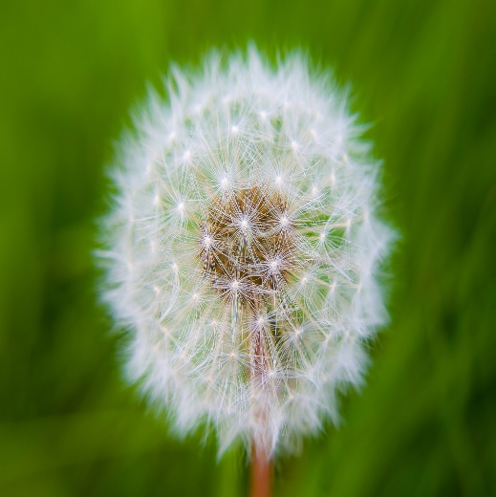
Question #2
A species that is not native to an area is called:
non-native
extraordinary
introduced
endemic
a & c
Image from Bing Images – public domain.
Notes:
Image is a Dandelion.
Source:
https://lakes.grace.edu/native-non-native-invasive-species/
Non-native: a species that originated somewhere other than its current location and has been introduced to the area where it now lives (also called exotic species).

Slide 17
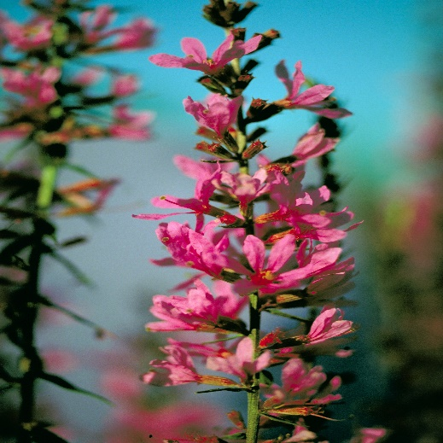
Question #3
A species that is not native to an area and does harm is called:
native
invasive
natural
symbiotic
Image from DUC.
Notes:
Image is Purple Loosestrife.
Source:
https://lakes.grace.edu/native-non-native-invasive-species/
Invasive: a species of plant or animal that outcompetes other species causing damage to an ecosystem – this can be a native (rarely) or non-native (exotic) species.

Slide 18
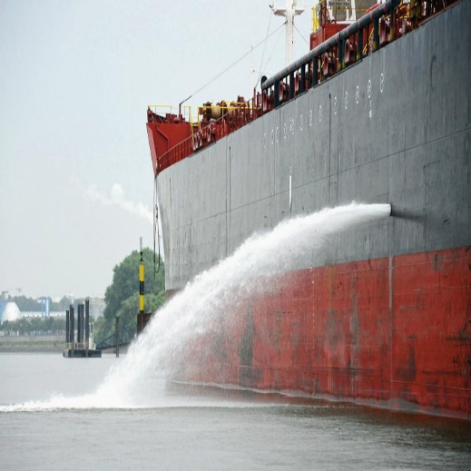
Question #4
The primary cause of invasive species introduction is:
too much food
human activities
migration
weather events
Image from Bing Images – public domain.
Notes:
Source:
http://invasivespeciesmanitoba.com/site/index.php?page=how-do-they-spread
How do invasive plants or animals spread into Manitoba?
Increased global trade and travel have created many new pathways for the international and incidental spread of invasive aquatic species. The growing trade in aquatic ornamental plants for water gardening and aquariums is also cause for concern. Many of the currently known invasive exotic plant species in North America have been imported and planted as ornamentals.
Dispersal: Humans are most often directly responsible for introducing a species to a new region, whether intentionally or unintentionally.
Hitchhikers: Species can become unintentionally transported globally, by catching a ride in places like ship ballast water, or locally, by attaching to boats or other equipment used by anglers and hunters.
Imported: Intentionally imported species are not usually intended for widespread distribution into the environment. However, plants, brought in for gardeners as ornamentals, or exotic pets can become invasive pests in regions where they were never intended to be released.
Illegal Trade: Illegal smuggling/trading of fruits and vegetables across borders can introduce not only potentially harmful new plant species but also any insects and parasites that may live in them.
Natural Dispersal: Through time, species are able to expand ranges naturally, establishing in areas they previously did not exist in.

Slide 19
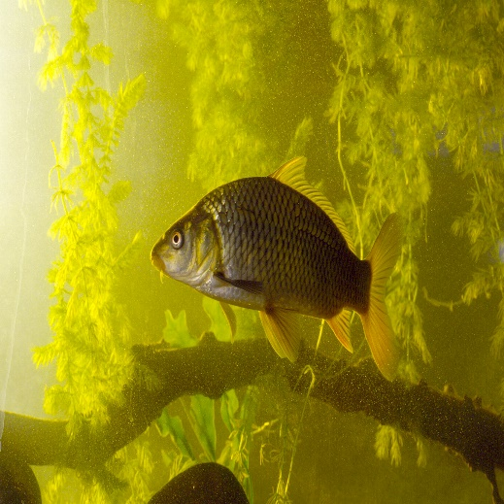
Question #5
This invasive species stir up the bottom of a wetland.
zebra mussels
common carp
spiny waterflea
rusty crayfish
Image from DUC
Notes:
Source:
http://invasivespeciesmanitoba.com/site/index.php?page=common-carp
History
Common Carp is native from Asia and parts of Europe. It was introduced to North America as a food and ornamental fish into freshwaters throughout the world. It was first introduced to Manitoba in 1886, by 1954 they were a nuisance to commercial fishers.
Threat
Carp are constantly stirring up the substrate when they feed, meaning that they can greatly decrease the clarity of the water. This makes waterways unattractive, destroys habitat, reduces the abundance of aquatic plants, and can make the water unsuitable for swimming or drinking. They also release phosphorus normally locked up in bottom sediments and aquatic fauna, and lower the abundance of insects by predation and loss of habitat.

Slide 20
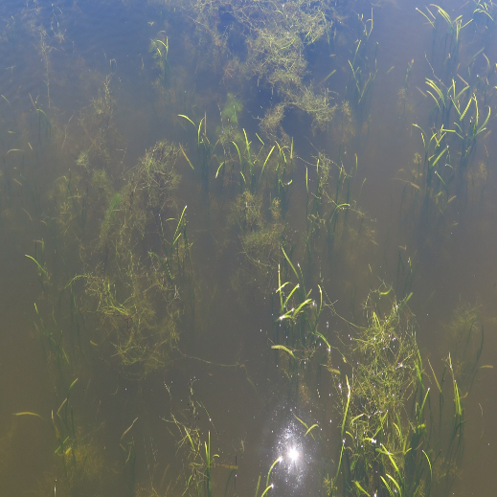
Question #6
Common carp are _______.
carnivores
herbivores
omnivores
Image from DUC.
Notes:
Source:
https://www.iowadnr.gov/idnr/Fishing/Iowa-Fish-Species/Fish-Details/SpeciesCode/CAP
Carp are omnivorous feeders, taking both vegetable and animal matter. Aquatic insects, crustaceans, and small mollusks make up the bulk of their diet. They are particularly fond of tender roots and shoots of young aquatic plants.

Slide 21
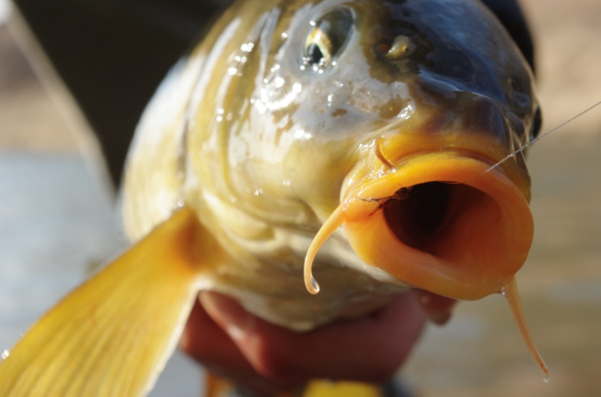
Question #7
Common carp feed _____.
at the bottom of the wetland
in the water column
at the water surface
Image from Bing Images – public domain.
Notes:
Source:
The Freshwater Fishes of Manitoba by Kenneth W. Stewart and Douglas A. Watkinson

Slide 22
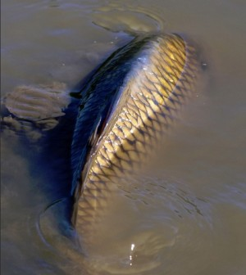
Question #8
True or False.
Carp are constantly stirring up the substrate when they feed.
Image from Bing Images – public domain.
Notes:
Source:
https://www.oiso.ca/species/common-carp/#:~:text=Common%20Carp%20are%20large%20omnivorous,are%20used%20as%20ornamental%20fish.&text=Wild%20Common%20Carp%20are%20typically,given%20adequate%20space%20and%20nutrients.

Slide 23
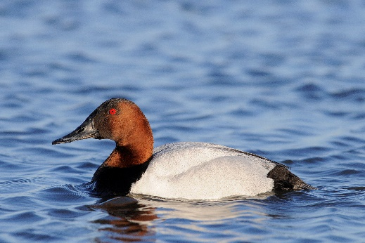
Question #9
Common carp decrease the clarity of the water:
making it unattractive
destroying habitat
reducing the abundance of aquatic plants
making it unsuitable for other species
a & c
all of the above
Image from DUC.
Notes:
Source:
https://www.oiso.ca/species/common-carp/#:~:text=Common%20Carp%20are%20large%20omnivorous,are%20used%20as%20ornamental%20fish.&text=Wild%20Common%20Carp%20are%20typically,given%20adequate%20space%20and%20nutrients.

Slide 24
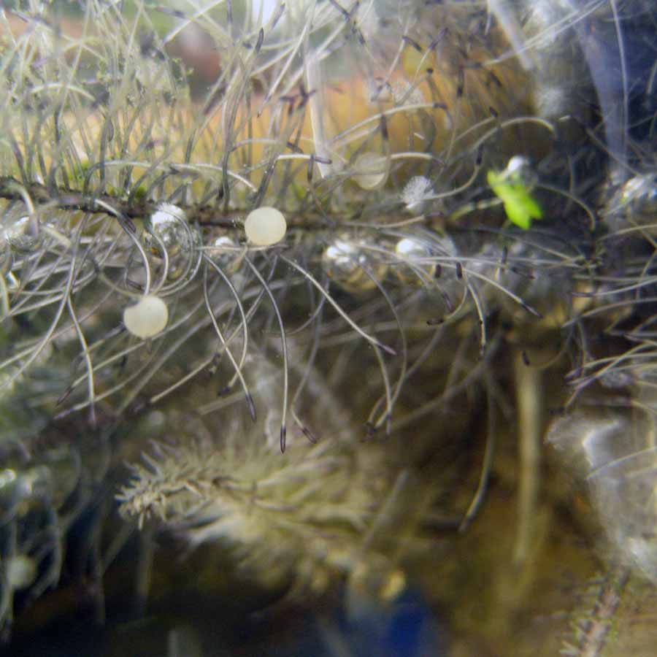
Question #10
Common carp need wetlands to?
spend the winter in
feed in
lay eggs in
b & c
Image from https://www.pondexperts.ca/pond-advice-tips/koi-spawning-behaviour/.
Notes:
Source:
The Freshwater Fishes of Manitoba by Kenneth W. Stewart and Douglas A. Watkinson

Slide 25
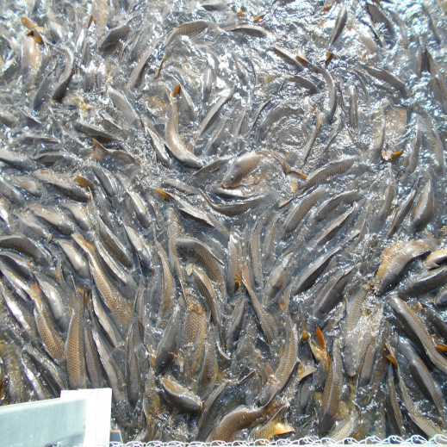
Answers – Round 2
a) a native species
e) a & c non-native or introduced
b) an invasive species
b) human activities
b) common carp
c) omnivores
a) at the bottom of a wetland
b) true
f) all of the above
d) b & c feed in and lay eggs in
Image from DUC.

Slide 26
Round 3 Delta Marsh
Notes:
Image from DUC.
Sources:
https://www.canada.ca/en/environment-climate-change/services/biodiversity/why-invasive-alien-species-are-problem.html
https://www.invasivespeciescentre.ca/learn/

Slide 27
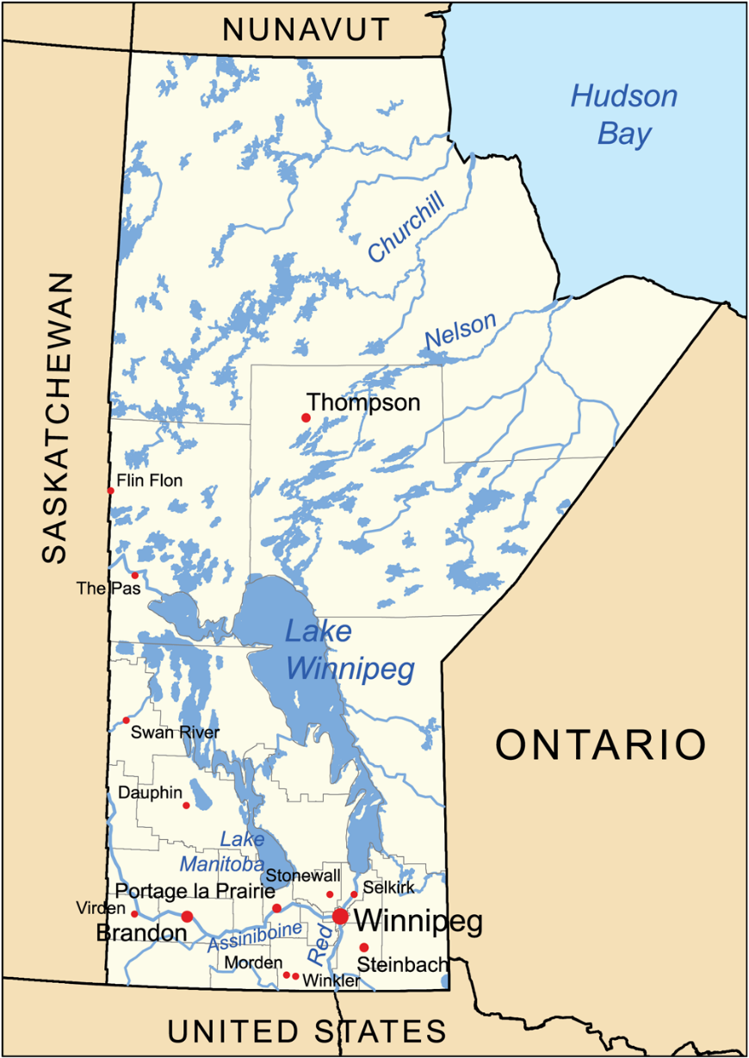
Question #1
Delta Marsh is found at
the south end of?
Lake Winnipeg
Lake Winnipegosis
Lake Manitoba
Falcon Lake
Image from Bing Images – public domain.

Slide 28
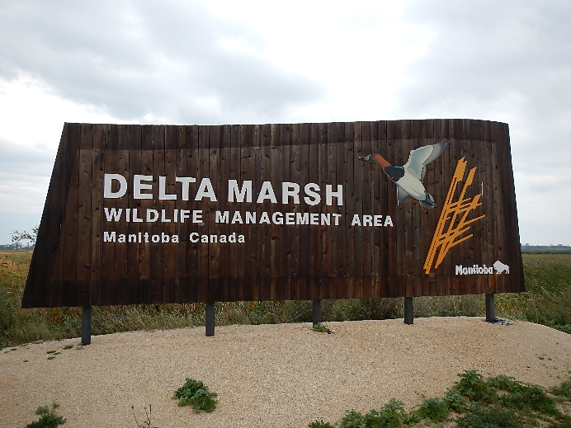
Question #2
At 185 km² Delta Marsh is Manitoba’s ____ largest marsh.
first
second
third
fourth
Image from DUC.
Notes:
Source:
https://link.springer.com/referenceworkentry/10.1007%2F978-94-007-6173-5_190-1#:~:text=Netley%2DLibau%20Marsh%20(222%20km,important%20wildlife%20and%20fisheries%20habitat.
Netley-Libau Marsh (222 km²) on Lake Winnipeg, and Delta Marsh (185 km²) on Lake Manitoba, are believed to be the largest freshwater coastal wetlands in North America. These wetlands provide many benefits to their adjoining lakes, and provide important wildlife and fisheries habitat. However, lake-level regulation, nonpoint source nutrient pollution and invasive species are significant threats to these coastal wetlands and the ecosystem benefits they provide.

Slide 29
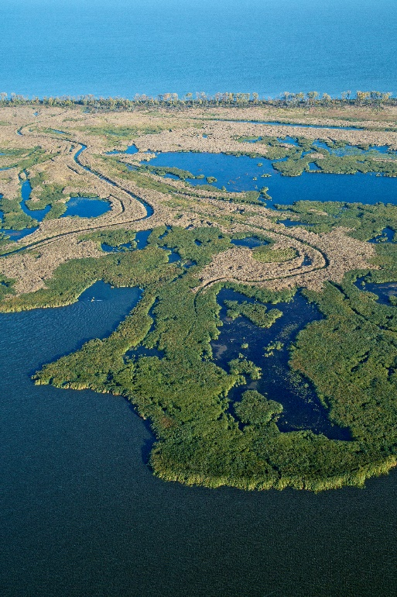
Question #3
Delta Marsh used to be a delta of what river?
Red River
Seine River
Souris River
Assiniboine River
Image from DUC.
Notes:
Source: Ducks Unlimited Canada. Unpublished data.
Delta Marsh consists of a series of large open bays, isolated ponds, former river channels, flooded emergent vegetation, wet meadows, low prairie, and uplands. The channels are remnants of the Assiniboine River when it flowed north into Lake Manitoba approximately 4500 to 2000 years ago (Teller and Last 1981).

Slide 30
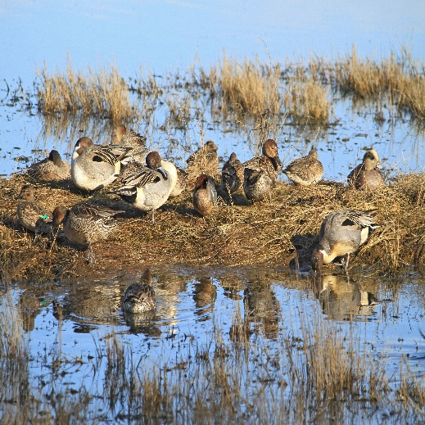
Question #4
Delta Marsh is an important area for wildlife to:
breed
stage
overwinter
overwinter & stage
breed & stage
Image from DUC.
Notes:
Source: https://en.wikipedia.org/wiki/Delta_Marsh

Slide 31
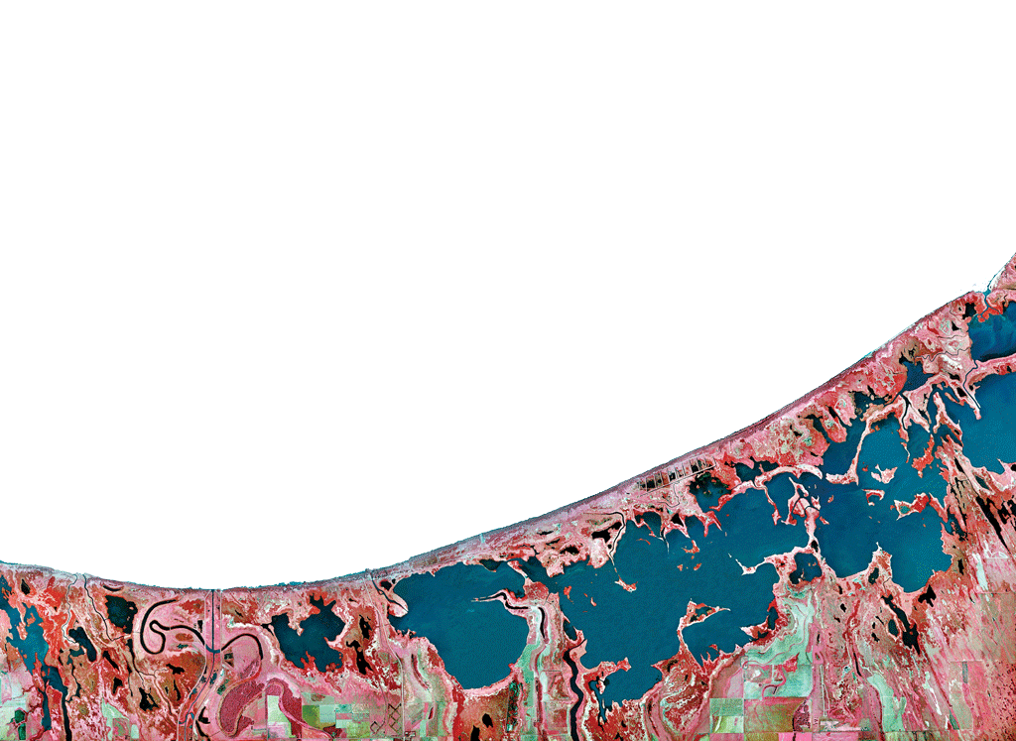
Question #5
True or False
Delta Marsh is an internationally important wetland.
Image from DUC.
Notes:
Source:
https://www.ramsar.org/sites-countries/wetlands-of-international-importance
https://www.ramsar.org/wetland/Canada
https://rsis.ramsar.org/ris/238 – write-up is currently incorrect (discusses a wetland in BC) but looking into getting it corrected
True: Delta Marsh is a recognized Ramsar Site.

Slide 32
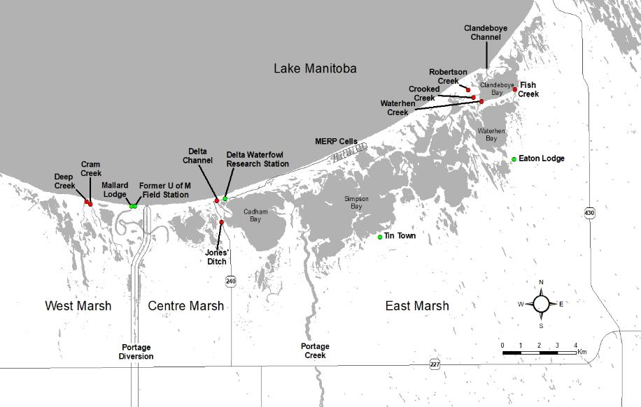
Question #6
True or False
Delta Marsh is isolated from Lake Manitoba.
Image from DUC.
Notes:
Source: Ducks Unlimited Canada. Unpublished data.
False: There are four channels that transect the ridge and connect the marsh to the lake; Clandeboye Channel, Delta Channel, Cram Creek, and Deep Creek. These channels allow the exchange of water, sediment, nutrients, and fish between the marsh and lake. Water exchange is primarily driven by wind strength and direction, with flows in the channels frequently reversing direction. North winds push lake water into the marsh, while south winds move water out of the marsh. It consists of a series of large open bays, isolated ponds, former river channels, flooded emergent vegetation, wet meadows, low prairie, and uplands

Slide 33
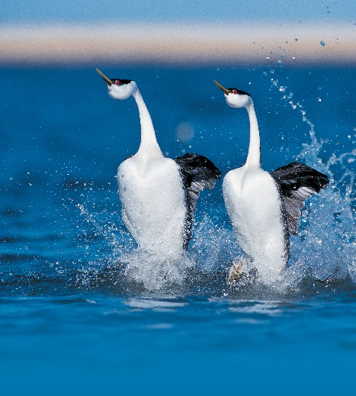
Question #7
Delta Marsh is important to
waterfowl
shorebirds
songbird
waterbirds
none of the above
all of the above
Image from DUC.
Notes:
Source:
https://www.ibacanada.ca/site.jsp?siteID=MB001

Slide 34
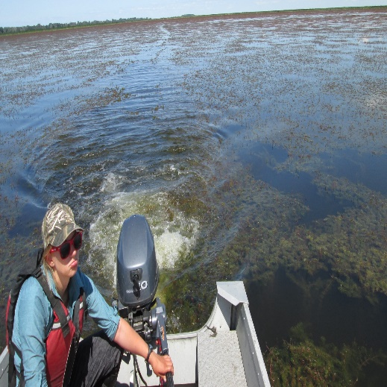
Question #8
Delta Marsh has seen a decline in the number of underwater plants and an decrease in the clarity of the water. What is the cause?
Common carp
Wind
Increase in the number of ducks
Decrease in the number of ducks
Image from OHMIC.
Notes:
Source:
https://www.oiso.ca/species/common-carp/#:~:text=Common%20Carp%20are%20large%20omnivorous,are%20used%20as%20ornamental%20fish.&text=Wild%20Common%20Carp%20are%20typically,given%20adequate%20space%20and%20nutrients.
Ducks Unlimited Canada. Unpublished data.
Water clarity and submersed aquatic vegetation (SAV) play important ecological roles in shallow water ecosystems such as Delta Marsh. High water clarity promotes SAV growth by allowing increased light penetration through the water column (Robel 1961, Hanson and Butler 1994a). Areas with healthy SAV communities serve as spawning, refuge, and feeding habitat for many species of fish (Randall et al. 1995, Weaver et al. 1997, Seilheimer and Chow-Fraser 2006, Cvetkovic et al. 2009, Miller et al. 2018). Associated invertebrates are food sources for both fish and waterfowl (Bartonek and Hickey 1969, Keast 1984, DuBowy 1985, Hann 1995, Miller et al. 2018), and the vegetative parts of plants are consumed by some waterfowl species (Collias and Collias 1963, Bartonek and Hickey 1969, Anderson and Low 1976, DuBowy 1985). SAV in turn helps maintain a clear water state through several pathways: reducing sediment and nutrient suspension caused by wave action (Hamilton and Mitchell 1996, Horppil and Nurminen 2005), acting as a refugia for zooplankton that consume phytoplankton (Scheffer 1999, Celewicz-Goldyn and Kuczynska-Kippen 2017), competing with phytoplankton for nutrients (van Donk et al. 1990), and potentially limiting algae growth through allelopathy (Wium-Andersen et al. 1982, Körner and Nicklish 2002, Hilt and Gross 2008).
High Carp biomass has been shown to negatively impact water clarity and SAV assemblages; indirectly by increasing suspended solids and turbidity, and lowering light penetration (Lougheed et al. 1998, Parkos et al. 2003, Badiou and Goldsborough 2010, 2015, Weber & Brown 2015, Kaemingk et al. 2016), and directly through uprooting and stem breakage of SAV during feeding and spawning activities (Tyron 1954, Crivelli 1983). Carp absence-presence studies in shallow water ecosystems have demonstrated a switch from a clear water, SAV dominated phase to a turbid, phytoplankton dominated phase (Lougheed et al. 1998, Zambrano and Hinojosa 1999, Hnatiuk 2006, Bajer et al. 2009, Kaemingk et al. 2016). Conversely, other studies have documented an opposite shift from a turbid to a clear water state after benthivorous fish (especially Carp) have been removed or partially excluded, which triggers an increase in growth, extent, and diversity of SAV (Meijer et al. 1990, Ivey et al. 1998, Schrage and Downing 2004, Kaemingk et al. 2016).

Slide 35
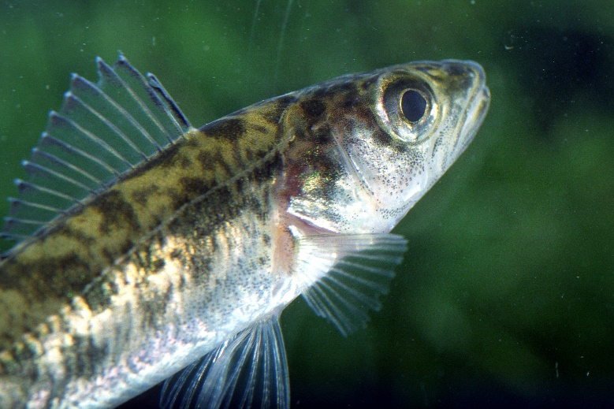
Question #9
How many species of fish are found in Delta Marsh?
11
21
31
41
Image from DUC.
Notes:
Image is of a Walleye.
Source:
Ducks Unlimited Canada. Unpublished data.
There are 31 species of fish reported from Delta Marsh (Table 1.1). Nine species are not native to the marsh or Lake Manitoba.
Hiodontidae
Hiodon alosoides goldeye
Hiodon tergisus mooneye
Catostomidae
Carpiodes cyprinus quillback
Catostomus commersoni white sucker
Ictiobus cyprinellus bigmouth buffalo
Moxostoma anisurum silver redhorse
Moxostoma macrolepidotum shorthead redhorse
Cyprinidae
Cyprinus carpio common carp
Notropis atherinoides emerald shiner
Notropis hudsonius spottail shiner
Pimephales promelas fathead minnow
Platygobio gracilis flathead chub
Ictaluridae
Ameiurus melas black bullhead
Ameiurus nebulosus brown bullhead
Ictalurus punctatus channel catfish
Noturus gyrinus tadpole madtom
Esocidae
Esox lucius northern pike
Salmonidae
Coregonus artedi lake herring, cisco
Umbridae
Umbra limi central mudminnow
Percopsidae
Percopsis omiscomaycus trout-perch
Lotidae
Lota lota burbot
Gasterosteidae
Culaea inconstans brook stickleback
Pungitius pungitius ninespine stickleback
Percidae
Etheostoma exile Iowa darter
Etheostoma nigrum johnny darter
Perca flavescens yellow perch
Percina caprodes logperch
Sander canadensis sauger
Sander vitreus walleye
Sciaenidae
Aplodinotus grunniens freshwater drum
Centrarchidae
Ambloplites rupestris rock bass
Note: underlined ones are introduced species.

Slide 36
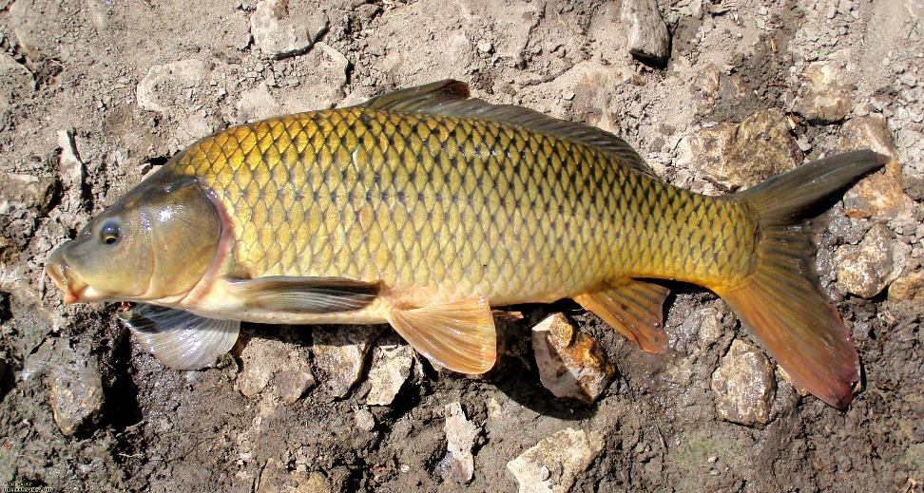
Question #10
Common Carp first showed up in the Delta Marsh in what year?
1937
1947
1957
1967
Image from Bing Images – public domain.
Notes:
Source:
Ducks Unlimited Canada. Unpublished data.
Carp were first introduced into Manitoba ponds around 1885 for commercial purposes, however no permanent populations were thought to have established (McCrimmon 1968). The first recorded appearance of Carp in the wild was in the Red River at Lockport in 1938 (Hinks 1943). Carp are believed to have first appeared at Lake Manitoba and Delta Marsh around 1947 (Atton 1959; Miller and Moore 1967), although 1948 (Doan 1964; Swain 1979) and 1952 (Hochbaum and Ward 1964) are also dates that are reported. By the early 1960s, large spring runs of Carp were observed at Deep and Cram Creeks, and Delta and Clandeboye Channels (Technical Committee for the Development of the Delta Marsh 1968).
Even though they were found in 1947, their effect was not really noticeable for several decades (late 1960s).

Slide 37
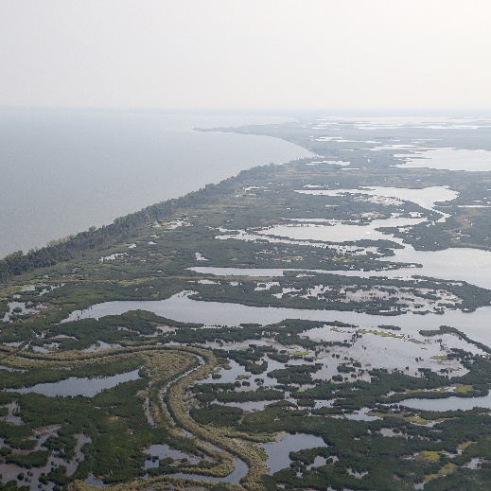
Answers – Round 3
c) Lake Manitoba
b) second
d) Assiniboine River
e) breed & stage
true
false
f) all of the above
a) Common carp
c) 31
b) 1947
Image from DUC.

Slide 38
Thank You!

