Slide 1

Common Carp at Delta Marsh project
An in depth study of an invasive species
Notes:
Today we will be learning about invasive species, their effect and how to control them.

Slide 2
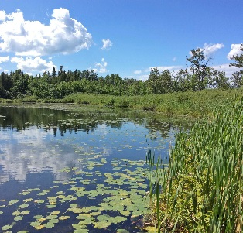
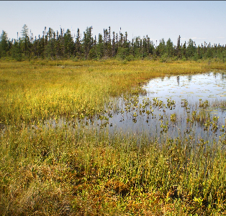
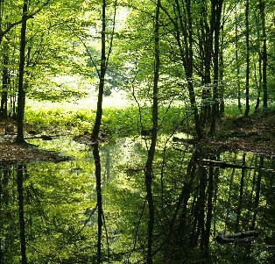
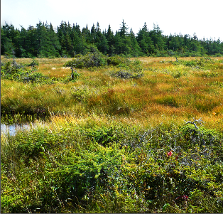
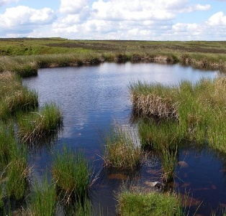
Wetlands
Wetlands are ecosystems that have specific biotic and abiotic characteristics that make it distinct from other ecosystems.
A wetland is an area of land that is permanently or periodically saturated with water. The water can only be 2 metres or less in depth, due to the water-loving plants that grow in and around the water.
Types of Wetlands:
Freshwater Marsh
Fen
Swamp
Bog
Shallow Open Water
Shallow water image from geograph.org.uk. All other images from Ducks Unlimited Canada.
Notes:
Wetlands cover almost half of Manitoba, and can be found in every region (ecozone) in the province.
The main biotic and abiotic characteristics of a wetland are:
An area of land that is permanently or periodically saturated with water
The water is 2 metres or less in depth
Water-loving plants grow in and around the water
Each type of wetland has slightly different biotic and abiotic characteristics that make it distinct from other types of wetlands, all while still following the overall characteristics of a wetland.
Note to Teachers:
There is a complete description of unique characteristics for each type of wetland shown here included in the Grade 11 pre- and post-visit activity guide.

Slide 3
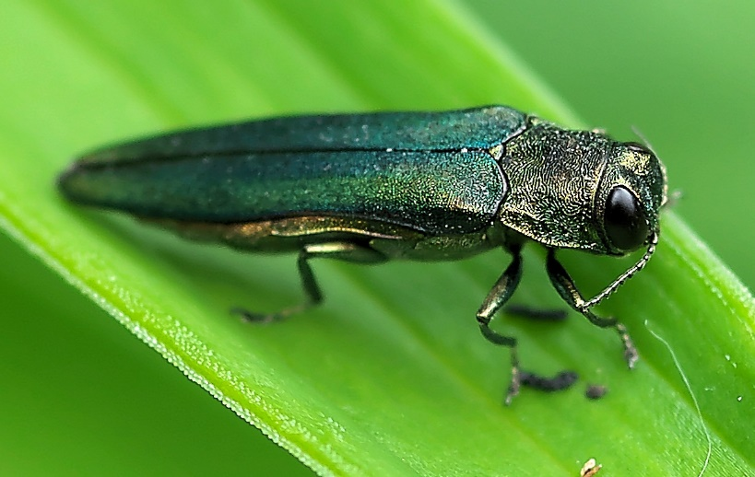
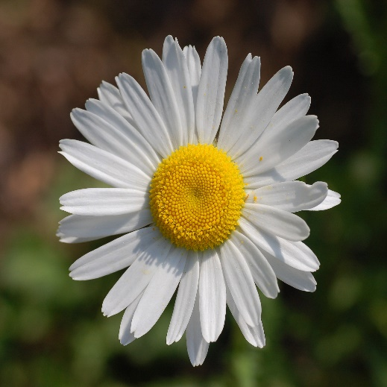
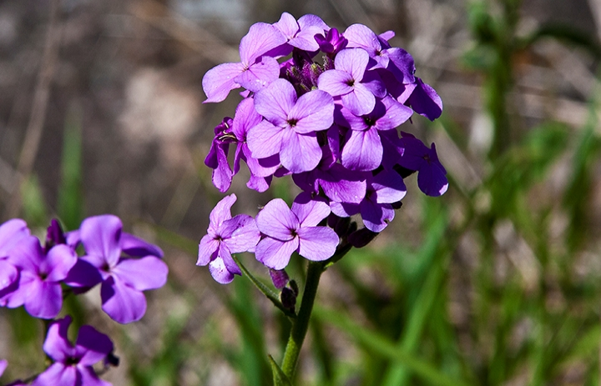
What is an invasive species?
Introduced species or organism which causes damage to biodiversity, agricultural production or human health
No natural enemies/predators here in Manitoba
Outcompetes native species
See notes for image sources.
Notes:
Emerald Ash Borer image from: https://bugspray.com/emerald-ash-borer-control.html
Ox-eyed Daisy image from: https://en.wikipedia.org/wiki/Leucanthemum_vulgare
Dame’s Rocket image from: https://en.wikipedia.org/wiki/Hesperis_matronalis
Resources
Invasive Species Council of Manitoba: http://invasivespeciesmanitoba.com/site/
Invasive Species in Manitoba: River, Lake and Wetland Invaders; a pocket field guide by the Invasive Species Council of Manitoba
www.invasivespeciesinfo.gov: https://www.invasivespeciesinfo.gov/what-are-invasive-species
https://www.invasivespeciescentre.ca/learn/

Slide 4
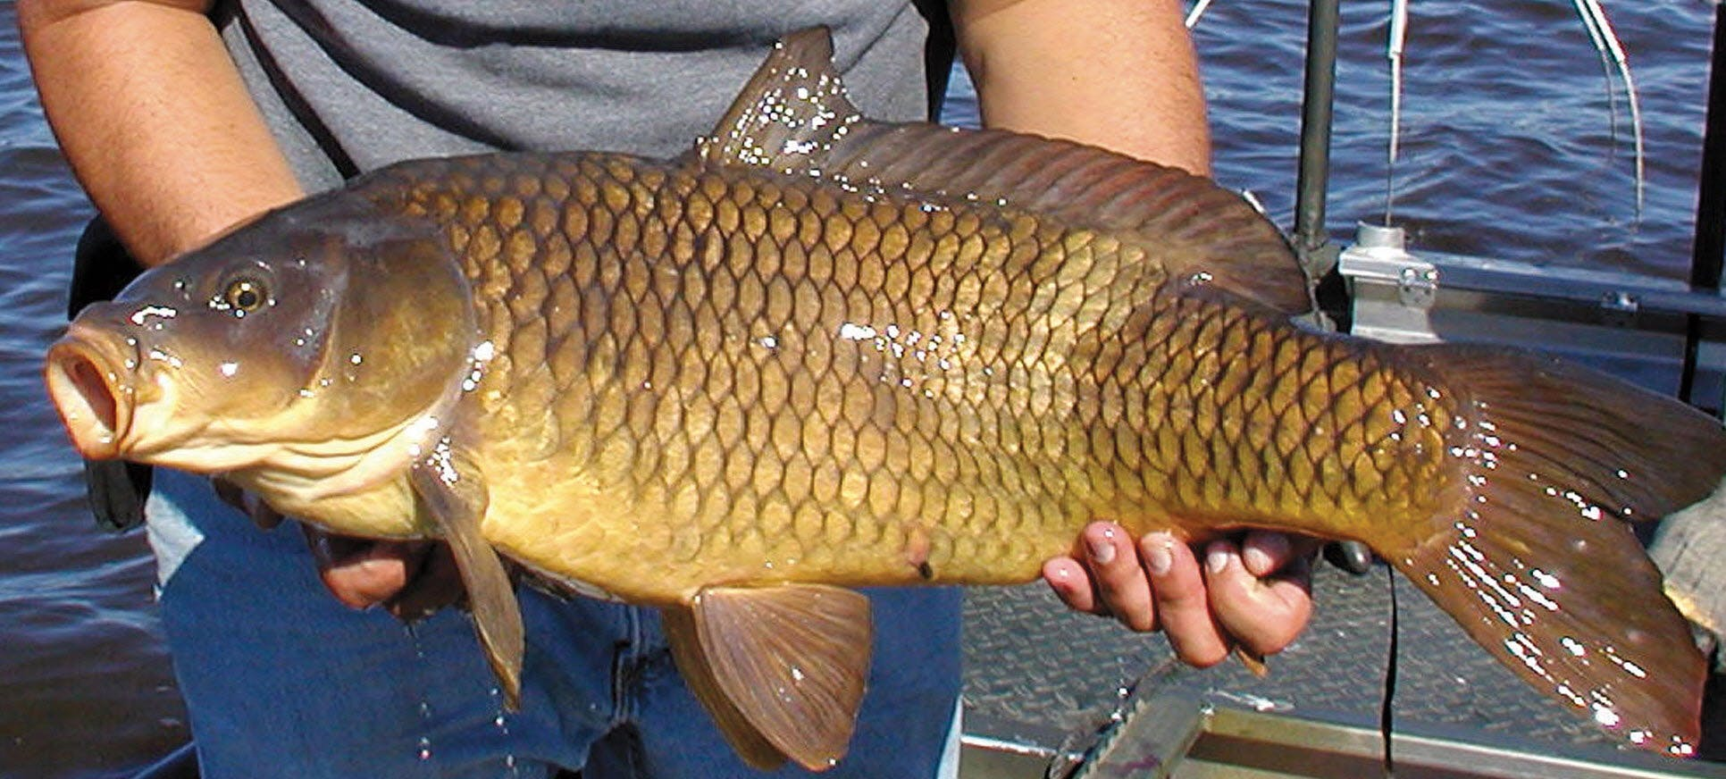
Common Carp
Part of the minnow family
Omnivorous but prefers the tender roots and shoots of young aquatic plants
Feeds along the bottom (benthic)
Extremely adaptable and can be found in many habitats
Adults can weight more than 50 pounds.
Lay eggs (spawn) in marshes
Image from https://www.startribune.com/why-some-anglers-love-carp/270345611/.
Notes:
Resources
https://en.wikipedia.org/wiki/Common_carp
Invasive Species Council of Manitoba: http://invasivespeciesmanitoba.com/site/index.php?page=common-carp
Ducks Unlimited Canada: https://www.ducks.ca/stories/conservator/ducs-fight-against-invasive-species/
Iowa Department of Natural Resources: https://www.iowadnr.gov/Fishing/Iowa-Fish-Species
The Freshwater Fishes of Manitoba by Kenneth W. Stewart and Douglas A. Watkinson
https://www.oiso.ca/species/common-carp/#:~:text=Common%20Carp%20are%20large%20omnivorous,are%20used%20as%20ornamental%20fish.&text=Wild%20Common%20Carp%20are%20typically,given%20adequate%20space%20and%20nutrients.

Slide 5
Common Carp
Common Carp is native in Asia and parts of Europe
It was first introduced to Manitoba in 1886.
It was introduced to North America as a food and ornamental fish into freshwaters throughout the world.
Is considered invasive in Manitoba
Image from https://www.startribune.com/why-some-anglers-love-carp/270345611/.
Notes:
Resources
https://en.wikipedia.org/wiki/Common_carp
Invasive Species Council of Manitoba: http://invasivespeciesmanitoba.com/site/index.php?page=common-carp
Ducks Unlimited Canada: https://www.ducks.ca/stories/conservator/ducs-fight-against-invasive-species/
Iowa Department of Natural Resources: https://www.iowadnr.gov/Fishing/Iowa-Fish-Species
The Freshwater Fishes of Manitoba by Kenneth W. Stewart and Douglas A. Watkinson
https://www.oiso.ca/species/common-carp/#:~:text=Common%20Carp%20are%20large%20omnivorous,are%20used%20as%20ornamental%20fish.&text=Wild%20Common%20Carp%20are%20typically,given%20adequate%20space%20and%20nutrients.

Slide 6
Clandeboye Channel
Deep Creek
Delta Channel
Cram Creek
Notes:
Delta Marsh consists of an extensive open marsh located near the south shore of Lake Manitoba, approximately 24 km north of the town of Portage la Prairie, Manitoba. The marsh extends for nearly 30 km along the shore of the lake, and has a breadth of up to 4 km. The marsh consists of a network of interconnected shallow bays separated from Lake Manitoba by a wooded barrier dune ridge of 300m to 600m width.
Despite its name, Delta Marsh is no longer a river delta. However, it was originally the delta of the Assiniboine River, which flowed into Lake Manitoba from the southwest until approximately 2500 years ago. (The current course of the river continues east past Lake Manitoba until it intersects the Red River in Winnipeg).
Resources:
https://en.wikipedia.org/wiki/Delta_Marsh
https://www.gov.mb.ca/sd/pai/mb_network/pdf/delta_marsh_backgrounder.pdf

Slide 7
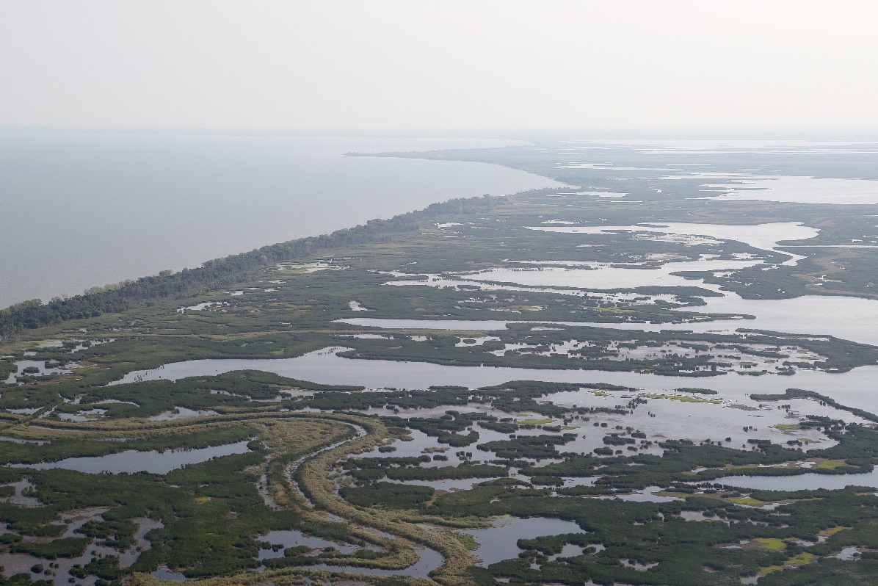
Delta Marsh
Is a large freshwater coastal wetland at the south end of Lake Manitoba
Has channels that allow the exchange of water, sediment, nutrients and fish between the marsh and lake
Is approximately 32 long
Is approximately 18,500 ha
Is waterfowl staging habitat
Image from DUC
Notes:
Is a Wetland of International Significance under the Ramsar Convention (1982)
Is Heritage Marsh in a program of the Province of Manitoba, the Manitoba Naturalists Society, the Manitoba Wildlife Federation, Ducks Unlimited Canada, and Wildlife Habitat Canada (1988)
Is an Important Bird Area (IBA), as designated by Bird Studies Canada (1999)
Is a Wildlife Management Area (WMA) (2006)
Ducks Unlimited Canada. Unpublished data.
Delta Marsh is a large freshwater coastal wetland stretching approximately 32 km along the south end of Lake Manitoba. At approximately 18,500 ha, it is the largest coastal wetland on Lake Manitoba, representing about 27% of the wetland area adjacent to the lake. A forested beach ridge separates the lake and the marsh. There are four channels that transect the ridge and connect the marsh to the lake; Clandeboye Channel, Delta Channel, Cram Creek, and Deep Creek. These channels allow the exchange of water, sediment, nutrients, and fish between the marsh and lake. Water exchange is primarily driven by wind strength and direction, with flows in the channels frequently reversing direction. North winds push lake water into the marsh, while south winds move water out of the marsh.
Delta Marsh consists of a series of large open bays, isolated ponds, former river channels, flooded emergent vegetation, wet meadows, low prairie, and uplands. The channels are remnants of the Assiniboine River when it flowed north into Lake Manitoba approximately 4500 to 2000 years ago. Average water depth in the large open bays is about 1–1.3 m (based on the average regulated water level for Lake Manitoba of 247.5 m ASL), but depths of up to 3.6 m can be found at some internal channels (e.g., Waterhen Creek).
Dominant emergent vegetation consists of Phragmites australis (Common Reed), Typha x glauca (Hybrid Cattail), Scolochloa festucacea (Whitetop), and Schoenoplectus acutus var. acutus (Hardstem Bulrush). Dominant submersed aquatic vegetation is Myriophyllum sibiricum (Northern Watermilfoil), Stuckenia pectinata (Sago Pondweed), S. vaginata (Sheathed Pondweed), Potamogeton richardsonii (Richardson’s Pondweed), and Ceratophyllum demersum (Coontail). The green macroalgae Chara can also be present on the marsh bottom in some areas.
Water levels on the marsh reflect those of Lake Manitoba. As with other prairie water bodies, the lake and marsh have gone through periods of high and low water levels. Prior to the 1960s, lake levels fluctuated by up to 1.7 m through wet and dry periods. There were low water periods in the early 1930s and early 1940s. The lowest recorded monthly mean water level was 247.0 m (810.2 ft) ASL in December 1942. A major flood event occurred in the mid-1950s (248.7 m [815.8 ft] ASL, July 1955) which caused significant damage around the lake and had a marked impact on marsh vegetation. Since the early 1960s, lake water level fluctuations have been moderated by a water control structure on the Fairford River which drains the lake. Lake levels were regulated between 247.2–247.8 m (810.9–812.9 ft) ASL, with a mean of 247.5 m (812.2 ft) ASL (Lake Manitoba Regulation Review Advisory Committee 2003). Stabilized water levels were reasonably maintained for about four decades, from the mid-1960s to the early 2000s. A drought in southern Manitoba in 2003 and 2004 resulted in the lowest water levels recorded on the lake in six decades (247.0 m [810.3 ft] ASL, October 2003). This was followed less than 10 years later by a flood in 2011, with the highest water levels ever recorded on the lake (249.0 m [817.0 ft] ASL, July 2011). A second smaller flood event followed two years later in 2014 (248.2 m [814.4 ft] ASL, August 2014).
Delta Marsh is well known for its long history of waterfowl hunting. Archeological studies have found evidence of waterfowl harvesting by early indigenous people. Over 100 years ago, market hunting provided local employment. Hunting lodges were numerous at the marsh and the rich and famous from around the world came to Delta to hunt. Due to its importance as waterfowl staging habitat, in 1925 the remaining public lands at the marsh were reserved from sale or settlement and set aside as public shooting grounds. Delta was recognized as a wetland of international importance and received Ramsar recognition in 1982. In 1999 it was recognized as an Important Bird Area by Birdlife International. The publicly-owned lands in and around the marsh were designated as a Wildlife Management Area by the province of Manitoba in 2006.
Two research stations contributed greatly to our knowledge and understanding of the marsh. The Delta Waterfowl and Wetlands Research Station (now Delta Waterfowl Conservation and Research Station) was established in 1938, and the University of Manitoba Delta Marsh Field Station in 1966. Both stations supported a variety of wetland related activities, including many undergraduate and graduate students and their research. Unfortunately, both stations were damaged during the flood in 2011. The university field station was closed and all buildings (except for Mallard Lodge) were removed or demolished. The waterfowl research station lost many of its buildings as well, but still hosts some research activities.

Slide 8
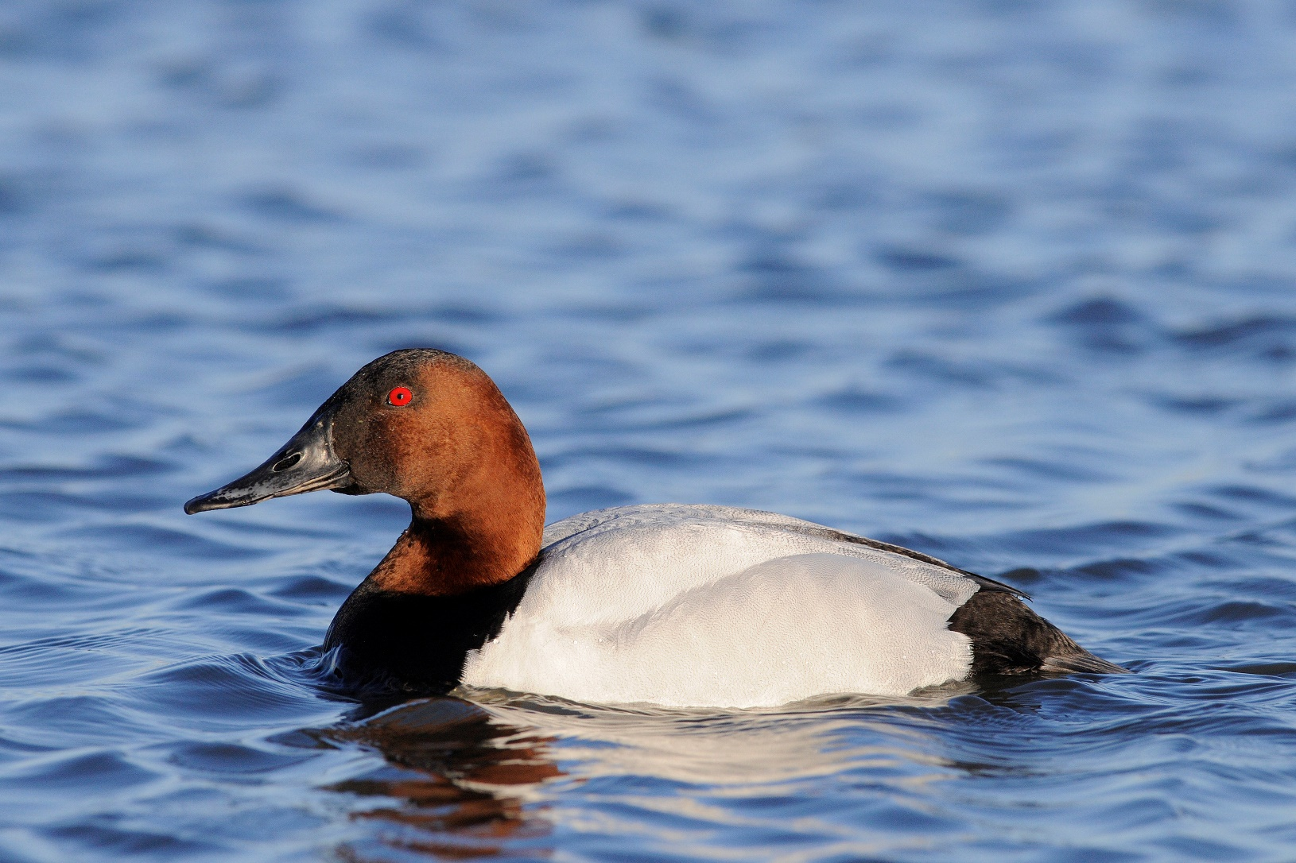
“Deterioration of marsh habitat has become a subject of much concern to marsh users.”
Delta Marsh Study Report
1974
Image from DUC
Notes:
Pod Cast of Ducks Unlimited Inc.:
Episode 1: https://www.youtube.com/watch?v=uoAajWZnRu0 (focus is on decline of marsh)

Slide 9
Changes reported for the Delta Marsh
Loss of islands and emergent vegetation within the larger bays
Expansion of cattail and loss of shallow ponds
Decline in submersed plants
Increased turbidity of the water column
Frequent blue-green algal blooms
Few muskrats and less trapping opportunities
Decline in waterfowl numbers and hunting

Slide 10
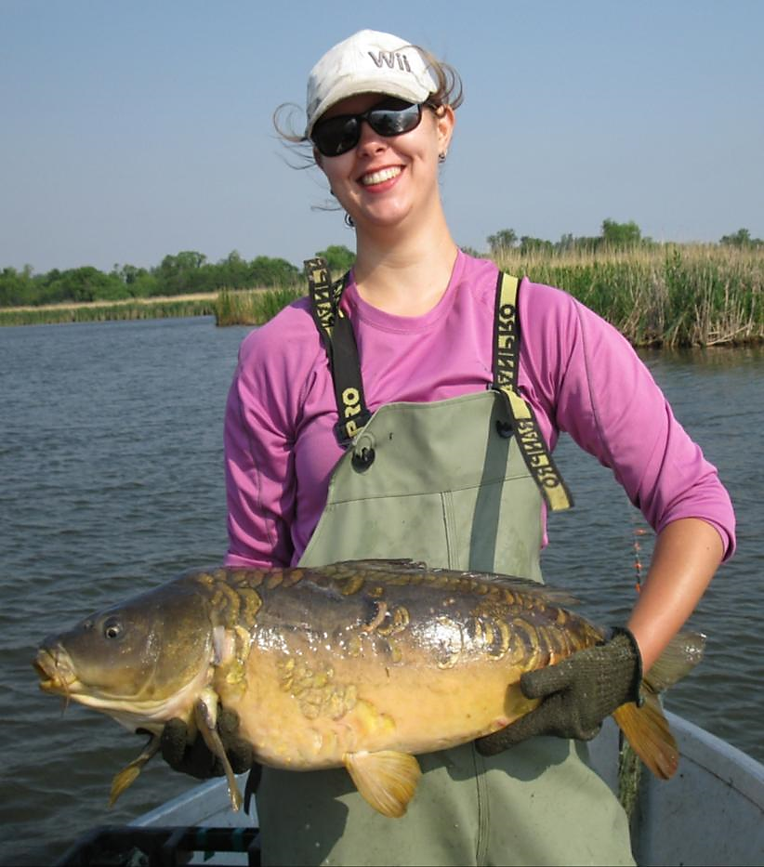
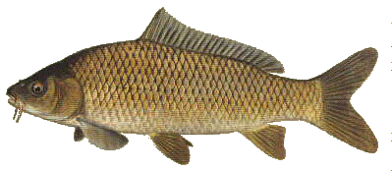
One of the main causes of the changes
Cyprinus carpio
common carp
increased
turbidity
increased
nutrients
loss of
submersed
vegetation
increased
phytoplankton
Image from DUC
Notes:
One of the main causes of the changes to Delta Marsh is the Common Carp
Effects Common Carp have on the ecosystem
Resources:
https://www.ducks.ca/stories/science/cleaning-common-carp/
https://www.researchgate.net/publication/288110284_Impacts_of_the_common_carp_Cyprinus_carpio_on_freshwater_ecosystems_A_review#:~:text=The%20common%20carp%20can%2C%20directly,of%20phytoplankton%3B%204)%20decreasing%20submerged
Common carp (Cyprinus carpio), an invasive species that first appeared at Delta Marsh in the 1950s, made such a mess of the marsh that canvasback and lesser scaup started going elsewhere. Invertebrate and native aquatic plant numbers dropped. The native fish populations may be affected too.
Every spring, the carp migrate in to Delta Marsh from Lake Manitoba. They are drawn to spawn in the warm, shallow water of the marsh.
The carp also feed in the marsh. They rake the wetland floor and stir up sediment. This restricts sunlight, stunting the growth of aquatic plants. Invertebrates that rely on those plants for food and cover suffered – as did the numbers of ducks.
The common carp can, directly and/or indirectly, negatively impact aquatic ecosystems by: 1) increasing total suspended solids, sedimentation and erosion; 2) increasing water column nutrient concentrations; 3) increasing the biomass and altering the community structure of phytoplankton; 4) decreasing submerged macrophyte abundance 5) decreasing large zooplankton; 6) decreasing benthic invertebrates; 7) reducing native fish diversity and abundance; 8) competing with waterfowl for food resources; and 9) by altering contaminant cycling.

Slide 11

Common Carp
Carp are constantly stirring up the substrate when they feed. They can greatly decrease the clarity of the water.
This makes waterways
  unattractive
  destroys habitat
  reduces the abundance of aquatic plants
  can make the water unsuitable for swimming or drinking
Image from https://www.startribune.com/why-some-anglers-love-carp/270345611/.
Notes:
Resources
https://en.wikipedia.org/wiki/Common_carp
Invasive Species Council of Manitoba: http://invasivespeciesmanitoba.com/site/index.php?page=common-carp
History: Common Carp is native from Asia and parts of Europe. It was introduced to North America as a food and ornamental fish into freshwaters throughout the world. It was first introduced to Manitoba in 1886, by 1954 they were a nuisance to commercial fishers.
Ducks Unlimited Canada: https://www.ducks.ca/stories/conservator/ducs-fight-against-invasive-species/
https://www.oiso.ca/species/common-carp/#:~:text=Common%20Carp%20are%20large%20omnivorous,are%20used%20as%20ornamental%20fish.&text=Wild%20Common%20Carp%20are%20typically,given%20adequate%20space%20and%20nutrients.

Slide 12
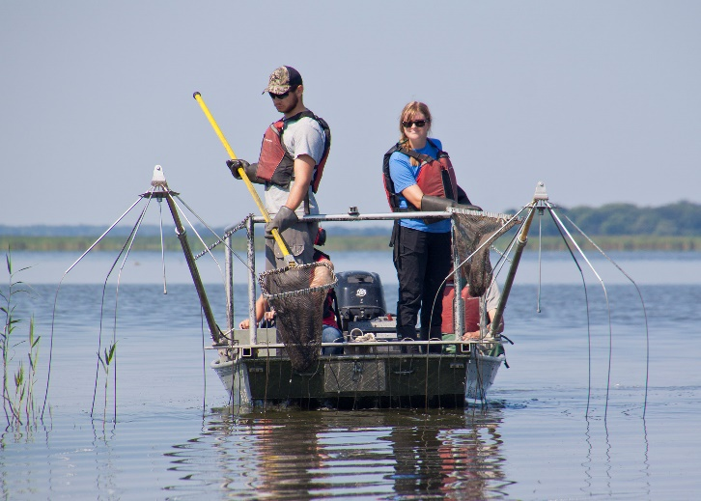
Ducks Unlimited Canada
Delta Marsh had always been a good waterfowl wetland
Ducks Unlimited wanted to restore that tradition
Knew that carp were part of the problem
Needed to gather some baseline information
  What was the fish community like?
  What was the sizes of fish?
  When did the fish move into the marsh from Lake Manitoba to spawn?
Image from DUC
Notes:
Resources
https://en.wikipedia.org/wiki/Common_carp
Invasive Species Council of Manitoba: http://invasivespeciesmanitoba.com/site/index.php?page=common-carp
Ducks Unlimited Canada: https://www.ducks.ca/stories/conservator/ducs-fight-against-invasive-species/
https://www.oiso.ca/species/common-carp/#:~:text=Common%20Carp%20are%20large%20omnivorous,are%20used%20as%20ornamental%20fish.&text=Wild%20Common%20Carp%20are%20typically,given%20adequate%20space%20and%20nutrients.

Slide 13
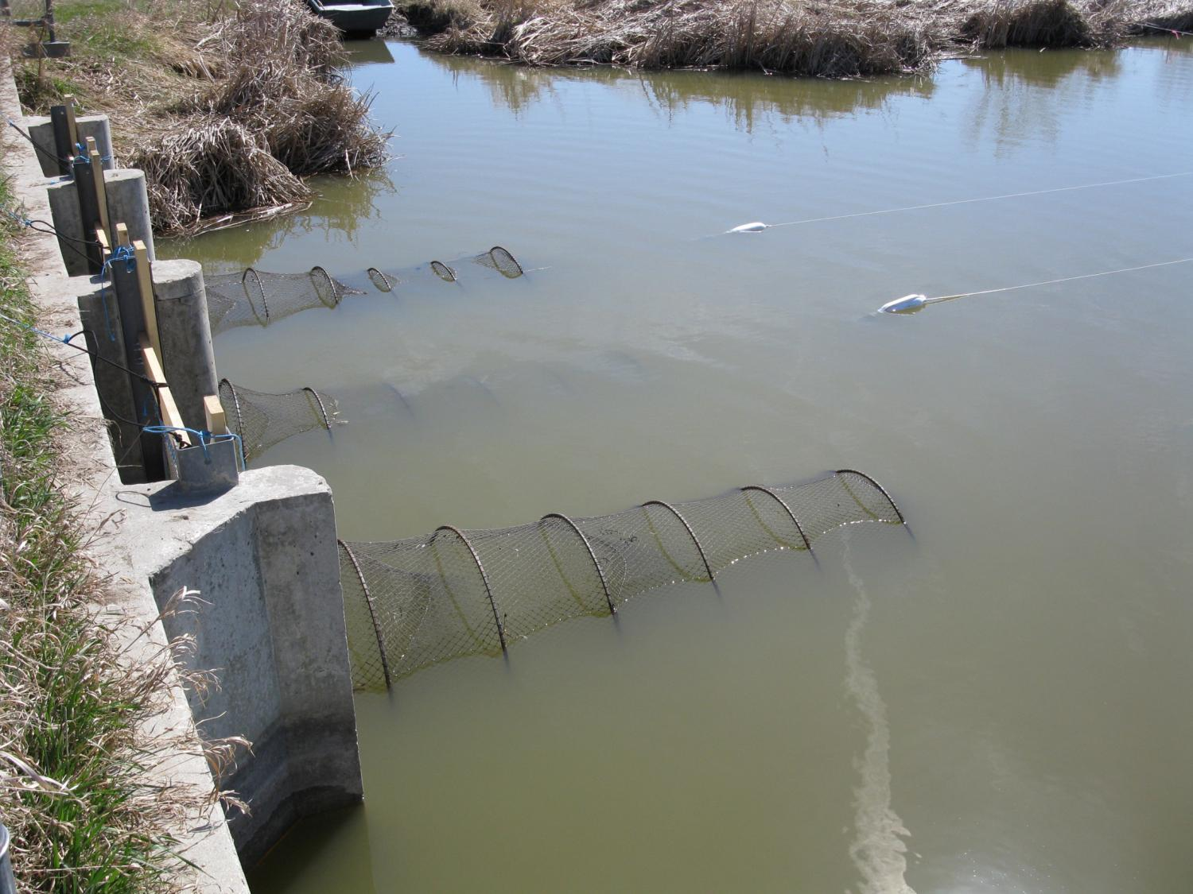
Caught fish
Hoop nets
Gill nets
Electrotrofishing
Image from DUC

Slide 14
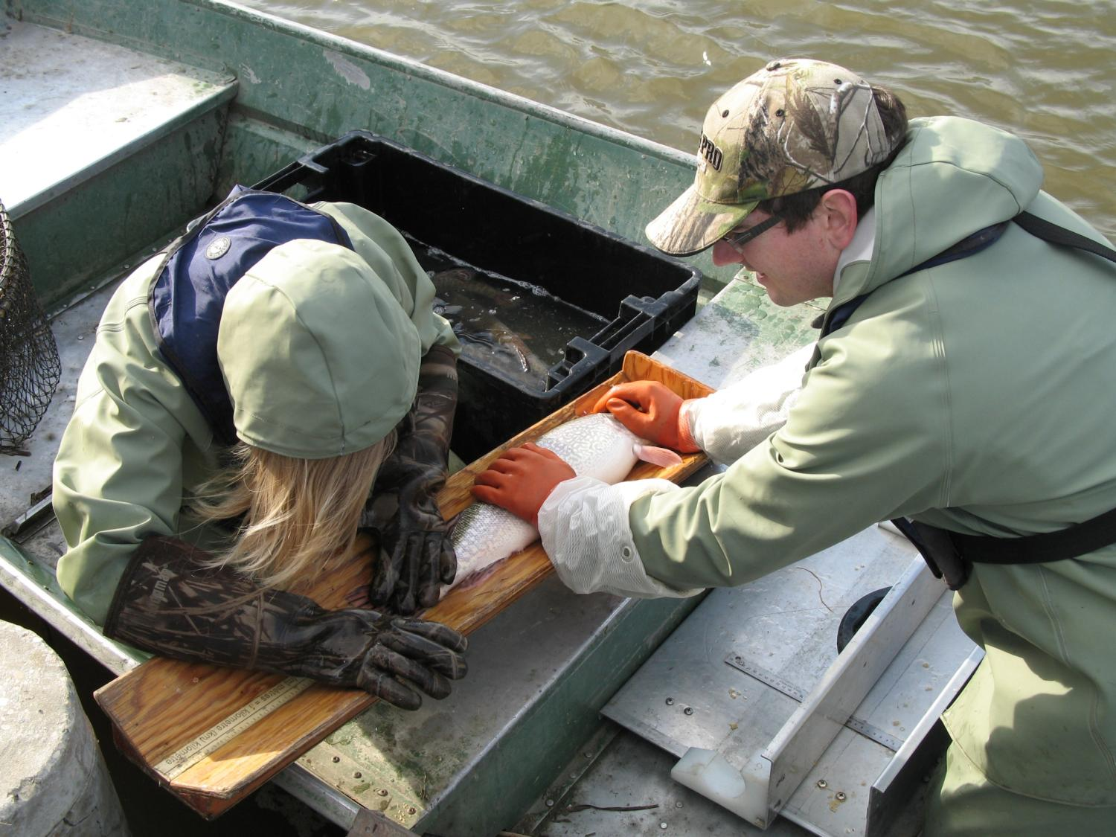
Identified fish & measured them
Image from DUC

Slide 15
Results

Slide 16
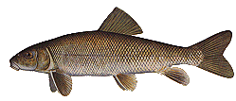
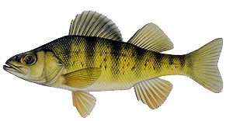
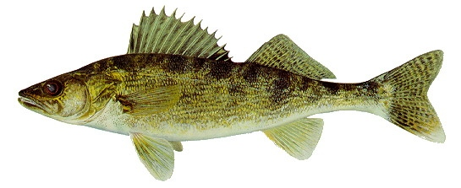
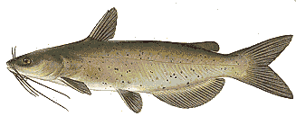
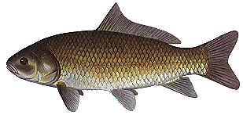
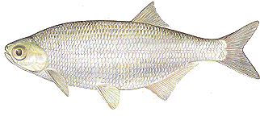
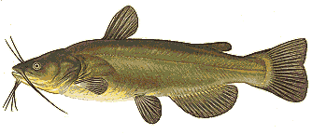
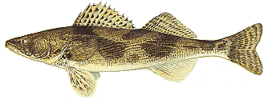

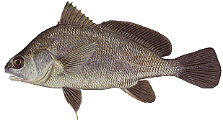

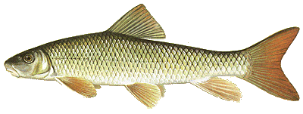
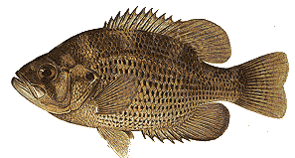


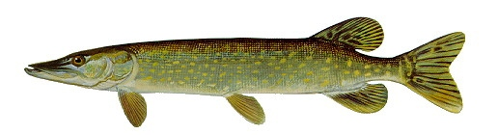
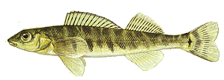
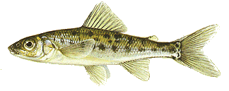

Delta Marsh Fish Community (species caught)
white sucker
yellow perch
walleye
channel catfish
bigmouth buffalo
mooneye
fathead minnow
brook stickleback
black bullhead
sauger
emerald shiner
Johnny darter
rock bass
shorthead redhorse sucker
freshwater drum
logperch
trout-perch
northern pike
burbot
carp
Image from https://www.iowadnr.gov/Fishing/Iowa-Fish-Species
Notes:
- 30 species of fish reported for the marsh
- 8 species are recent additions
- carp have been present since the late 1940s or early 1950s
- 7 species are thought to have been introduced via the Assiniboine Diversion since the spring of 1970 (central mudminnow, bigmouth buffalo, channel catfish, tadpole madtome, brown and black bullheads, and rock bass)

Slide 17
When caught
Delta Channel - 2010
600
Northern Pike
Yellow Perch
500
Quillback
White Sucker
Common Carp
400
Freshwater Drum
25 Days after ice off channel
Number of Fish per Day
300
200
100
0
17
18
19
20
21
22
23
24
25
26
27
28
29
30
01
02
03
04
05
06
07
08
09
10
11
12
13
14
15
16
17
18
19
20
21
22
April
May
Image from DUC
Notes:
Not all fish species move into the marsh to spawn at the same time of year.
We want our solution to prevent carp from moving into the marsh to spawn but need to make sure that the other species of fish still have access.

Slide 18
Size
Image from DUC
Notes:
Different species of fish and different ages of fish are different sizes. All sizes need to spawn in the marsh.

Slide 19
How would you get rid of Common Carp in Delta Marsh?

Slide 20
Options for Common Carp Control
Poisons (e.g., rotenone)
Exclusion barriers (e.g., electric fences, acoustic and bubble screens, metal fences or screens, velocity tubes or chutes)
Traps (jumping traps)
Habitat management (e.g., seasonal drawdown, winterkill)
Harvest management
Pathogens (e.g., koi herpes virus)
Genetic manipulation (e.g., daughterless carp)
Immuno-contraception
Notes:
Source:
Ducks Unlimited Canada. Unpublished data.
However, control measures to reduce Carp abundance vary widely and depend on the local situation (e.g., Roberts and Tilzey 1997, Weber and Brown 2009). Management actions currently in use or under consideration include: harvest management (Bajer et al. 2011), poisons (e.g., rotenone; Schrage and Downing 2004, Bonneau and Scarnecchia 2015), exclusion barriers (e.g., electric fences, acoustic and bubble screens, metal screens; Verrill and Berry 1995, French et al. 1999, Lougheed et al. 2004, Zielinski and Sorensen 2015), jumping traps (Stuart et al. 2006), habitat management (seasonal drawdown and winterkill; Verrill and Berry 1995, Shields 2011), pathogens (e.g., Koi herpesvirus; McColl et al. 2007), genetic manipulation (e.g., daughterless carp; Brown and Gilligan 2014) and immuno-contraception (Hinds and Pech 1997).

Slide 21
Invasive Species project
You will be researching one of the options for controlling Common Carp listed in the previous slide. You must answer the following questions:
Which solution did you select?
Why did you select it?
How would it control carp? What information would you need to collect? How would you collect it? What equipment would you use?
What are its effects on wetlands?
What are its effects on other wetland inhabitants? What could be some unintended consequences of this option of carp control?
How does science play a role? How does technology play a role?
What is the economic cost of your solution?
Notes:
Individually or in groups, students will be researching and presenting one of the options for Common Carp Control. Students will need to answer these questions.

Slide 22


Thank You!

