Slide 1
Watershed Proposal
Learning about Canada’s watersheds
Notes:
Today we will be learning about watersheds, and how humans interact with them. We will be learning about the 5 broad watersheds that cover Canada.

Slide 2
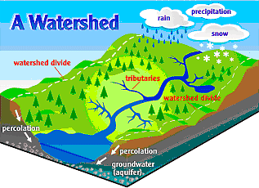
What is a Watershed?
A watershed, also known as a drainage basin, is an area of land where all water drains to a central point like a lake, river, or stream.
Each large watershed is made up of smaller watersheds.
Image from Bing Images – public domain.
Notes:
Source: https://www.usgs.gov/special-topic/water-science-school/science/watersheds-and-drainage-basins?qt-science_center_objects=0#qt-science_center_objects
A watershed is an area of land that drains all the streams and rainfall to a common outlet such as the outflow of a reservoir, mouth of a bay, or any point along a stream channel. Watersheds can be as small as a footprint or large enough to encompass all the land that drains water into rivers that drain into Hudson Bay, where it enters the Arctic Ocean.
The word "watershed" is sometimes used interchangeably with drainage basin or catchment. Ridges and hills that separate two watersheds are called the drainage divide. The watershed consists of surface water--lakes, streams, reservoirs, and wetlands--and all the underlying groundwater. Larger watersheds contain many smaller watersheds. It all depends on the outflow point; all of the land that drains water to the outflow point is the watershed for that outflow location. Watersheds are important because the streamflow and the water quality of a river are affected by things, human-induced or not, happening in the land area "above" the river-outflow point.

Slide 3
What is a Watershed?
Image from https://caringforourwatersheds.com/.
Notes:
Source: Nutrien’s Caring for Our Watersheds https://youtu.be/K_o-jK6vWIo
Click on image to play video.

Slide 4
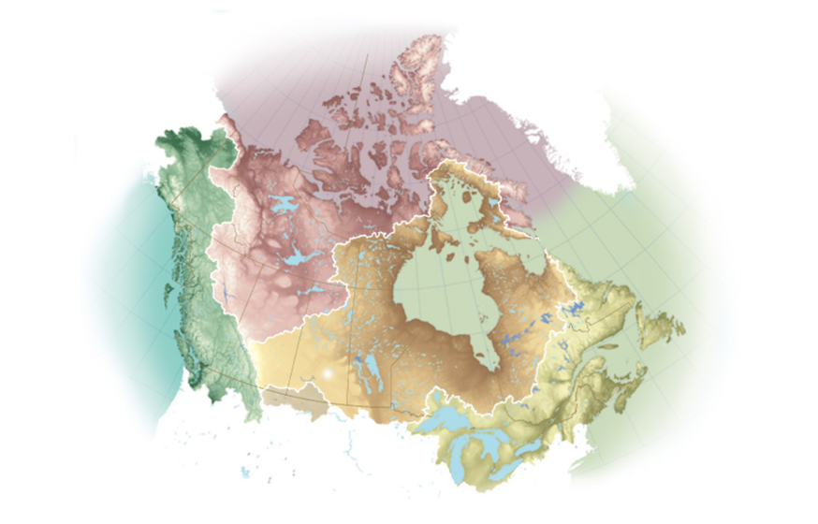
Hudson Bay Watershed
The Hudson Bay Watershed is made up of smaller watersheds including the Lake Winnipeg watershed.
Image from http://www.canadiangeographic.com/watersheds/map/?path=english/watersheds-list.
Notes:
See the Know Watersheds! Power Point for details on Canada’s five large watersheds.

Slide 5
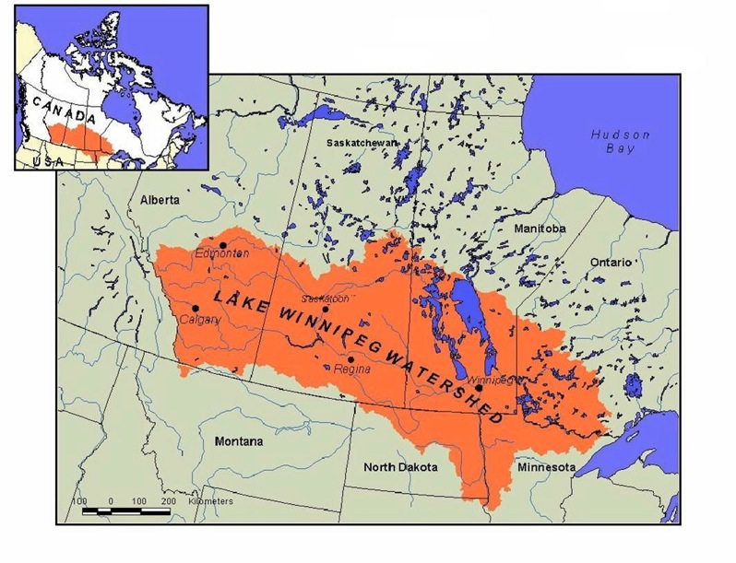
The Lake Winnipeg watershed is also made up of smaller watersheds.
This is the watershed we will focus on as it covers all of Manitoba.
Image from https://climatechangeconnection.org/impacts/lake-winnipeg-impacts/lake-winnipeg-water-dynamics/
Notes:
Source: https://climatechangeconnection.org/impacts/lake-winnipeg-impacts/lake-winnipeg-water-dynamics/

Slide 6
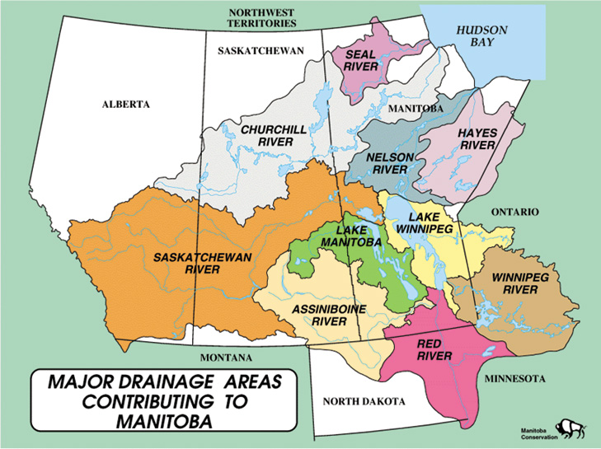
https://www.gov.mb.ca/waterstewardship/water_info/transboundary/maps.html

Slide 7
Where is your Watershed?
Image from https://caringforourwatersheds.com/.
Notes:
Source: Nutrien’s Caring for Our Watersheds https://www.youtube.com/watch?v=62V_sL2X1wg&feature=youtu.be&list=PLwsfnkzf7bW4VxUkKf9-Kxlc2iwxKrHue
Click on image to play video.

Slide 8
Watershed Proposal
You will be researching an issue affecting your local watershed. To help you come up with an idea, try answering the following questions:
What do you like to do?
What are you passionate about?
How can you relate it back to your watershed?
Is your idea realistic? (timeline, cost, etc.)
Who could help make your idea a reality?
Notes:
Students, individually or in groups, will each be researching and analyzing an issue affecting their local watershed.
Good source of ideas: https://caringforourwatersheds.com/category/canada/manitoba/

Slide 9
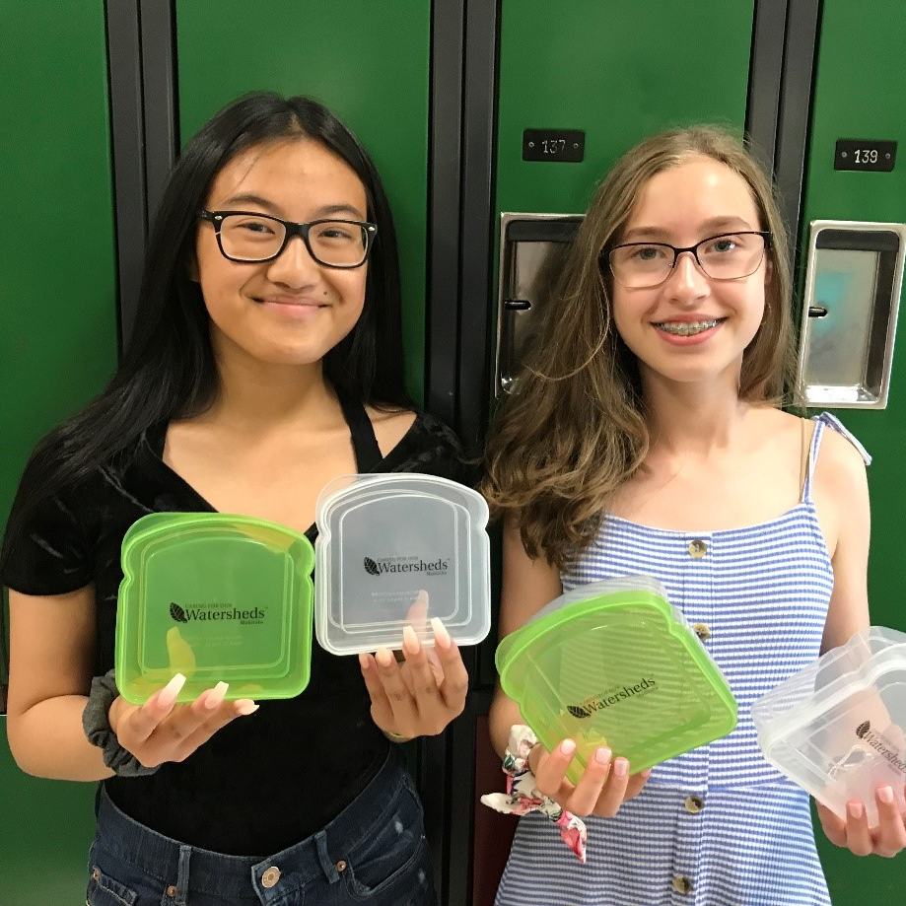
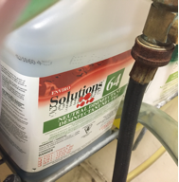
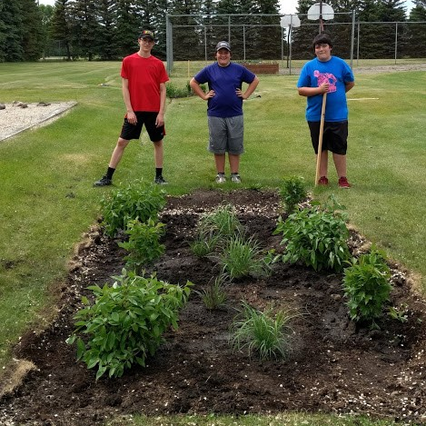
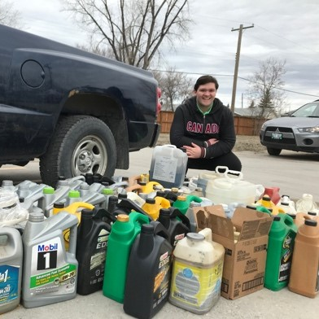
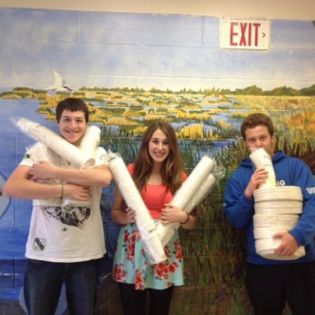
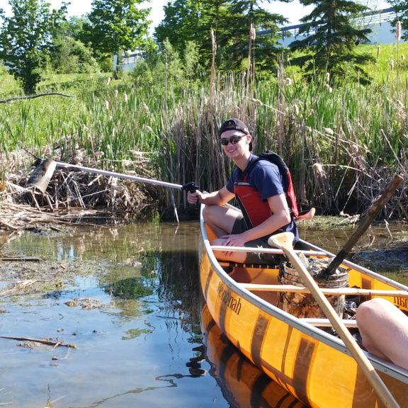
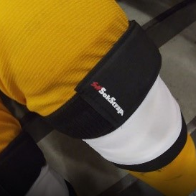
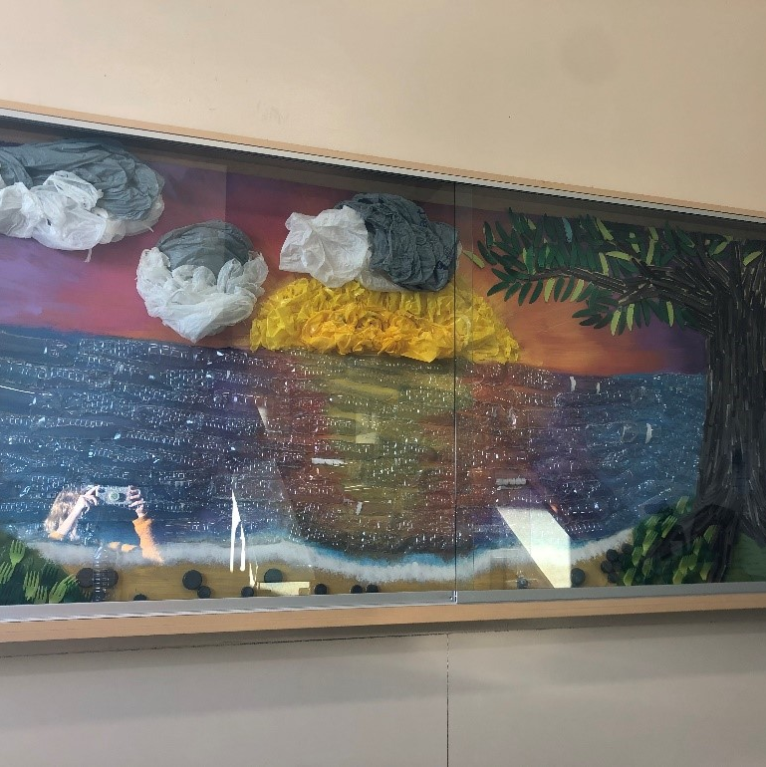
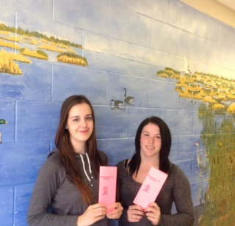
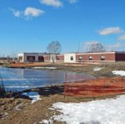
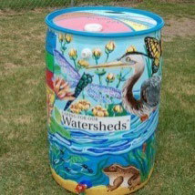
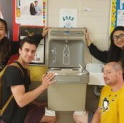
Ideas
Image from https://caringforourwatersheds.com/category/canada/manitoba/.
Notes:
Good source of ideas: https://caringforourwatersheds.com/category/canada/manitoba/
Photos:
Don’t flush medications
Making the cafeteria greener
Replacing cleaning solutions with green ones
Create a wetland
Creek cleanup
Rain garden
Rain barrels
Mural made of recycled materials
Oil recycling drive
Reusable containers
Water bottle refilling station
Replacing hockey tape with SokStraps

Slide 10
Thank You!

