Slide 1
Sparkling Clean Water
Learning about drinking water & wastewater
Notes:
Today we will be learning about where the city of Winnipeg gets its water and how it is cleaned. We will also touch on how wastewater can be treated.

Slide 2
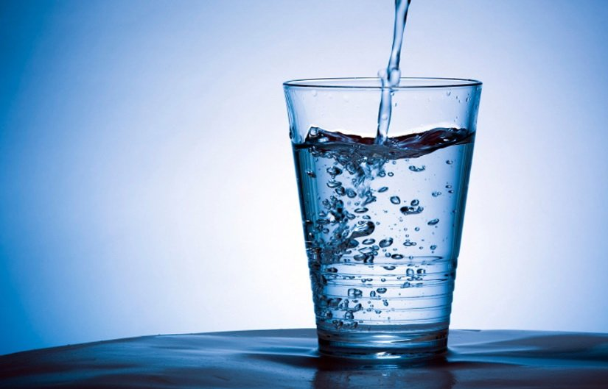
Where does drinking water come from?
Many cities of fewer than 5,000 people get their drinking water by drilling wells into groundwater supplies as do rural individuals.
Larger cities obtain their water from surface waters such as rivers and lakes.
Cities that rely on rivers as a source often dam the river.
Image from Bing Images – public domain.
Notes:
Source: http://www.lsf-lst.ca/media/LSF_-_FLOW_-_ON_Grade_8_Water_Unit_Sample.pdf

Slide 3
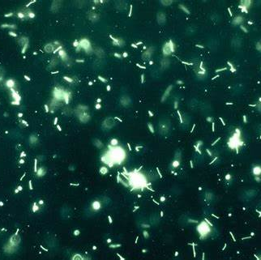
Is it good enough to drink?
The water may look clean, but is it?
Many pollutants cannot be seen and so the water needs to be treated.
What might some of those pollutants be?
Detergents
Heavy metals
Pathogens
Pesticides
Tiny sediments
Image from Bing Images – public domain.
Notes:
Source: http://www.lsf-lst.ca/media/LSF_-_FLOW_-_ON_Grade_8_Water_Unit_Sample.pdf (page 18 and 19)
Pages 18 and 19 discuss many possible pollutants and their effects on aquatic ecosystems. This topic is suggested as an extension of the Sparkling Clean Water activity.

Slide 4
What about Winnipeg?
Image fromhttps://winnipeg.ca/WaterAndWaste/water/treatment/plant.stm.
Notes:
Source: https://winnipeg.ca/WaterAndWaste/water/treatment/plant.stm
Click on image to get to site and then click arrow to play video.
Another resource is: https://www.water-technology.net/projects/winnipeg-treatment/.

Slide 5
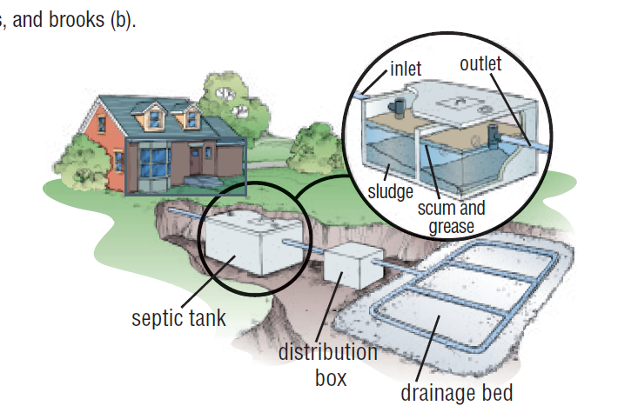
What about wastewater?
People also create a lot of wastewater
The average Canadian uses about 335 litres of water per day.
Where does this water go?
It goes down a drain into the sewer.
It needs to be cleaned as well.
There are different ways of treating this water:
Wastewater treatment plants
Septic tanks and fields
Lagoon systems
Image from https://jodivanbeek.weebly.com/uploads/2/6/1/3/26136874/11.7_waterwater_treatment.pdf.
Notes:
Source: http://www.lsf-lst.ca/media/LSF_-_FLOW_-_ON_Grade_8_Water_Unit_Sample.pdf
Wastewater treatment plants: https://www.winnipeg.ca/waterandwaste/sewage/treatmentPlant/default.stm and page 1 of: https://jodivanbeek.weebly.com/uploads/2/6/1/3/26136874/11.7_waterwater_treatment.pdf
Septic tanks and fields: page 2 of: https://jodivanbeek.weebly.com/uploads/2/6/1/3/26136874/11.7_waterwater_treatment.pdf and https://extension.uga.edu/publications/detail.html?number=B1421&title=A%20Beginner%27s%20Guide%20to%20Septic%20Systems#How
Not all wastewater goes to municipal treatment systems. Homes and small businesses in rural areas commonly have septic systems that treat their wastewater on a much smaller scale. A septic system includes a septic tank and a drainage bed. Solids are trapped in the septic tank, where bacteria slowly digest the wastes. Liquid flows to the drainage bed, where it gradually soaks into the ground.
Lagoon systems: http://web.deu.edu.tr/atiksu/ana52/ani4044-13.html

Slide 6
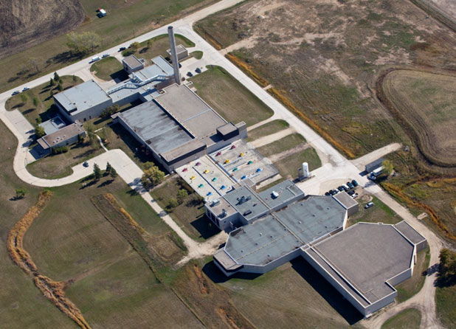
What about Winnipeg?
Sewer systems collect wastewater from industry, commercial businesses and homes. From there, it is sent to one of three wastewater treatment plants.
Wastewater is treated to remove the major contaminants (carbon, nitrogen and phosphorus) and harmful bacteria, such as E. coli.
There are five steps to treat the wastewater:
Pre-treatment
Primary treatment
Secondary treatment
Final clarification
Digestion, dewatering & solids disposal
Image from https://www.winnipeg.ca/waterandwaste/sewage/treatmentPlant/default.stm#tab-south-end-sewage-treatment-plant.
Notes:
Source: https://www.winnipeg.ca/waterandwaste/sewage/treatmentPlant/default.stm
Pre-treatment
Screens are used to remove plastics, rags, and other debris from the incoming raw wastewater. After screening, sand and grit settles to the bottom. The sand and grit are removed and trucked to the Brady Road Resource Management Facility for disposal.
Primary treatment
Next the wastewater moves into sedimentation tanks, where approximately 65% of the suspended material settles to the bottom of the tank. In addition to material that settles in the bottom of the tanks, grease and oil that floats to the surface is removed by paddles or skimmers. Primary treatment takes several hours before the wastewater moves to the next stage of treatment.
Secondary treatment
After Primary Treatment, the wastewater flows into bioreactors which contain a mixture of micro-organisms that feed on the carbon in the wastewater. Oxygen is fed into the bioreactor so the micro-organisms can metabolize the carbon they're feeding on. This process also takes several hours. The activated sludge, or biomass, must be separated from the treated wastewater. The separation takes place in another group of sedimentation tanks called Secondary Clarifiers.
Final Clarification
In the final clarifier tanks, the biomass from the bioreactors settles out by gravity. About 25 to 50% of the settled biomass is returned to the head of each bioreactor to begin the process again.
The biomass that is reused provides a constant source of micro-organisms to the incoming wastewater for treatment. Because the biological growth within the bioreactors produces more biomass than is needed, some of it must be removed.
This excess biomass, called Waste Activated Sludge, is pumped to the Digesters, where it decomposes. All the material that settles in the Primary Clarifiers is also pumped to the Digesters.
Digestion, Dewatering and Solids Disposal
During digestion, the anaerobic bacteria break down the solids over the course of about 15 days. About half of the solids are destroyed during this process.
In the Digesters, a different type of bacteria, called anaerobes, feed on the carbon in the solids to produce biogases—mainly carbon dioxide and methane. Methane is recovered at the North End Sewage Treatment Plant (NEWPCC) and used to heat the Digesters and other buildings.
Once digestion is complete, excess water must be removed from the digested sludge. Dewatering is accomplished using high speed mechanical centrifuges. The liquid produced during dewatering is returned to another activated sludge process designed specifically to remove ammonia and nitrogen produced during digestion.
Digested material contains about 2% solids but is thickened to about 25% before being transported. The thickening process significantly reduces the volume of material that must be transported for final disposal. The thickened solids, now called biosolids, are trucked to the Brady Road Resource Management Facility. On average, Brady Road receives 36,000 kg of biosolids each day for final disposal.

Slide 7
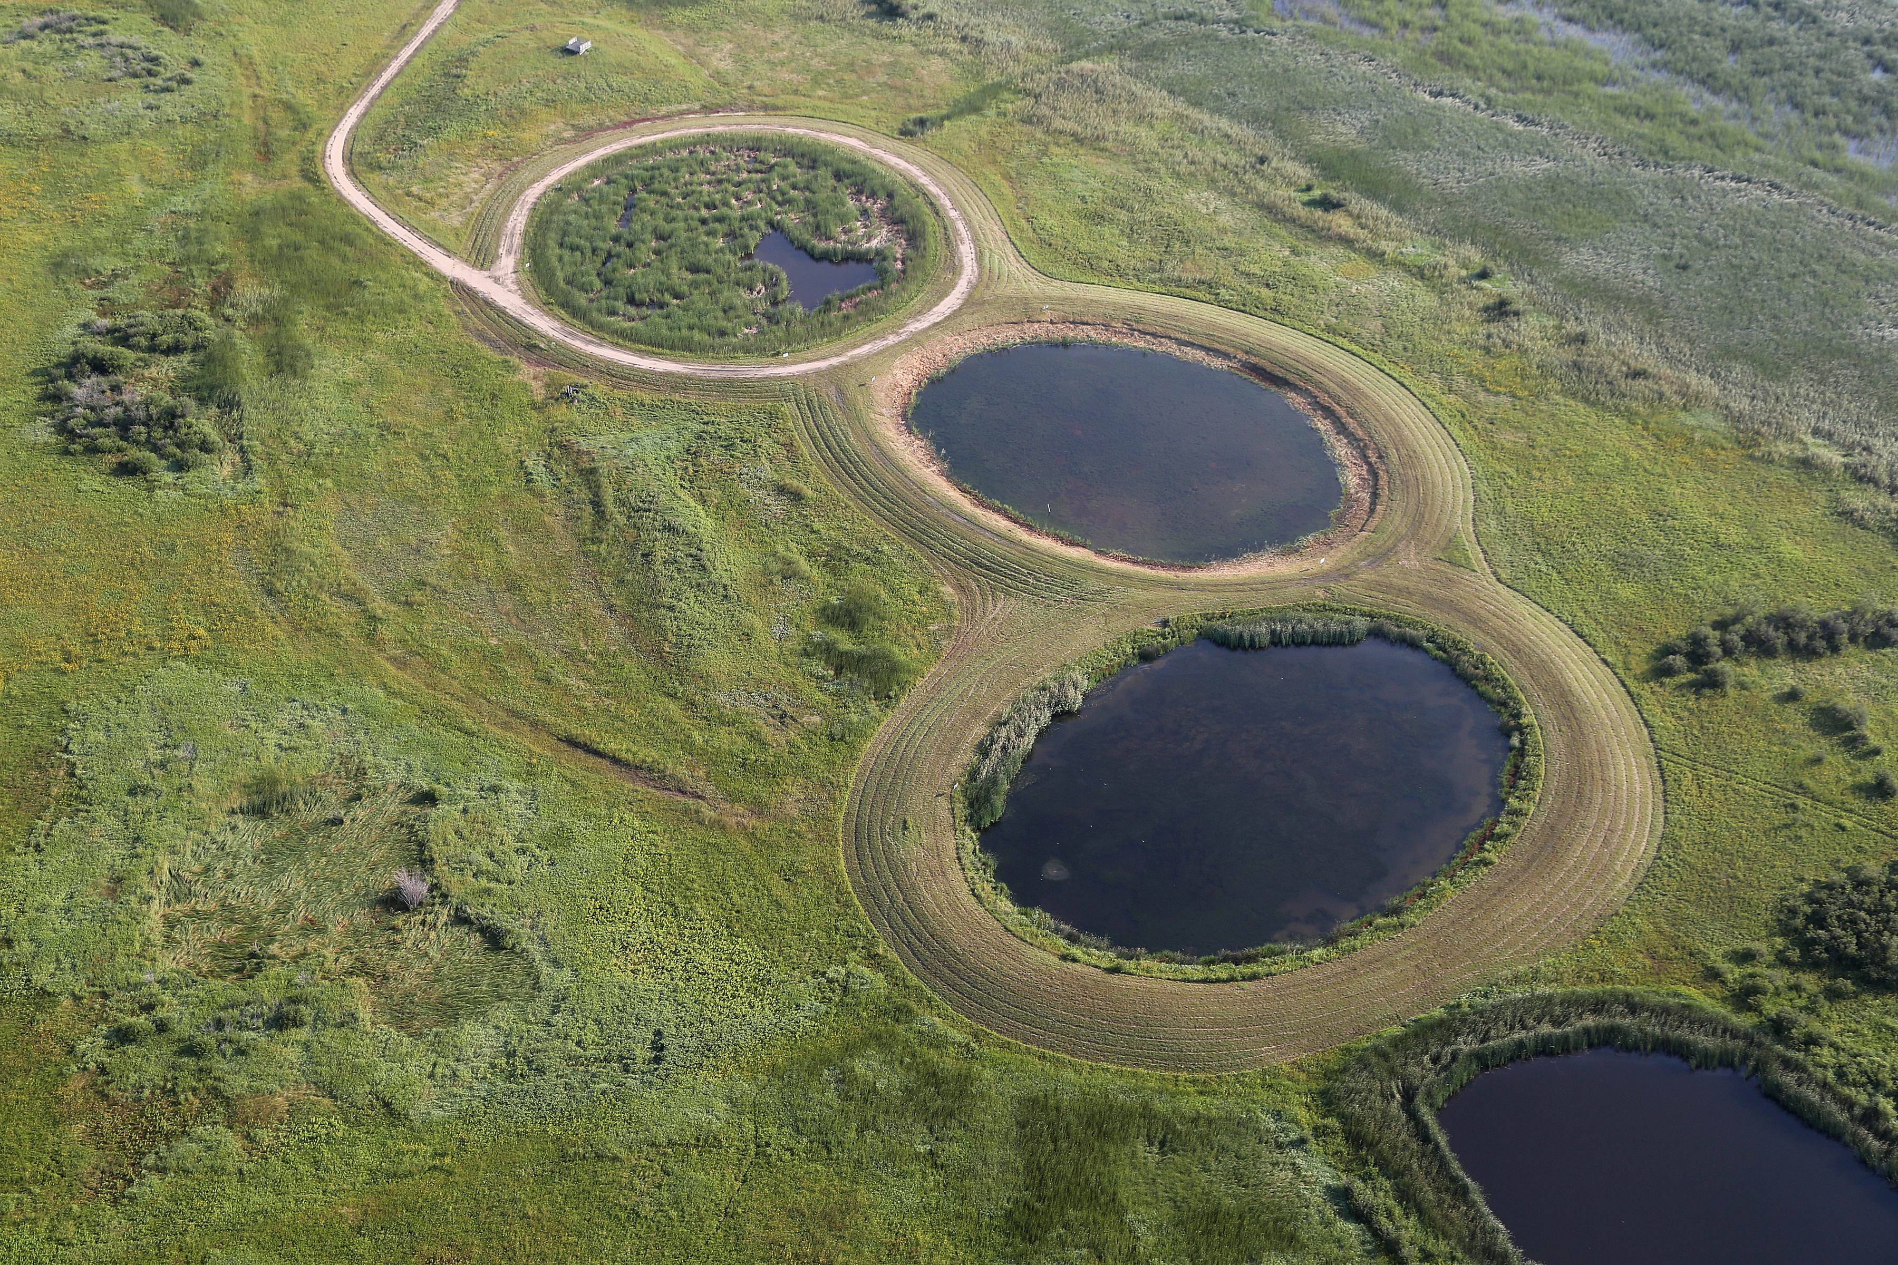
What do wetlands do?
They act as natural wastewater treatment.
They are important for clean water and a healthy environment.
They slow the passage of water and encourage the deposition of nutrients and sediments carried by water.
They can also remove toxic substances and heavy metals.
Natural wetlands should not be used for wastewater treatment; only constructed, artificial wetlands should be used for this purpose.
Image from Ducks Unlimited Canada.
Notes:
See the Oak Hammock Marsh Lagoon System pdf document under Support Materials on the website.
Natural wetlands should not be used for wastewater treatment; only constructed, artificial wetlands should be used for this purpose.
Ducks Unlimited Canada built an artificial wetland that cleans the 8,637,900 litres (1,900,600 gallons) of wastewater from the Conservation Centre per year.
How lagoons work in general
Lagoons are shallow, man-made ponds that are built to maximize natural treatment processes.
In a lagoon, bacteria break the sewage down to gases and other simple materials that dissolve in the water.
The bacteria are able to perform their task by using oxygen that is produced by algae which grows in the water.
Algae are one celled microscopic plants that grow in water. They need sunlight to live, as they convert carbon dioxide into oxygen.
The algae also require some of the simple compounds produced as the bacteria break the sewage down.
Sunlight can penetrate the water to a depth of 1.2 metres (4 feet).
The depth of the lagoon means that the bottom layer of the lagoon receives no sunlight and no algae will grow. This leads to an anaerobic zone (no oxygen), if its depth is too great then the lagoon starts to smell.
Most lagoons are 1.52 metres deep (5 feet) so that they don’t freeze to the bottom.
The bottom of the lagoon therefore receives materials that have settled out and is oxygen free.

Slide 8
Thank You!

