Slide 1
Cycling & Recycling
Exploring The roles of scavengers & decomposers
Notes:
As we explore the role of scavengers and decomposers in cycling energy and nutrients through an ecosystem, we will be using wetlands as our ecosystem example, which is a common habitat found in Manitoba covering 40% of this province. This means that all the animals and plants you see used in this presentation live in wetlands. What are wetlands? Well…

Slide 2
What is a Wetland?
An area of land that is permanently or periodically saturated with water
Has plants that are adapted to water or moist-soil conditions
The deepest a wetland can be is 2 metres (a little more than 6’5’’)
An ecosystem and habitat for many types of living things
Types of Wetlands:
Freshwater Marsh
Fen
Swamp
Bog
Shallow Open Water
Notes:
Note: For more details regarding each type of wetland’s specific characteristics, see the supportive materials from Grade Seven’s Pre-Activity 1: Know Your Zone!

Slide 3
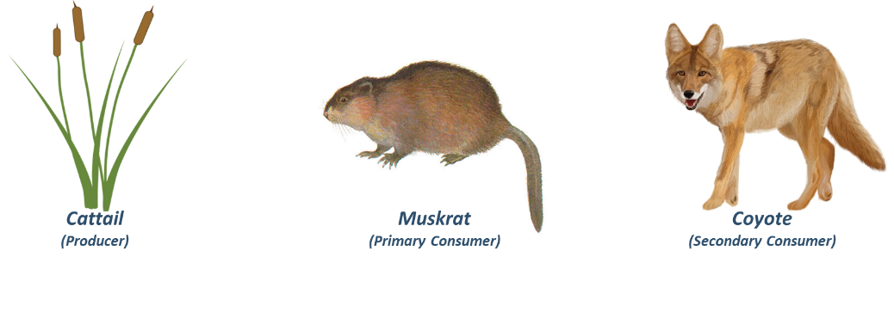
Transfer of Energy & Nutrients
In every ecosystem, including wetlands, there is a transfer and movement of energy and nutrients.
In its simplest form, this movement can be shown in a food chain.
Muskrat eats the Cattail.
Coyote eats the Muskrat.
Energy/Nutrient
Movement
Energy/Nutrient
Movement
Cattail image from clipground.com. Muskrat image from naturalunseenhazards.wordpress.com. Coyote image from yedraw.com.
Notes:
Review the following concepts:
An ecosystem is a place on Earth where living things interact with other living things as well as non-living things. In other words, a community of interacting organisms and their physical environment. An ecosystem can be very small or large, ranging from the microscopic to the entire biosphere.
A food chain shows how energy is transferred from one living thing to the next. Food chains always begin with a producer, which will always be some form of plant. Plants convert the Sun’s energy into consumable energy, so when a plant is consumed, the plant’s energy is given to the animal who ate it, and is referred to as the primary consumer. The consumer who eats the primary consumer is called the secondary consumer, and the chain goes on and on from there.

Slide 4
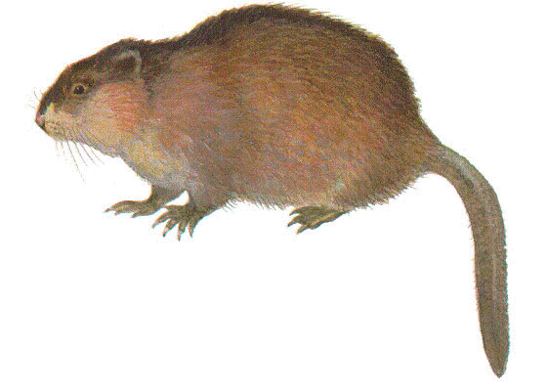
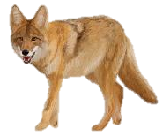
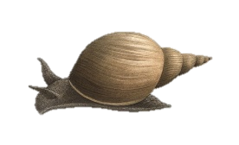
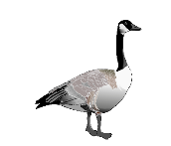
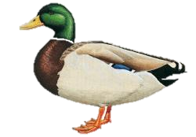
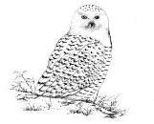
Transfer of Energy & Nutrients
Another way of showing the movement of energy and nutrients is through a food web, which shows the complexities of energy and nutrients moving within an ecosystem.
Energy & Nutrients
Muskrat
(Consumer)
Coyote
(Consumer)
Pond Snail
(Consumer)
Cattails
(Producer)
Snowy Owl
(Consumer)
Cottontail
(Consumer)
Grass
(Producer)
Canada Goose
(Consumer)
Mallard
(Consumer)
Muskrat image from naturalunseenhazards.wordpress.com. Coyote image from yedraw.com. Pond snail image from memrise.com. Cottontail image from kidssearch.com. Canada goose image from pngimg.com. Snowy owl image from birdwatchersgeneralstore.com. Mallard image from hbw.com. Grass image from supagro.fr. Cattail image from clipground.com
Notes:
Review the following concepts:
A food web is a way to demonstrate the predator-prey and consumer-producer relationships within an ecosystem (of whatever size), and is made up of a network of food chains. A food web will always include producers (plants who convert the Sun’s energy to consumable energy) and consumers (those who eat living things). Unlike a food chain, food webs are able to show the more complex and interconnected nature of living things within a particular ecosystem.

Slide 5
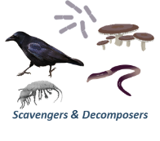
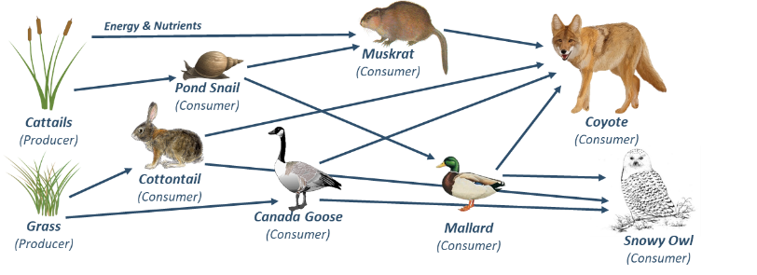
Transfer of Energy & Nutrients
Energy and nutrients don’t always move in a straight line - scavengers and decomposers consume dead plants and animals, and their scat (poop!).
A scavenger eats organisms they did not kill themselves.
A decomposer breaks down organic matter into simple nutrients that can be used again by other living things.
Muskrat image from naturalunseenhazards.wordpress.com. Coyote image from yedraw.com. Pond snail image from memrise.com. Cottontail image from kidssearch.com. Canada goose image from pngimg.com. Snowy owl image from birdwatchersgeneralstore.com. Mallard image from hbw.com. Grass image from supagro.fr. Cattail image from clipground.com
Notes:
Review the following concepts:
A scavenger is an animal that eats the bodies of organisms they did not kill themselves. Their food may have been killed by a different predator, or died of disease, accident, etc. Many scavengers eat meat, but some also eat decaying plant matter. Scavengers are mostly carnivorous or omnivorous animals. They may scavenge some or all of their food. Examples of wetland scavengers include ravens, foxes, shrimp, beetles, and worms.
A decomposer is an organism that breaks down organic matter into inorganic nutrients such as carbon or nitrogen. These nutrients are returned to the soil, where they will be used by plants and re-enter the food chain. Decomposers are generally small invertebrates such as flies, and microorganisms such as fungi and bacteria

Slide 6
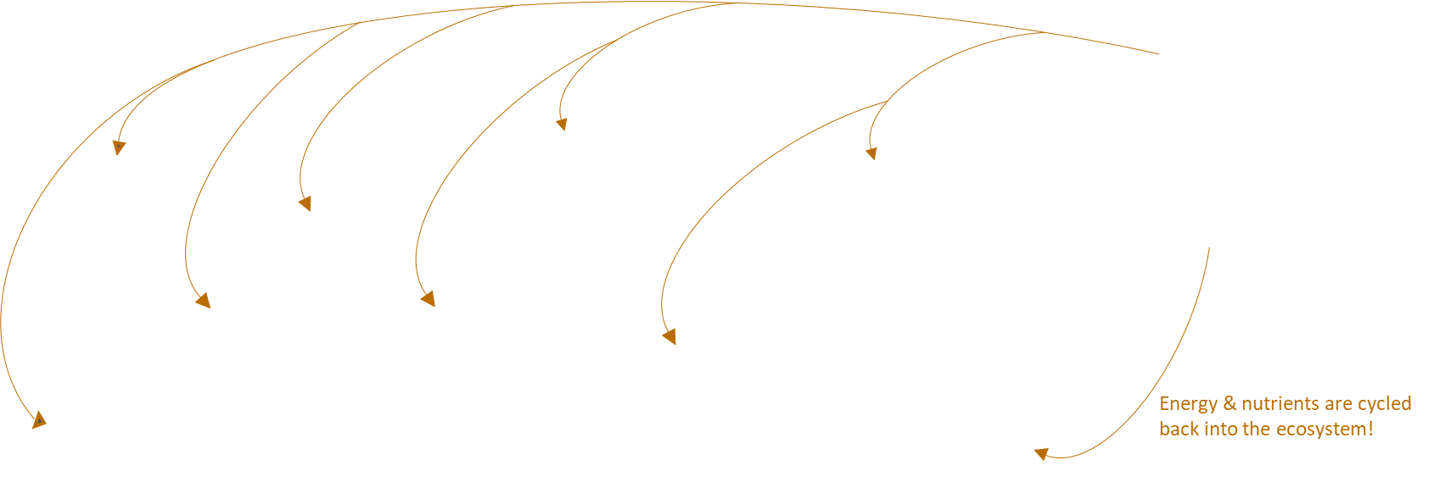
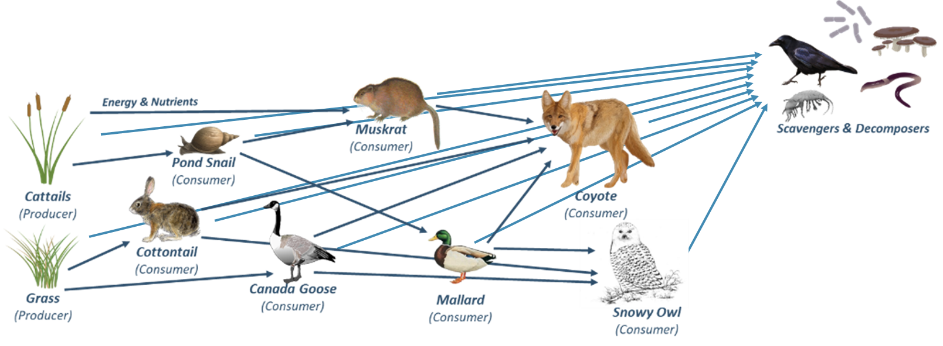
Transfer of Energy & Nutrients
Both scavengers and decomposers cycle organic matter through the ecosystem by returning nutrients to the soil, and by being eaten themselves!
Muskrat image from naturalunseenhazards.wordpress.com. Coyote image from yedraw.com. Pond snail image from memrise.com. Cottontail image from kidssearch.com. Canada goose image from pngimg.com. Snowy owl image from birdwatchersgeneralstore.com. Mallard image from hbw.com. Grass image from supagro.fr. Cattail image from clipground.com
Notes:
Review the following concepts:
Scavengers and decomposers act as nature’s recycling system! They make energy and nutrients accessible to other organisms in the food chain.

Slide 7
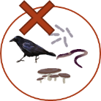
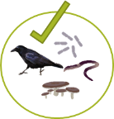
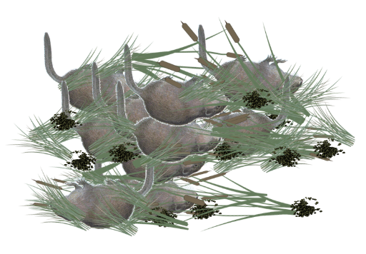
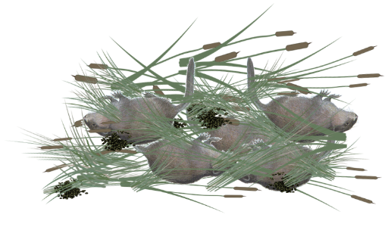
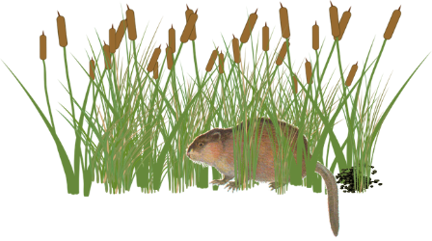
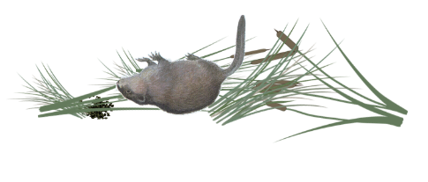
Scavengers & Decomposers
Both scavengers and decomposers play an important role in ecosystems. Imagine a world without them – it would be filled with dead organisms and their waste! Without their recycling abilities no nutrients would be returned to the soils, and soon the ecosystems’ food webs would break down.
Cattail image from clipground.com. Muskrat image from naturalunseenhazards.wordpress.com. Scat image from petpooskiddoo.com. Grass images from supagro.fr
Notes:
Review the following concepts:
Scavengers and decomposers prevent dead matter and waste from piling up. If they all disappeared, the world would soon be covered in dead matter, and eventually the ecosystems’ food webs would break down. Once all the available nutrients had been used up, there wouldn’t be any more returning to the ecosystem, and the living organisms would run out, and eventually die.

Slide 8
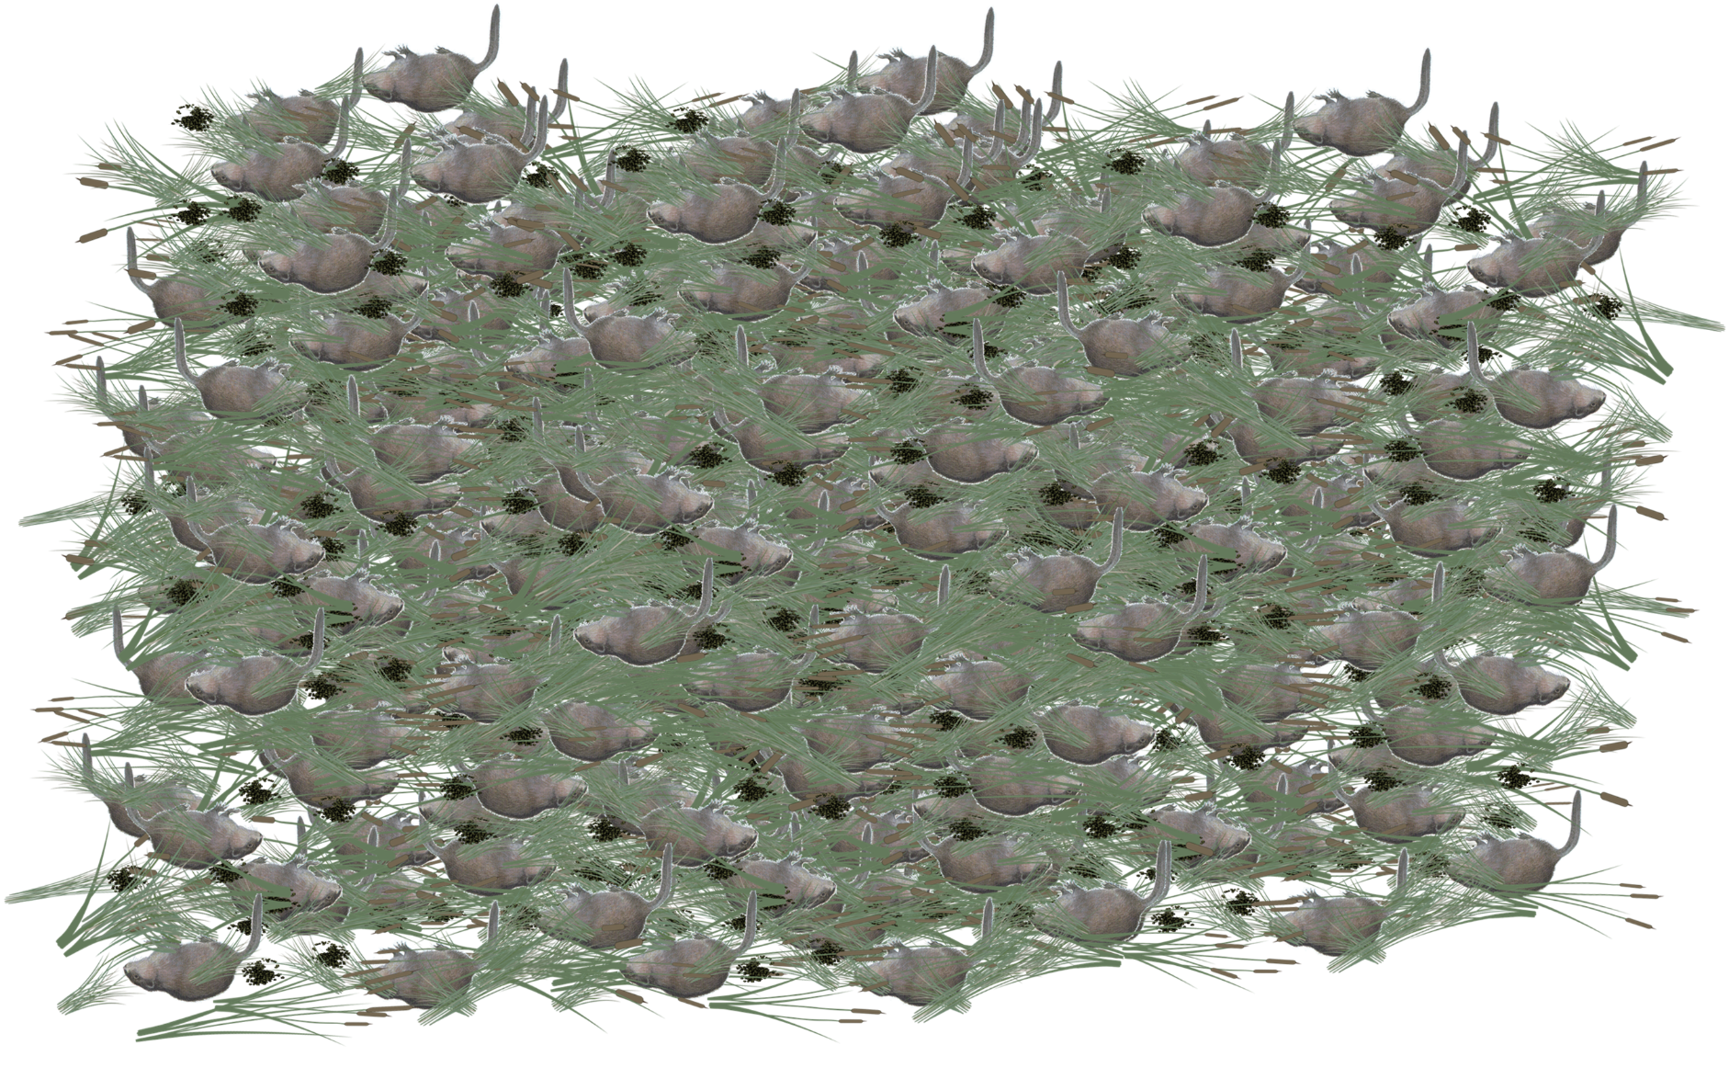
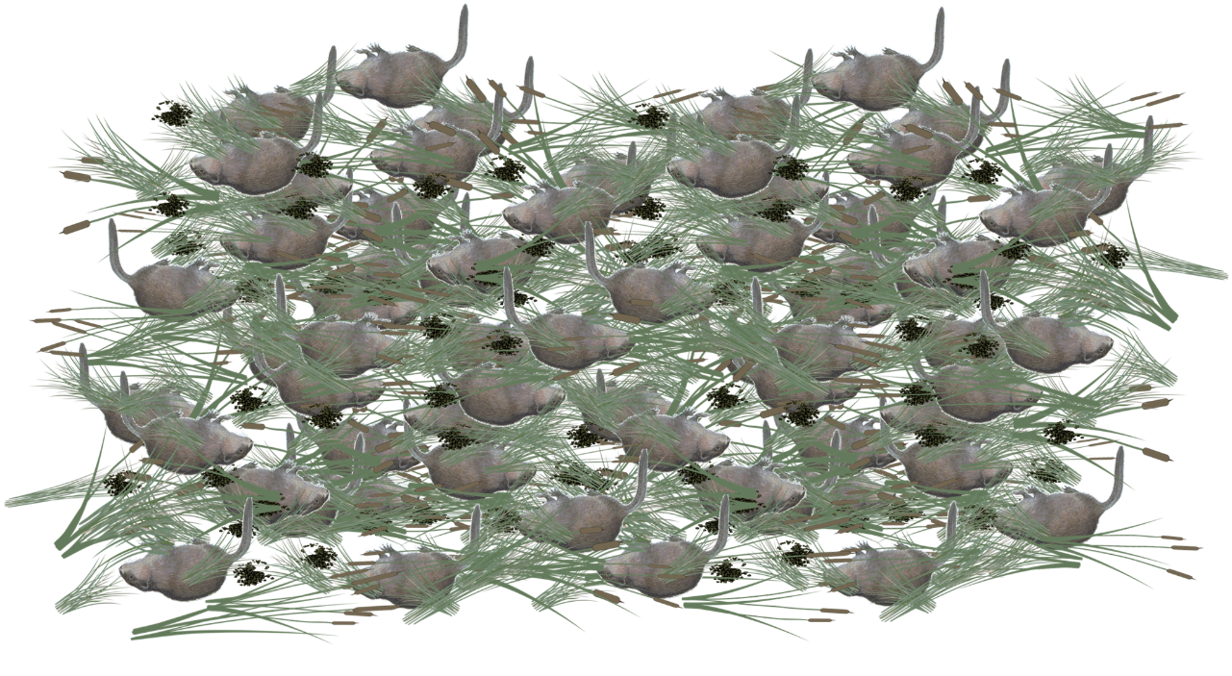
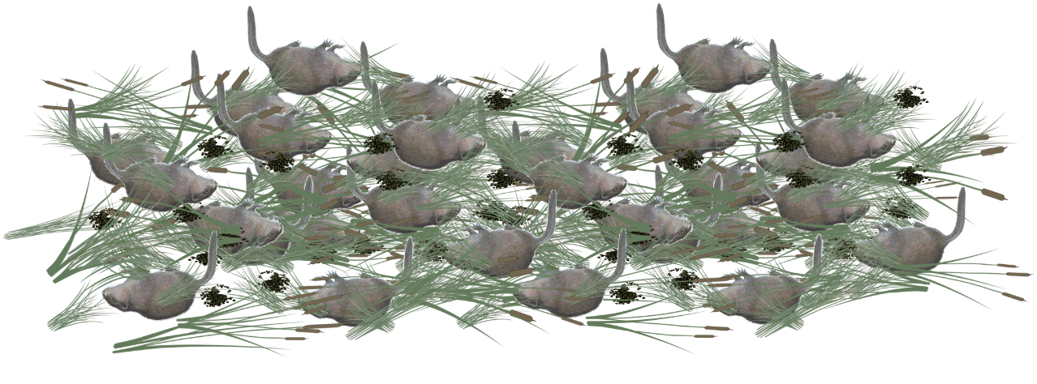

Slide 9
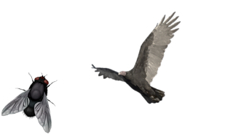
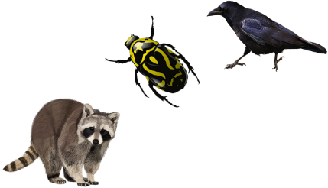
Types of Scavengers
A scavenger eats organisms they did not kill themselves. They consume dead plant & animal material.
Some animals only eat food they have scavenged
- Vultures
- Blowflies
Many animals will scavenge if they have the opportunity
- Ravens
- Beetles
- Raccoons
Raccoon image from yedraw.ca.
Notes:
Review the following concepts:
Most animals (especially carnivores and omnivores) scavenge if they are given the opportunity – don’t turn your nose up at a free lunch! But some animals are better adapted for scavenging than others. Vultures, for example, are specialized scavengers.

Slide 10
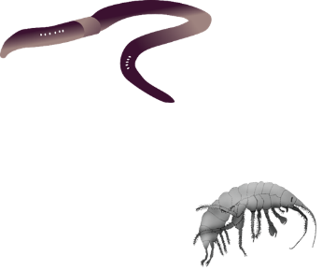
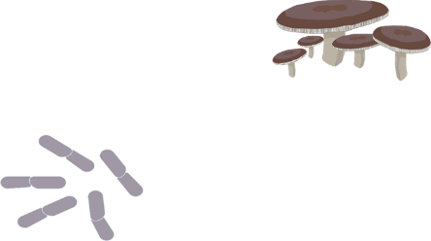
Types of Decomposers
A decomposer breaks down organic matter into simple nutrients that can be used again by other living things.
Some decomposers are invertebrates
- Worms
- Shrimp
Some decomposers are microorganisms
- Bacteria
- Fungi
Notes:
Invertebrates are animals without backbones
Microorganisms are organisms that are too small to be properly seen without a microscope

Slide 11
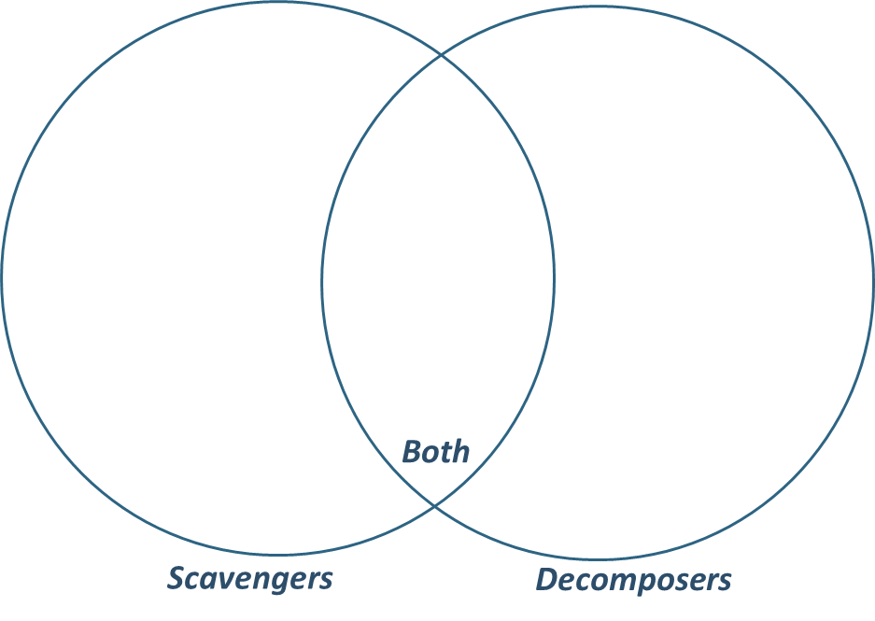
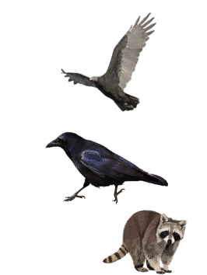
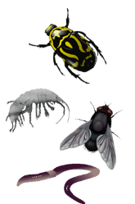
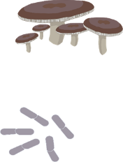
Types of Scavengers & Decomposers
Some scavengers also act as decomposers
Raccoon image from yedraw.ca.
Notes:
Some scavengers also act as decomposers – animals that eat dead organisms or their waste (poop) and break it down into simple nutrients that can be used again by other organisms such as plants. These nutrients are returned to the soil (or water in an aquatic ecosystem), where it is accessible.
Remember:
Scavenger = Animal that eats dead organic matter
Decomposer = Organism that breaks organic material down into simple nutrients that can be used by other organisms (such as plants!)
Large scavengers generally don’t break nutrients down, but many small scavengers do!

Slide 12
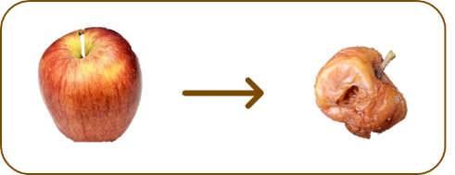
Scavengers & Decomposers
Scavengers and decomposers can be found in every ecosystem on earth! Today, we will be looking at some that live in our ecosystem.
We will place apples outside and observe how scavengers and decomposers affect them.
Notes:
See activity outline for instructions.

Slide 13
Thank You!

