Slide 1
Know Watersheds!
Learning about Canada’s watersheds
Notes:
Today we will be learning about watersheds, and how humans interact with them. We will be learning about the 5 broad watersheds that cover Canada.

Slide 2
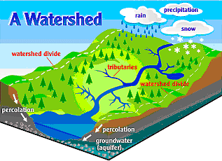
What is a Watershed?
A watershed, also known as a drainage basin, is an area of land where all water drains to a central point like a lake, river, or stream.
Each large watershed is made up of smaller watersheds.
Image from Bing Images – public domain.
Notes:
Source: https://www.usgs.gov/special-topic/water-science-school/science/watersheds-and-drainage-basins?qt-science_center_objects=0#qt-science_center_objects
A watershed is an area of land that drains all the streams and rainfall to a common outlet such as the outflow of a reservoir, mouth of a bay, or any point along a stream channel. Watersheds can be as small as a footprint or large enough to encompass all the land that drains water into rivers that drain into Hudson Bay, where it enters the Arctic Ocean.
The word "watershed" is sometimes used interchangeably with drainage basin or catchment. Ridges and hills that separate two watersheds are called the drainage divide. The watershed consists of surface water--lakes, streams, reservoirs, and wetlands--and all the underlying groundwater. Larger watersheds contain many smaller watersheds. It all depends on the outflow point; all of the land that drains water to the outflow point is the watershed for that outflow location. Watersheds are important because the streamflow and the water quality of a river are affected by things, human-induced or not, happening in the land area "above" the river-outflow point.

Slide 3
What is a Watershed?
Image from https://caringforourwatersheds.com/.
Notes:
Source: Nutrien’s Caring for Our Watersheds https://youtu.be/K_o-jK6vWIo
Click on image to play video.

Slide 4
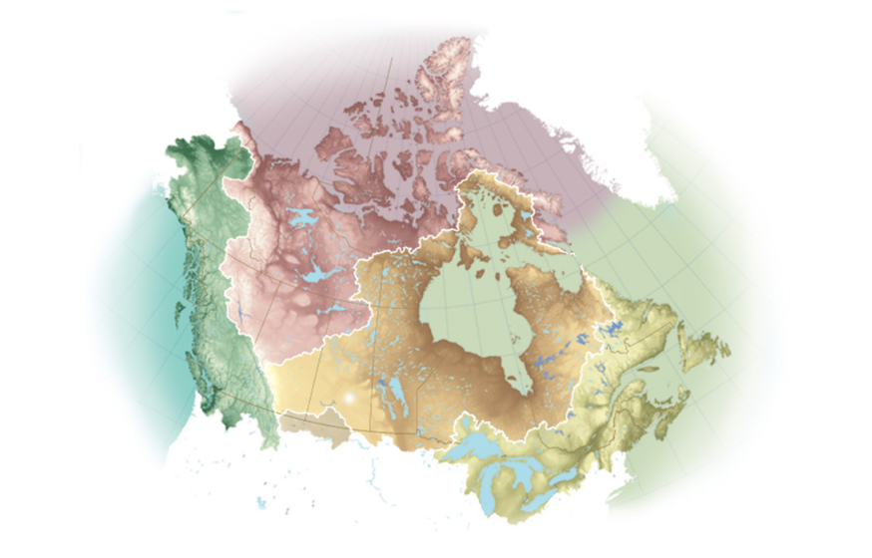
Canada’s Watersheds?
Canada has 5 large watersheds:
Pacific Ocean
Arctic Ocean
Hudson Bay
Gulf of Mexico
Atlantic Ocean
Click on image to explore Canadian Geographic’s map.
Image from http://www.canadiangeographic.com/watersheds/map/?path=english/watersheds-list.
Notes:
Explore with your students the five watershed by clicking on each region. This will help them learn what region each watershed covers.
Source: http://www.canadiangeographic.com/watersheds/map/?path=english/watersheds-list

Slide 5
Know Your Watersheds!
You will be researching one of Canada’s watersheds and then presenting your findings. Your research must answer the following questions:
Where does the water come from? Where does it go?
Research the watershed catchment area, including the geography of the area, the types of water sources, size, outlet, etc.
2) What kinds of animals might rely on the watershed?
3) How do people use the land and the water in the watershed?
Research the key uses.
4) What are some of the threats to the watershed?
Think about the kinds of threats both natural and human.
Notes:
Students, individually or in groups, will each be researching and analyzing one of the watersheds. Either assign or have students choose a watershed. It is recommended that each watershed is covered.
Some of the information may not be specific to their chosen watershed, but knowing what areas the watershed covers students should be able to discover which animals use it, how people use it and what are some of the potential threats. Students will then present their findings to the class, which should clearly communicate the answers to the above questions.
Good sources:
https://science.howstuffworks.com/environmental/conservation/issues/watershed2.htm
https://cwf-fcf.org/en/resources/for-educators/resource-sheets/you-live-in-a-watershed-get.html

Slide 6
Thank You!

