Slide 1
Ecological Succession
Change over time
Notes:
As we explore ecological succession and zonation in an ecosystem, we will be using wetlands as our ecosystem example. Wetlands are a common habitat found in Manitoba covering 40% of this province. This means that all the animals and plants you see used in this presentation live in wetlands. Ask students to recall their recent trip to Oak Hammock marsh, a wetland habitat!
Ask students if they remember what two “ingredients” are required to make a wetland. (Water & Plants)
What is the maximum depth of water in a wetland? (2 m – about the height of a doorway)

Slide 2
What is a Wetland?
An area of land that is permanently or periodically saturated with water
Has plants that are adapted to water or moist-soil conditions
Has water 2 metres deep or less
Types of Wetlands:
Freshwater Marsh
Fen
Swamp
Bog
Shallow Open Water
Notes:
Note: For more details regarding each type of wetland’s specific characteristics, see the supportive materials from Grade Seven’s Pre-Activity 1: Know Your Zone!

Slide 3
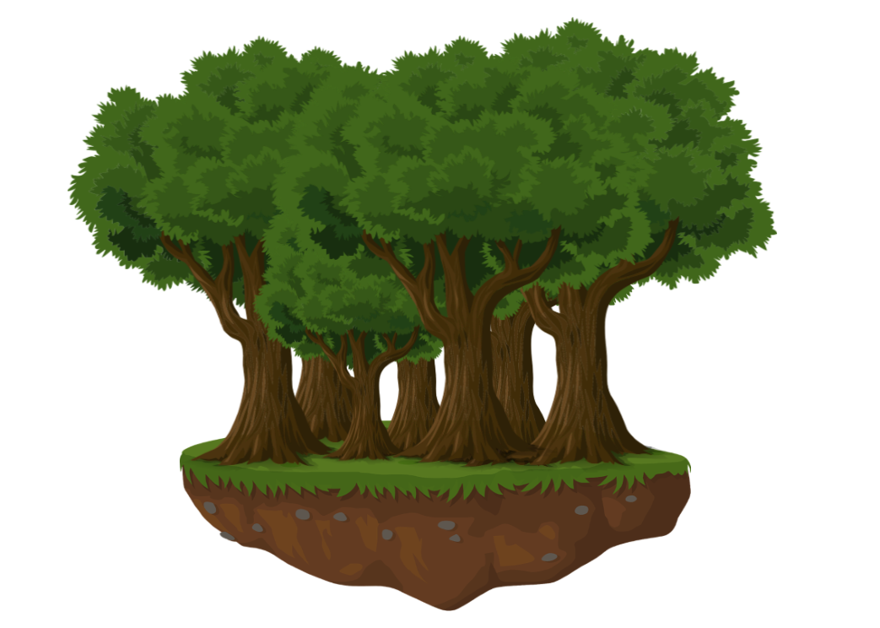
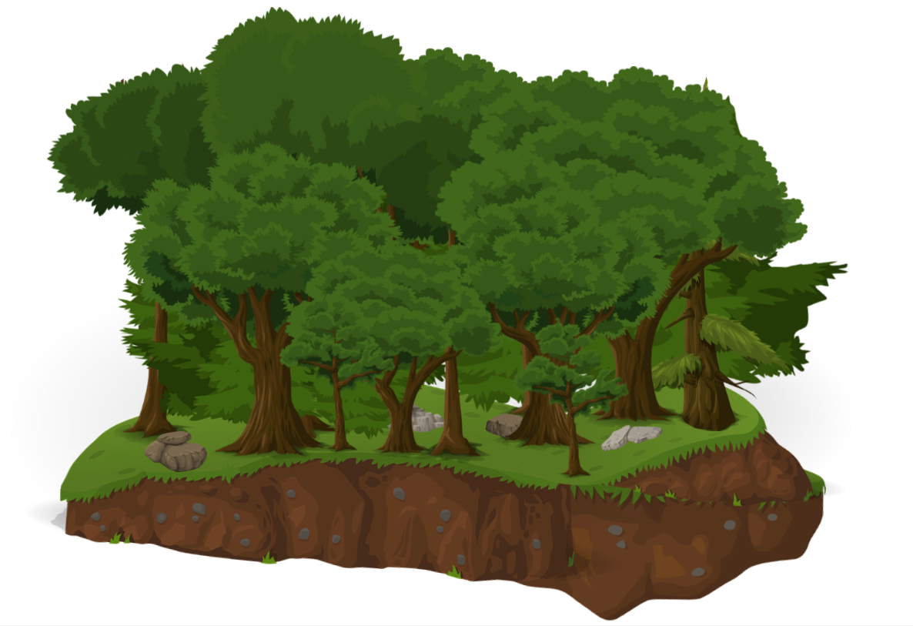
Ecological Change
Ecosystems are not homogeneous, meaning they aren’t made of many identical parts.
Instead, there is a mix of plant and animal species, and landscape features.
Today we will be looking at how ecosystems change over space (zonation) and over time (succession).
Then we will be acting out succession in a wetland ecosystem.
Notes:
Reflect on your recent visit to Oak Hammock Marsh. Were all the plants the same in every single place? No, of course not! In some places there were lots of phragmites, and in others lots of cattails. Some areas had few plants, and instead had lots of open water. This is an example of an ecosystem that is heterogeneous!
Review the following terms:
Homogeneous: Consisting of parts that are all the same. Identical throughout.
Heterogeneous: Made up of parts that are not the same as one another.
(Think of the difference between drinking a smoothie and eating fruit salad)

Slide 4
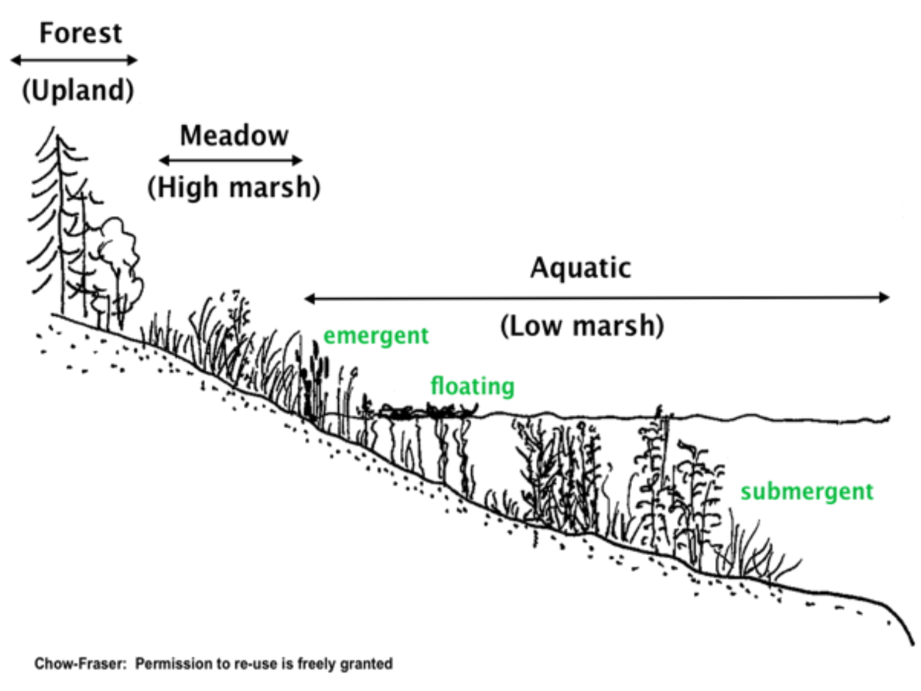
Ecological Zonation
Different organisms tend to live in different places, because they are adapted to handle different environmental conditions. Where an organism is found is influenced by both biotic and abiotic factors.
These factors are not identical everywhere in an ecosystem. This leads to zonation – different organisms found in different places, in a predictable pattern.
Image from Chow-Fraser
Notes:
Review:
Biotic = living components of an ecosystem
Abiotic = non-living components of an ecosystem
Zonation is the observed pattern of distinct flora and fauna over an area. Different communities of organisms are found in different places as a result of changes in abiotic and biotic factors.
In the example, different kinds of plants are seen at different water levels. Large trees grow in the dry upland forest, grasses grow in the high marsh meadow, which transitions into cattails and bulrushes at the edge of the aquatic low marsh. Lily pads and duckweed float at the surface of the shallow water, while coontail and pondweed grow submerged in the deepest parts of the marsh.

Slide 5
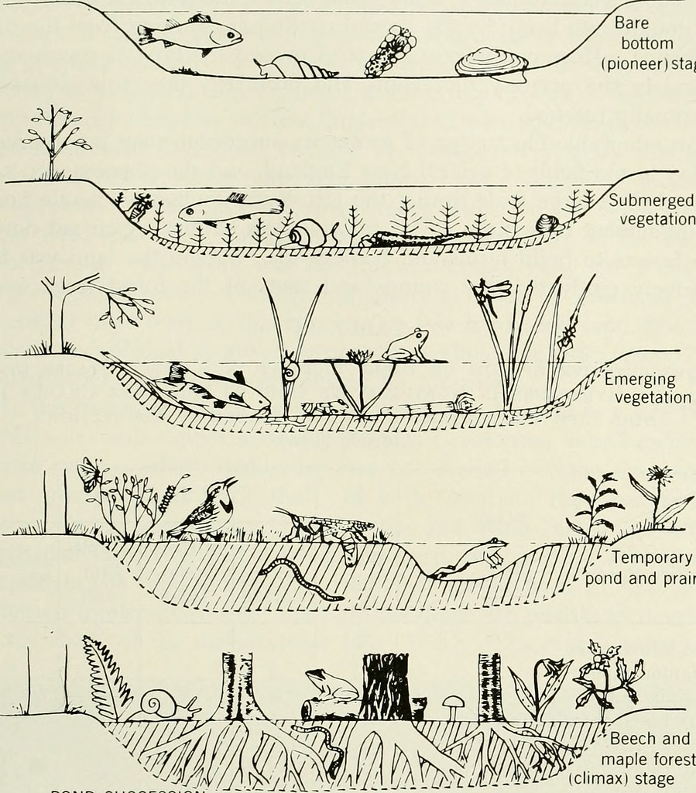
Ecological Succession
Ecosystems don’t just change over distance, they also change over time. This is known as ecological succession.
Time
Image from “Elements of Ecology” (1954)
Notes:
Ecological succession is the process of change in an ecological community’s species structure over time. The timescale could be viewed as tens, hundreds, or thousands of years. Not all ecosystems change at the same rate, or in the same way.
Note that although ecological succession is typically examined through the plant life in an ecosystem, the community of animal species in an ecosystem also changes in predictable ways.

Slide 6
Ecological Succession
The environment an organism lives in is always changing.
These changes are sometimes caused by the vegetation itself, such as tall plants creating shaded conditions, or decaying plant matter leading to more nutrients in the soil.
Sometimes changes are caused by other factors, such as floods, droughts, or seed dispersal by animals. Events which alter established communities, such as fires, are called disturbance events.
In a grassland, grasses and shrubs grow rapidly in the abundant sunlight.
Young trees sprout, shading the area underneath them.
Eventually the grasses disappear because they are not able to tolerate the shade.
Image from CNX OpenStax via Wikimedia Commons
Notes:
Long-term shifts in climate (such as changes in temperature, average rainfall, etc.), also produce successional changes in ecosystems. Today our climate is undergoing a radical shift. What might our ecosystems look like in 100 years? 1 000 years? 10 000 years?
Changes in an ecosystem can increase the rate of succession (such as animals dispersing seeds into an area) or decrease it (such as frequent droughts preventing the growth of trees). Some changes can even affect the sequence of succession. Disturbance events are events which severely disrupt an ecosystem, and destroy the existing community.
Primary Succession: Occurs in an area where plant life has never been before, such as lava flows, or glacial retreat.
Secondary Succession: Occurs in an area where life has been before, but a disturbance event destroyed the pre-existing community.

Slide 7
Succession Stages
Different types of communities are formed at different stages of succession.
Pioneer Community
Seral Community
Climax Community
First stage of succession
Fast-growing
Short-lived
Shade-intolerant
Intermediate stages of succession
Medium-growing
Medium-lived
Semi-shade-tolerant
Final stage of succession
Slow-growing
Long-lived
Shade-tolerant
Image from CNX OpenStax via Wikimedia Commons
Notes:
Succession begins with a pioneer community, then transitions into a seral community (typically multiple seral communities occur in sequence), eventually reaching a stable climax community.
In the example shown, grasses are the first plants to grow in an area. They grow quickly and are generally the first plants to sprout in an area, but do not live long and require sunny conditions (pioneer community). As they die and decompose, the soil is enriched, and seeds from slower-growing plants such as trees begin to germinate (seral community). As the tree saplings grow, they shade the ground around them, preventing new grasses from growing, and eventually a forest is established.
Just as the first plants to grow are fast-growing, sun-loving species, so are the first trees. In Manitoba’s forests the first trees to grow in open areas are typically aspen and birch; they grow quickly but do not live long. Under them shade-tolerant species such as maples and pines grow, and eventually take over.
Climax communities are dominated by species that live a long time and can grow in the presence of their own adults.

Slide 8
Although succession can result in a climax community, in reality this rarely occurs.
A climax community is one in which the species composition is not changing over time. Because ecosystems are always subject to disturbance events, all communities will change eventually.
Climax Communities
Image from Katelyn Murphy via Wikimedia Commons
Notes:
Climax communities are communities whose species composition is relatively stable, as long as no disturbance events occur.

Slide 9
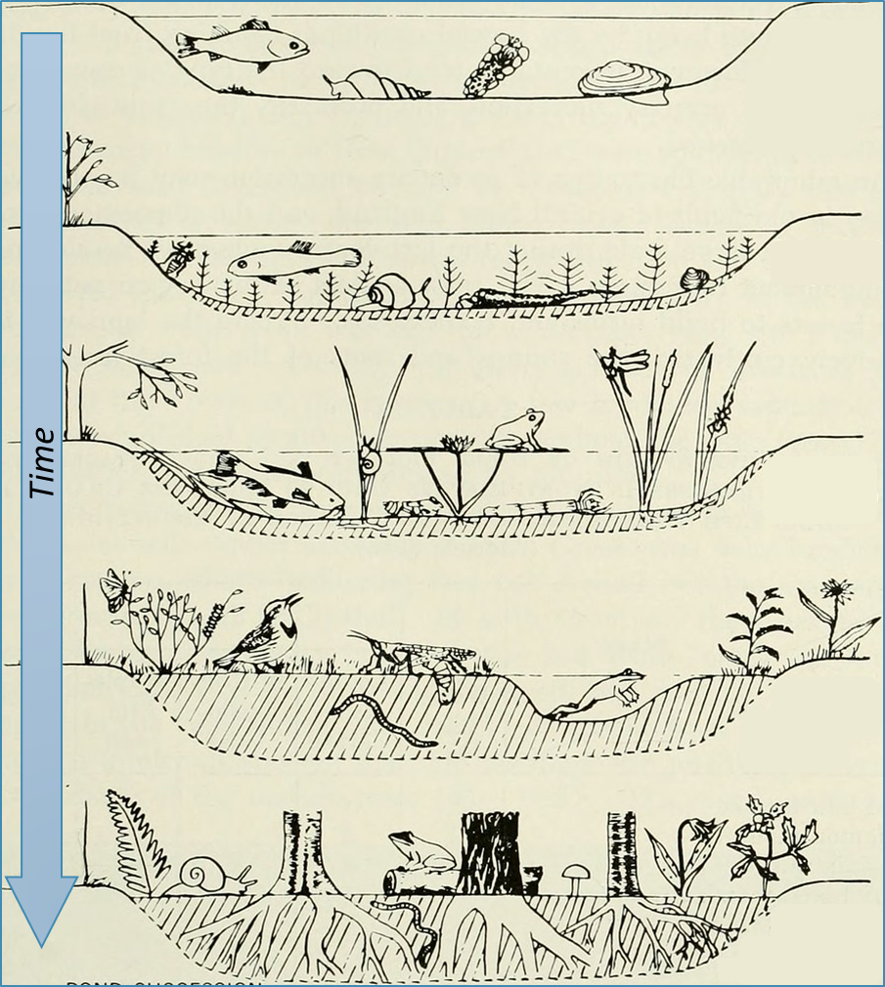
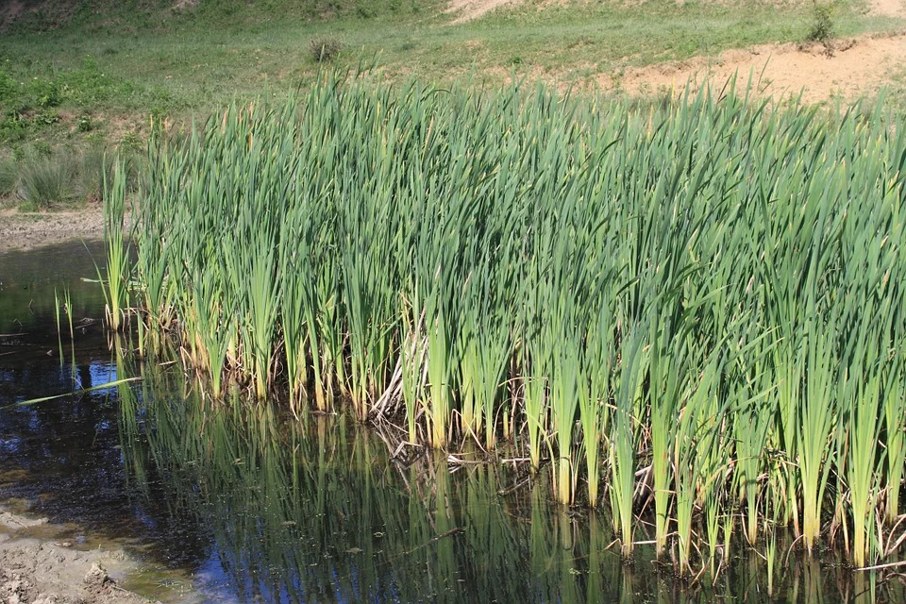
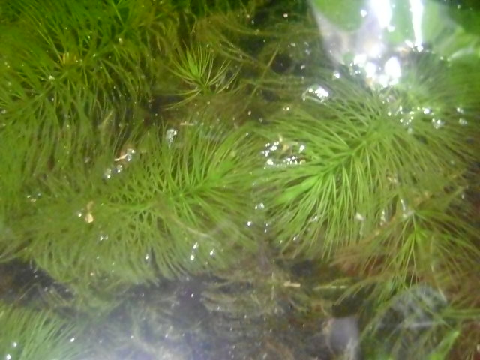
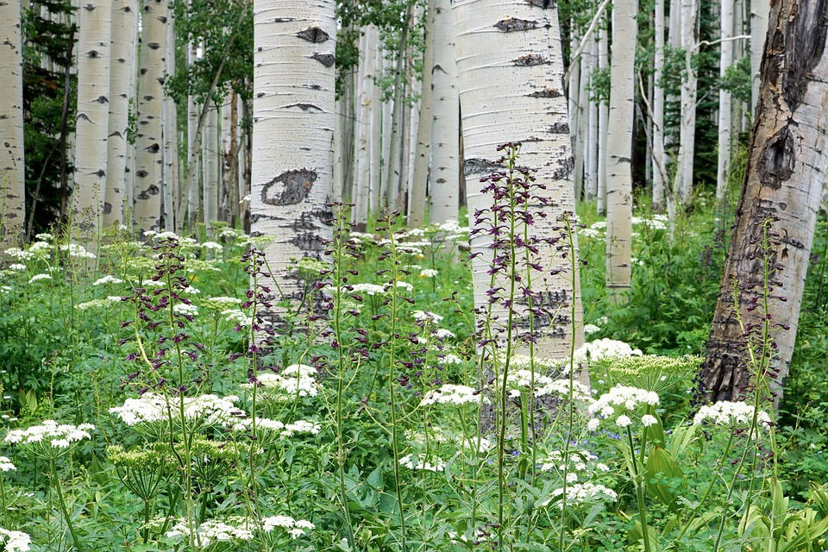
Wetland Succession
(1)
(2)
Wetlands, like all ecosystems, undergo ecological succession.
They often begin as areas of clear, deep water with little vegetation (1).
Over time the wetland fills with silt and dead plant matter, becoming shallower. Submerged vegetation begins to grow (2).
The wetland continues to fill in, and is shallow enough for emergent vegetation to grow (3).
The wetland continues to fill in, becoming dominated by upland vegetation (4/5).
(3)
(4)
(5)
Emergent vegetation are plants with leaves and stems above water, but roots below water (e.g. cattail, bulrush)
Submerged vegetation are plants that live entirely underwater (e.g. pondweed, coontail)
Upland vegetation are plants that do not grow well if submerged in water (e.g. aspen, alder, saskatoon)
Notes:
Submerged Vegetation: Plants that live entirely underwater. Examples: Pondweed, coontail, milfoil
Emergent Vegetation: Plants with leaves and stems above the water, but whose roots are submerged under water. Examples: Cattail, bulrush, reeds
Upland Vegetation: Plants that do not grow well if submerged in water. Examples: Aspen, alder, saskatoon

Slide 10
Wetland Succession
Today we are acting out succession in a freshwater ecosystem. Read the Species ID card your teacher gives you carefully, as you will become that plant!
You will be growing in a wetland. Just like real wetlands, they start off deep and through time get shallower. As that happens different plant species thrive.
Notes:
Hand out Species ID cards, and proceed with the activity. Once complete, continue this presentation to summarise what students learned.

Slide 11
Thank You!

